Slide 1
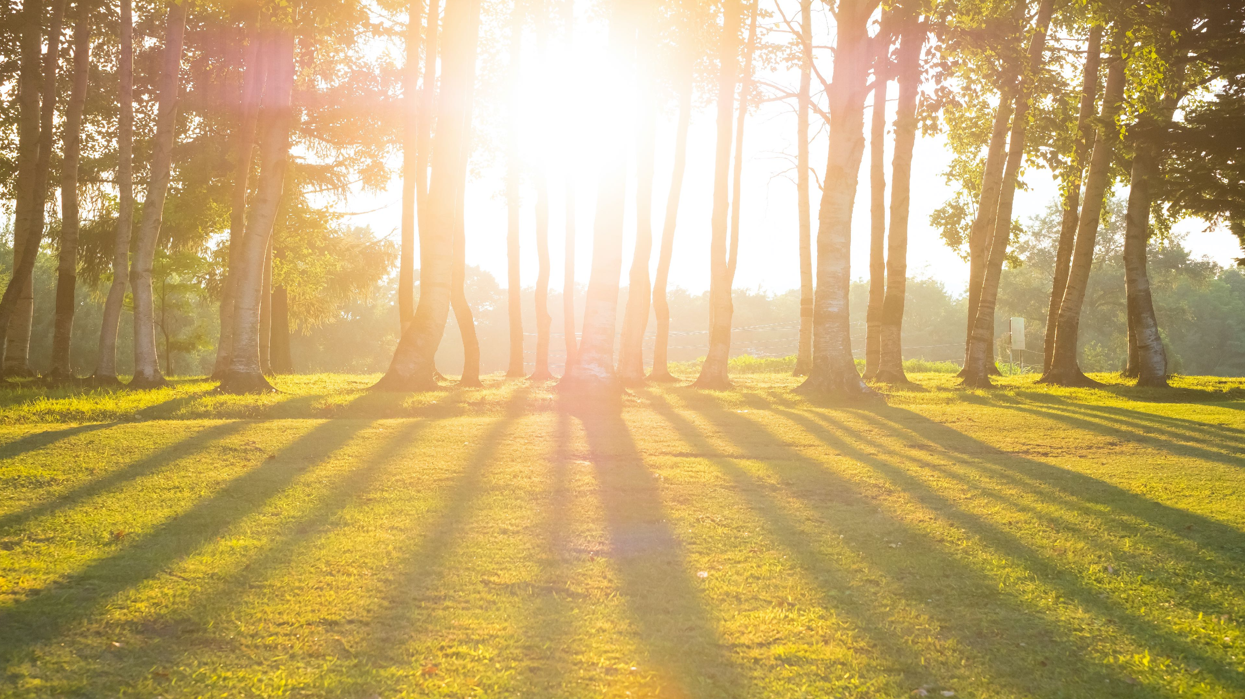
Welcome to Class!
Daily Check-in:
On a scale from 1-10 how is your day going? 1 = poor 10 = awesome

Slide 2
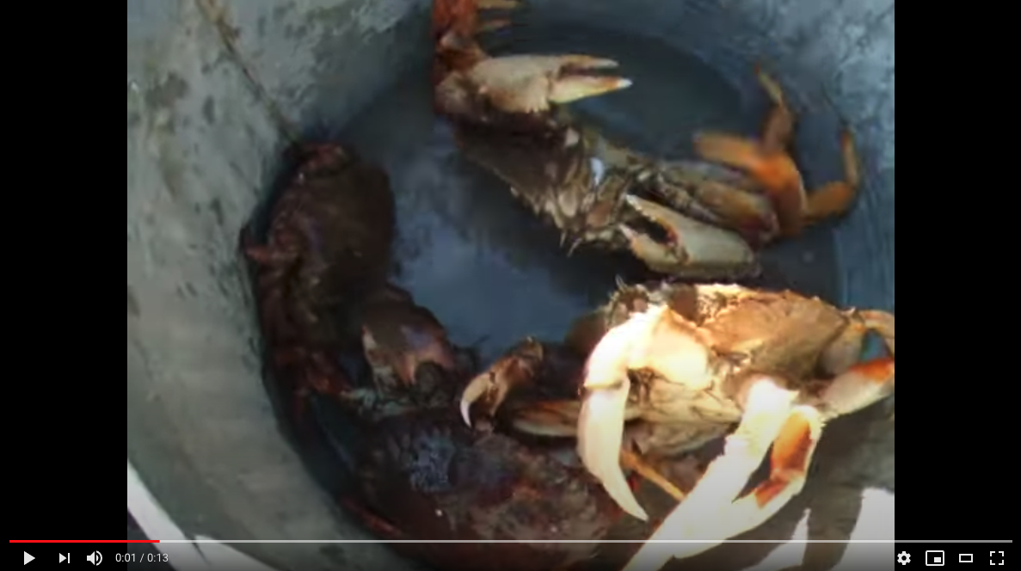
Video Crabs in a Bucket
https://www.youtube.com/watch?v=ia3VoYqC2G0

Slide 3
What is the “POT” that you are in?
4
How do friends (others) effect me in both positive ways and negative ways?
2
When I get in trouble (or in the pot)
am I keeping others in, or myself?
How?
3
1
Explain the Overall Concept
Why is it difficult for the crabs to climb out of the pot?

Slide 4
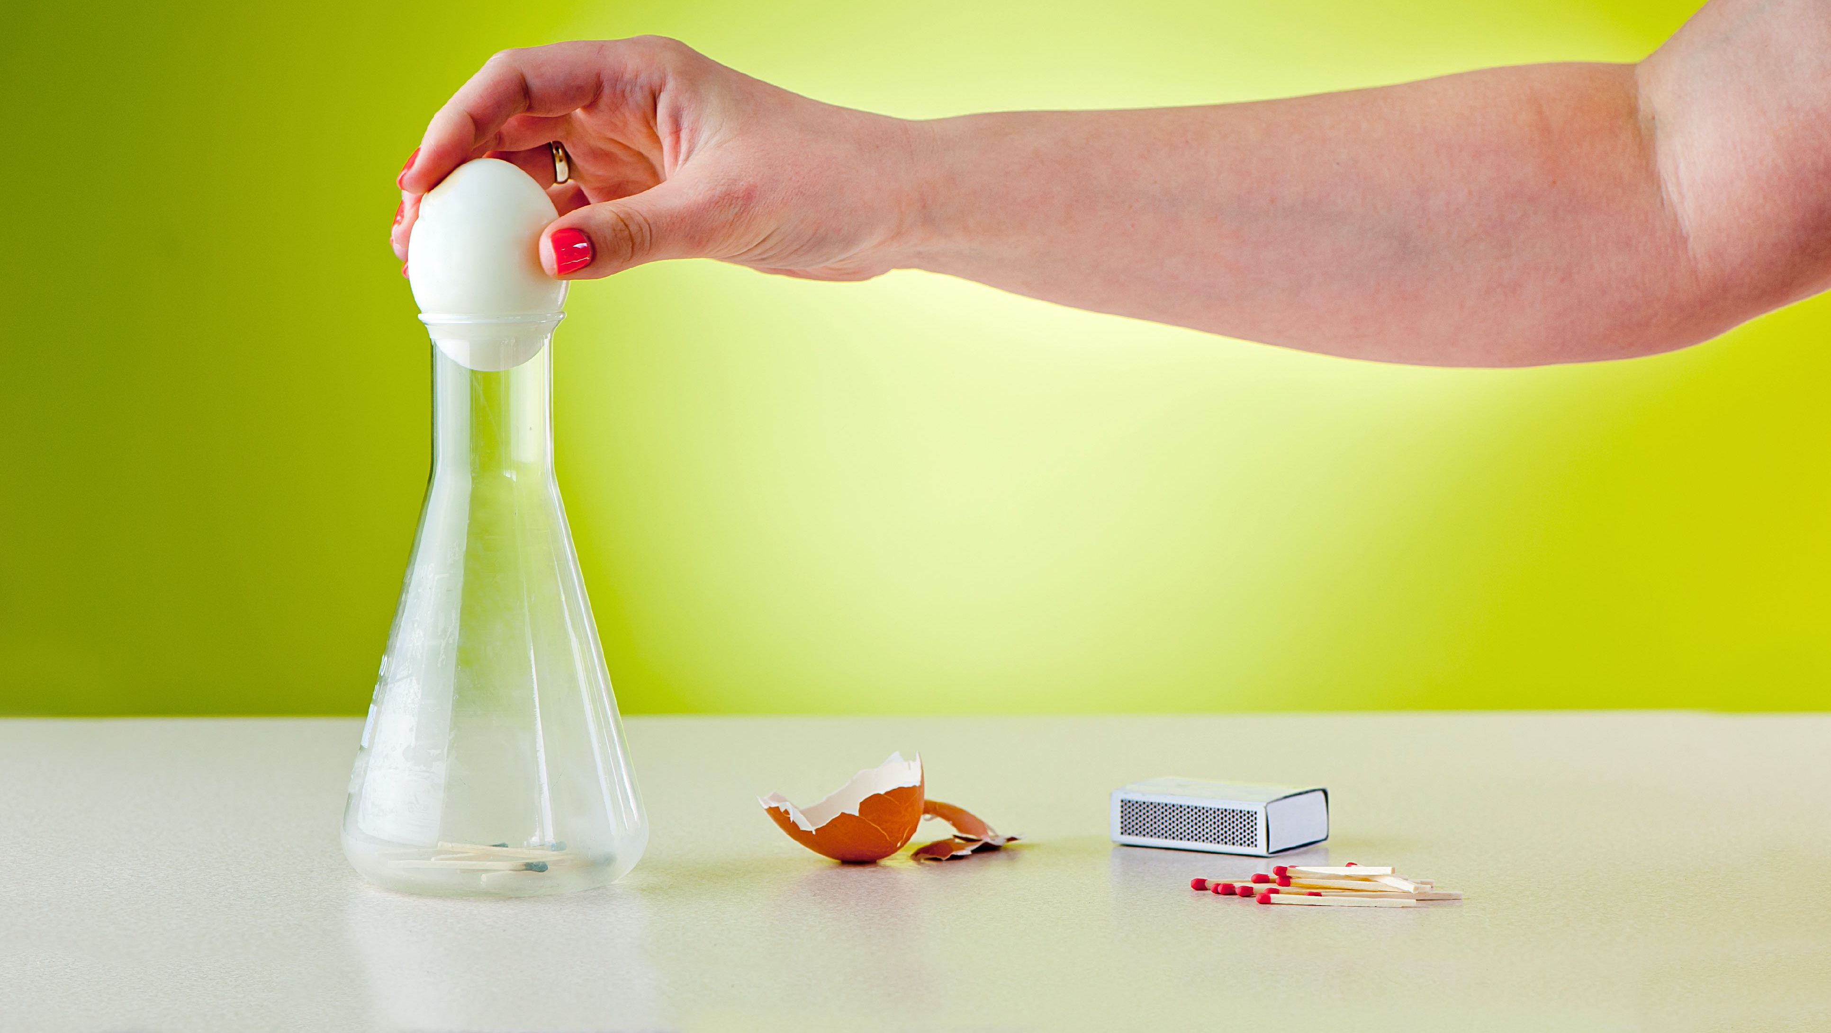
Activity: Egg in the Bottle
Questions:
Why do you think the egg went into the bottle when the flame was used?
How is this activity like peer pressure? What is an example of a situation where it is difficult to say no?
Are we more susceptible to peer pressure by being in the wrong place at the wrong time? How?
Why is it harder to say no the longer you are in a situation?
What can you do to help yourself resist the pressure to do something that might be harmful to you?
How do you get out of negative peer pressure?

Slide 5
What is the “POT” that you are in?
4
How do friends (others) effect me in both positive ways and negative ways?
2
Who wants to see “Me”
climb out? Why?
When I get in trouble (or in the pot)
am I keeping others in, or myself?
How?
5
3
1
Explain the Overall Concept
What are the reasons for staying “IN” the pot?
6
What will my future be like when I get out?
9
What will my future be like if I don’t get out?
Why is it difficult for the crabs to climb out of the pot?
7
What are the reasons for getting out of the “POT”?
10
What are the tools I can use to get out?
8
Warning: if you try to get out you will be Attacked! . . . Why?

Slide 6
Who can you identify in your life that is a positive or “true” friend?

Slide 7
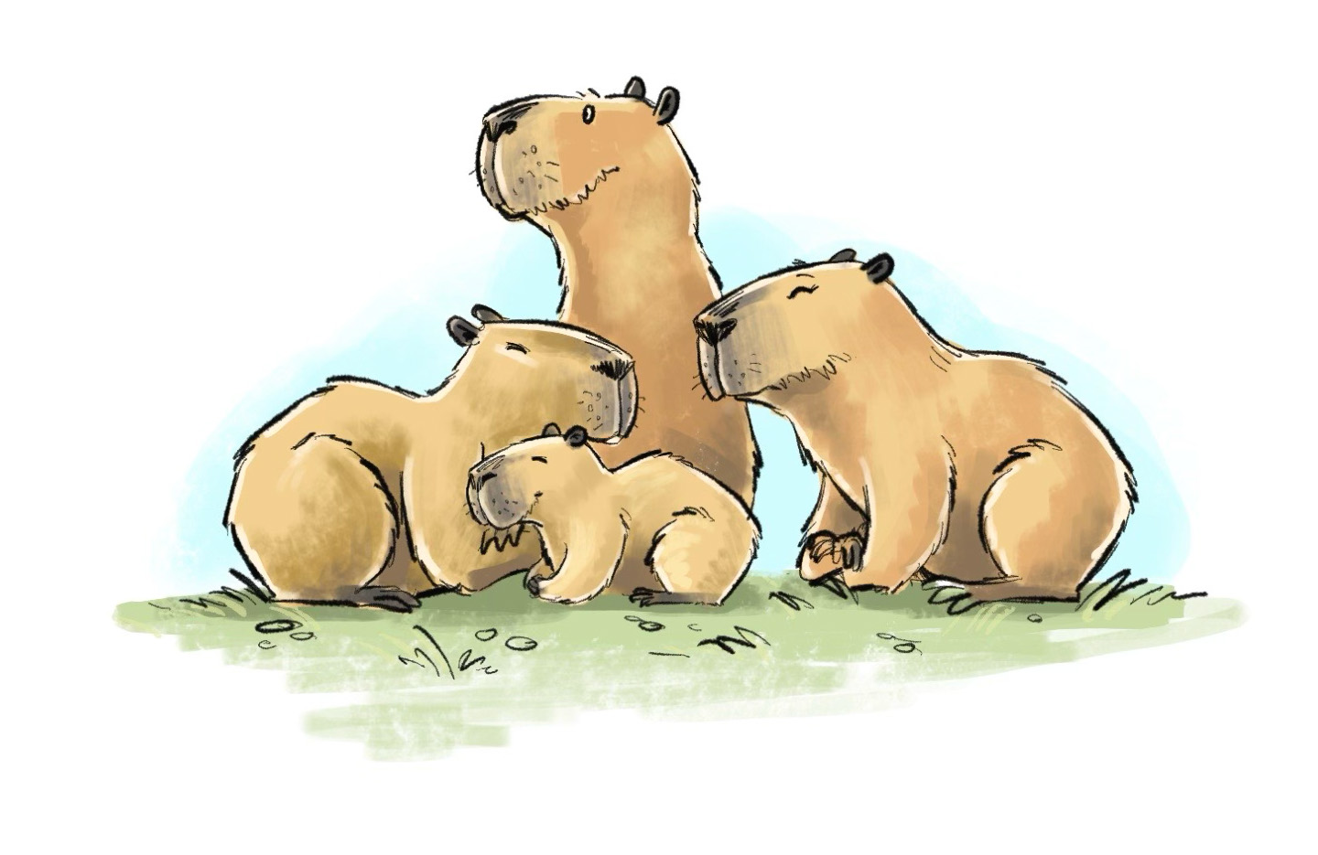
Climbing Out
Grades 1-2 Sample lesson

Slide 8
ACTIVITY:
The Kindest Creature on Earth

Slide 9
KIND

Slide 10
KIND
Instructions:
Make a list of qualities that the worlds kindest creature might have
Using that list of qualities, design and draw what that creature might look like. Try and show what your creature might look like if it had all of those qualities. Also, give it a name! :-)

Slide 11
ACTIVITY:
The Kindest Creature on Earth
Questions:
What qualities in your list did you see most often in everyone’s pictures?
Which picture besides your own did you like and why?
What real animal on Earth do you think would be considered the kindest animal on Earth? Why?

Slide 12
Video Clip
Personalize: (1st grade)
Add a still image to this slide from the video clip:
Video Link: https://youtu.be/zfueGqaXp1g
and use the image to discuss what to look for as students watch the videos.
Tech
Tip!
(don’t know how to grab an image from your screen?)
Windows: Shift + Windows logo key + S
Mac: Shift, Command, and 3 (full screen) or 4 (drag a box)

Slide 13
Video Clip
Personalize: (2nd grade)
Add a still image to this slide from the video clip:
Video Link: https://youtu.be/CdMUOsf2QNc and use the image to discuss what to look for as students watch the videos.
Tech
Tip!
(don’t know how to grab an image from your screen?)
Windows: Shift + Windows logo key + S
Mac: Shift, Command, and 3 (full screen) or 4 (drag a box)

Slide 14
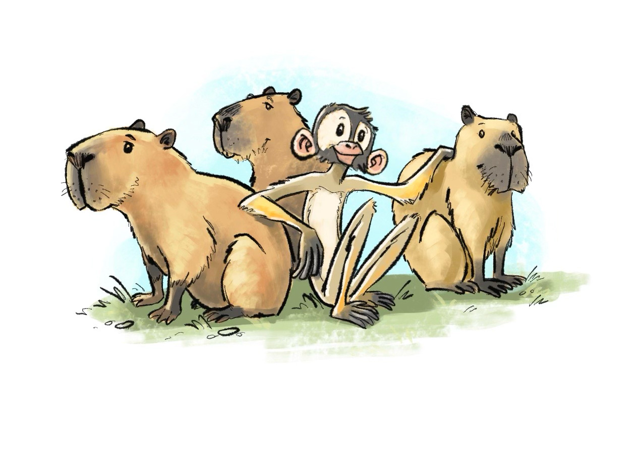
1
How is the capybara being kind?
Why is including others an important way to be kind?
How can we do that at school?

Slide 15
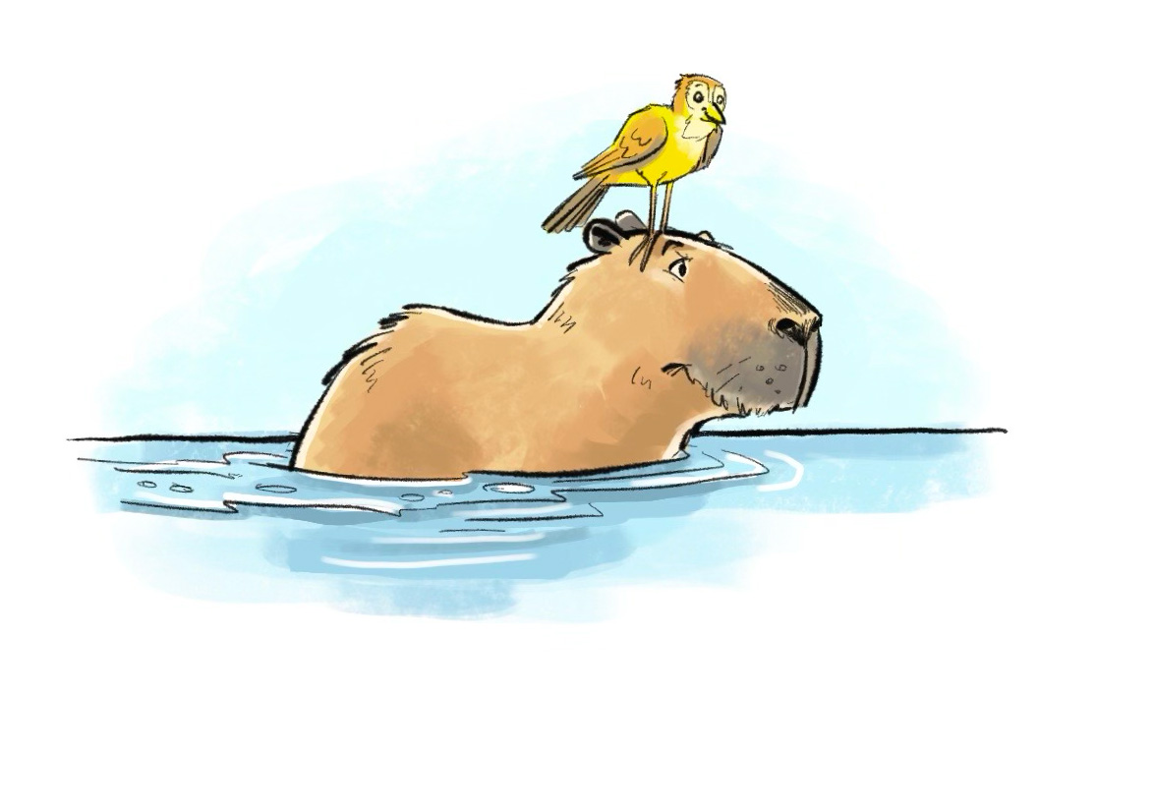
2
How is the capybara being kind here?
Why is helping others an important way to be kind?
How can we do that at school?

Slide 16
3
How is the capybara being kind here?
Why is looking after others an important way to be kind?
How can we do that at school?

Slide 17
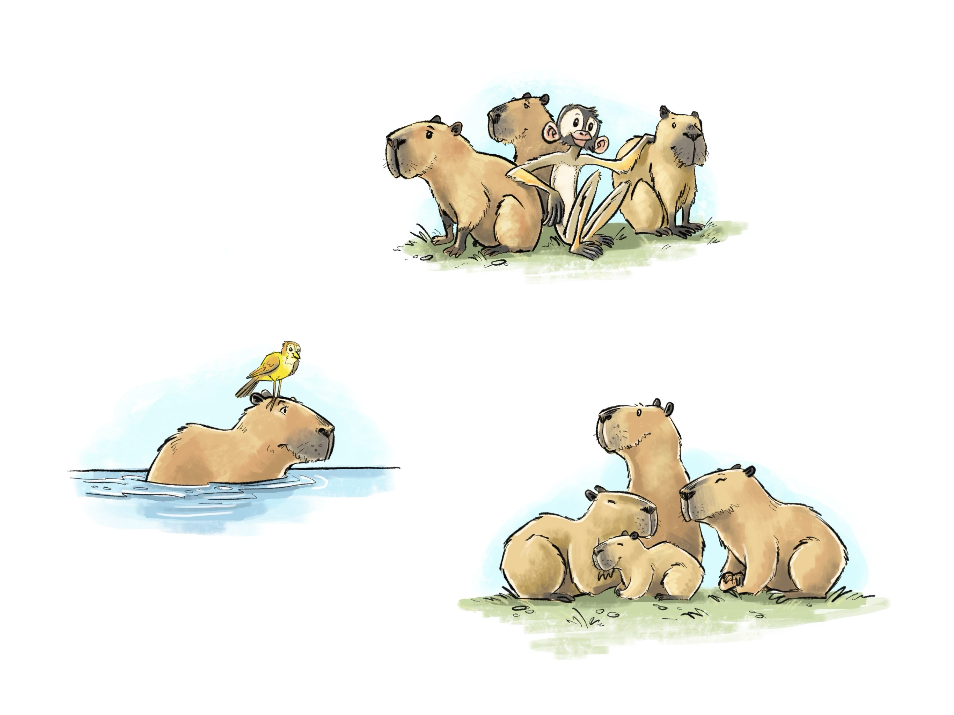
Resilience Booster:
Including others is being kind!
Acts of Kindness
What we have learned today:
Helping others is being kind!
Looking after others is being kind!
Assignment: What are some other examples of acts of kindness your classmates have done for each other?

Slide 18
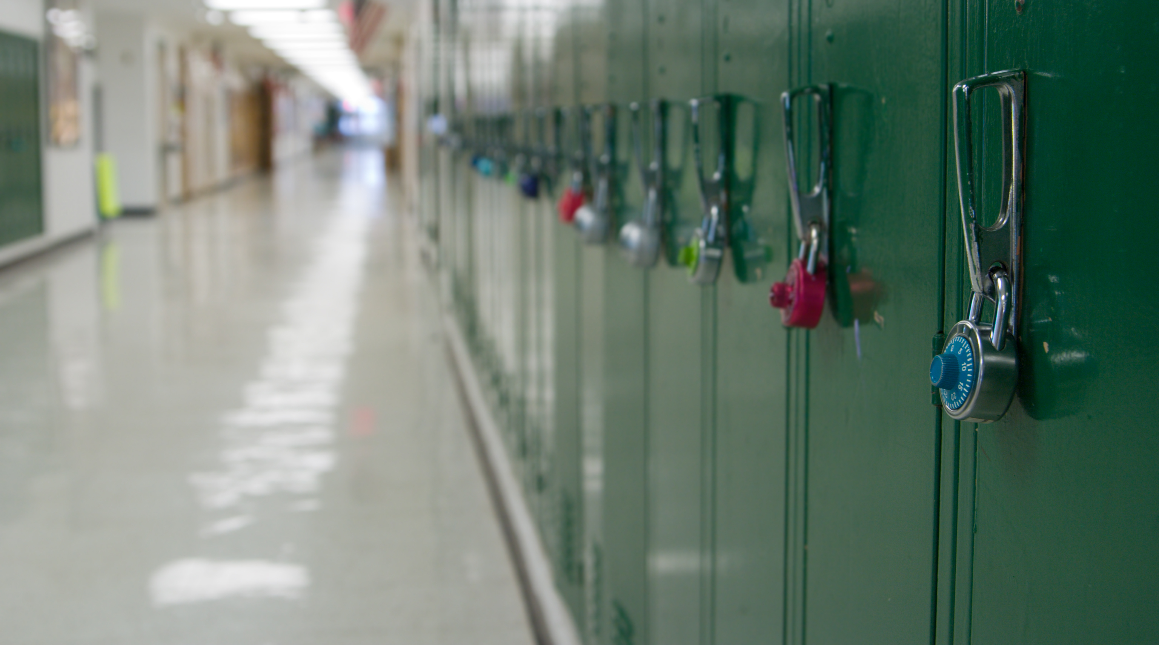
Thanks for coming!

