Slide 1
Activity: Name Writing
Instructions:
Get out a piece of paper and a pen or pencil to write with.
When I say “go,” you are to write your full name (first, middle, last name etc.) as many times as you can.
You will have 30 seconds to write your name and keep repeating that.

Slide 2
Activity: Name Writing
Questions:
Do you agree that it was harder when you changed hands? Why?
Why was it easier to do this activity with the hand that you normally write with?
Why is change hard?
What do we usually do in pressure situations when someone yells, hits, or blames us?
Why is it hard to do something different?

Slide 3
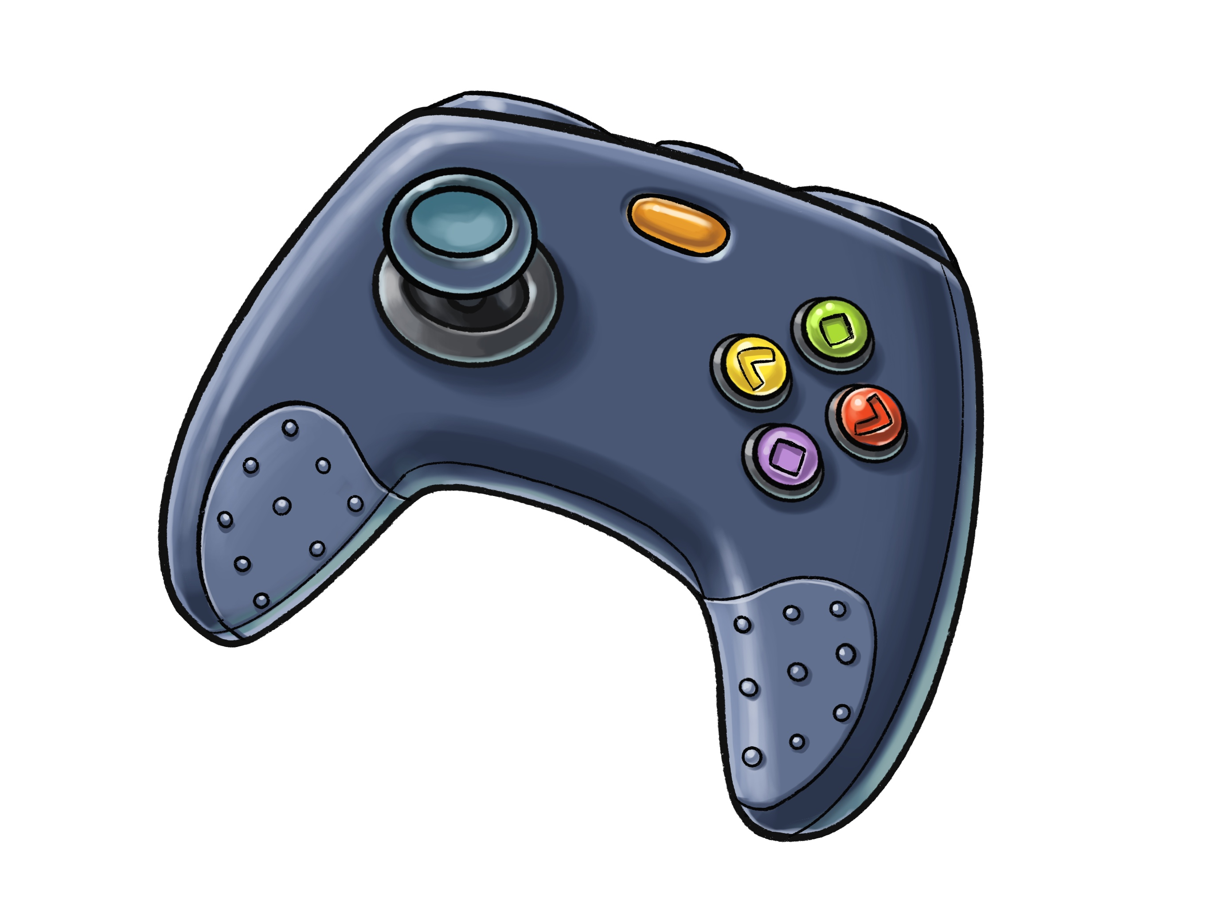
Defense Mechanisms
“Emotional Regulation”

Slide 4
1
What do these 4 buttons on a game controller typically do?

Slide 5
What does the direction stick on a game controller typically do?
2

Slide 6
3
What does the pause button typically do in a game?

Slide 7
4
Steps to control your defense mechanisms:
Situation: Recognize when we are in a pressure situation or a situation that may begin to get frustrating
Feelings: Notice your feelings in this situations. Can you identify them?
Pause and Choose: Are you going to remain in control or if we are going to let someone or something else take your controller?

Slide 8
Resilience Booster:
write down one thing you can do in the future to help remain in control when you feel you are in a pressure situation. Choose a more positive solution.
Find an opportunity in the next week where you can choose to remain in control and select a positive defense mechanism.

