Slide 1


NAME CHECK

Slide 2
Everybody stand up.

Slide 3
When I say GO, start moving
around the room.

Slide 4
GO!

Slide 5
FREEZE

Slide 6
Turn to the person closest to
you.

Slide 7
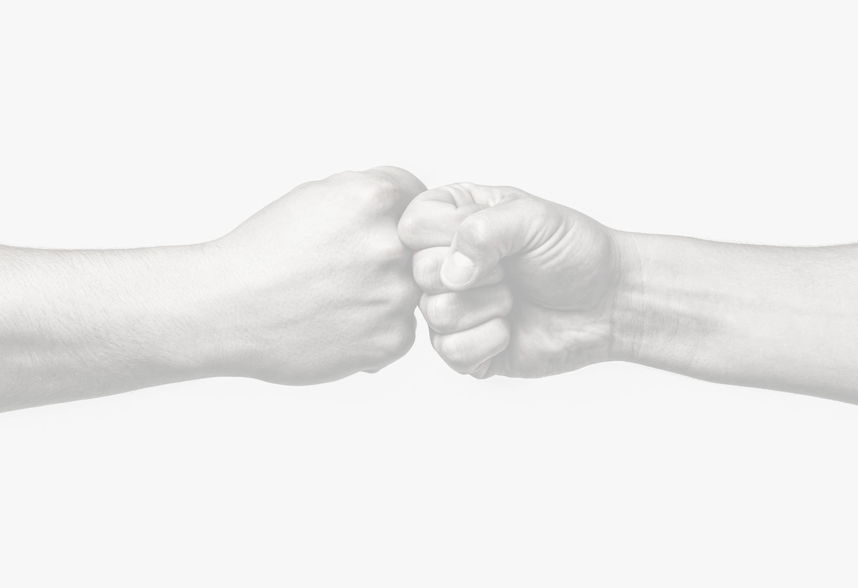
Give them a fist bump or wave
and tell them your name.

Slide 8
Let's go again.
Ready?

Slide 9
GO!

Slide 10
FREEZE

Slide 11
Find someone nearby (a different
person from last time)
Give them a fist bump or wave and
tell them your name.

Slide 12
Let's go 1 more
time… Ready?

Slide 13
GO!

Slide 14
FREEZE

Slide 15
Get together with the two people
closest to you.

Slide 16
Make sure all three of you know
everyone’s name.

Slide 17
Remember:
You matter here!

