Slide 1

Pair Up & Build
You have strengths you can build on.

Slide 2

Everybody stand up

Slide 3

Without talking, form a line from tallest to shortest
(No talking)

Slide 4
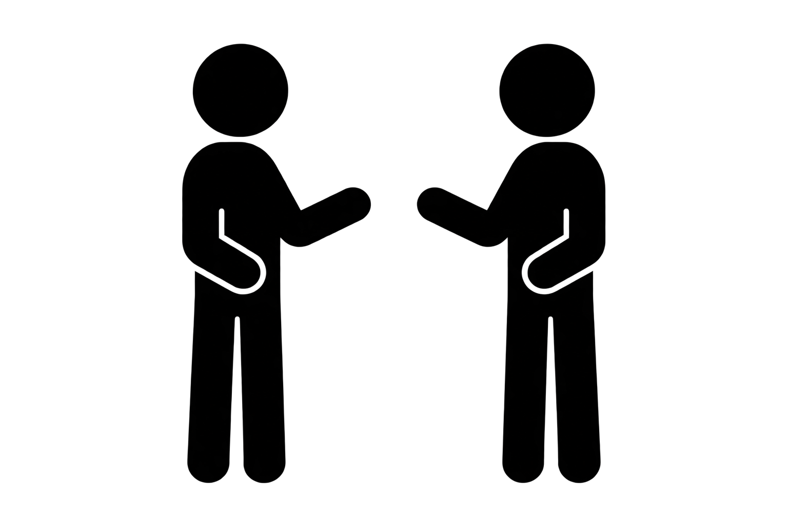
Face the person
across from you
That person is your partner

Slide 5

Sit with your partner
Find a spot in the room with a little space, or at a desk to sit
down together

Slide 6
Choose one strength you already have
Creative
Persistent
Kind
Curious
Brave
Helpful
Responsible
Funny
Resourceful
Hardworking
Good Listener
Problem Solver

Slide 7
Choose one strength you want to build
Creative
Persistent
Kind
Curious
Brave
Helpful
Responsible
Funny
Resourceful
Hardworking
Good Listener
Problem Solver

Slide 8
Share with your partner
How has your strength been
useful to you?

Slide 9
Share with your partner
How could adding that new strength
help you?

Slide 10
Remember:
You have strengths already and
you can build on them!

