Slide 1
Welcome to Class!
Daily Check-in:
On a scale from 1-10 how is your day going? 1 = poor 10 = awesome

Slide 2
15 Pencils
This is a game between 2 players
The goal: not get stuck with the last pencil (that means you lost!)
Instructions:
Decide who will go first
On your turn, each player can choose to remove up to 3 pencils from the pile
Alternate turns until someone is left with the last pencil and loses

Slide 3
15 Pencils
1
0
1
1
1
2
1
3
1
4
1
5
1
2
3
4
5
6
7
8
9

Slide 4
Questions:
Decide who will go first
On your turn, each player can choose to remove up to 3 pencils from the pile
Alternate turns until someone is left with the last pencil and loses

Slide 5
2
What Have I Jumped Over?
6
1. Identify Problem:
4. Take Action
3
What Can I Jump Over?
What specific behaviors (actions) do I need to stop or add to jump my hurdle?
What problem do I really want to overcome?
Stopped Behaviors Added Behaviors
2. Create Options
5. Believe in Change:
What are some options I can create?
On a scale from one to ten, circle where you are in believing change will happen.
4
Why Should I Try To Jump My Hurdle?
“I can’t change”
“I know I have the strength”
“Maybe”
3. Get Help
1. 2. 3. 4. 5. 6. 7. 8. 9. 10.
Who can help me get over my hurdle?
Who can I help?
1
My Problem:
5
Strengths:

Slide 6
2
What Have I Jumped Over?
6
1. Identify Problem:
4. Take Action
3
What Can I Jump Over?
What specific behaviors (actions) do I need to stop or add to jump my hurdle?
What problem do I really want to overcome?
Stopped Behaviors Added Behaviors
2. Create Options
5. Believe in Change:
What are some options I can create?
On a scale from one to ten, circle where you are in believing change will happen.
4
Why Should I Try To Jump My Hurdle?
“I can’t change”
“I know I have the strength”
“Maybe”
3. Get Help
1. 2. 3. 4. 5. 6. 7. 8. 9. 10.
Who can help me get over my hurdle?
Who can I help?
6. Jump Back Up:
If I trip how will jumping back up make me stronger?
1
My Problem:
You Only Lose
If You
Give
Up!
What Should My “Self Talk” Be Telling Me As I Try To Jump My Hurdle?
5
Strengths:

Slide 7
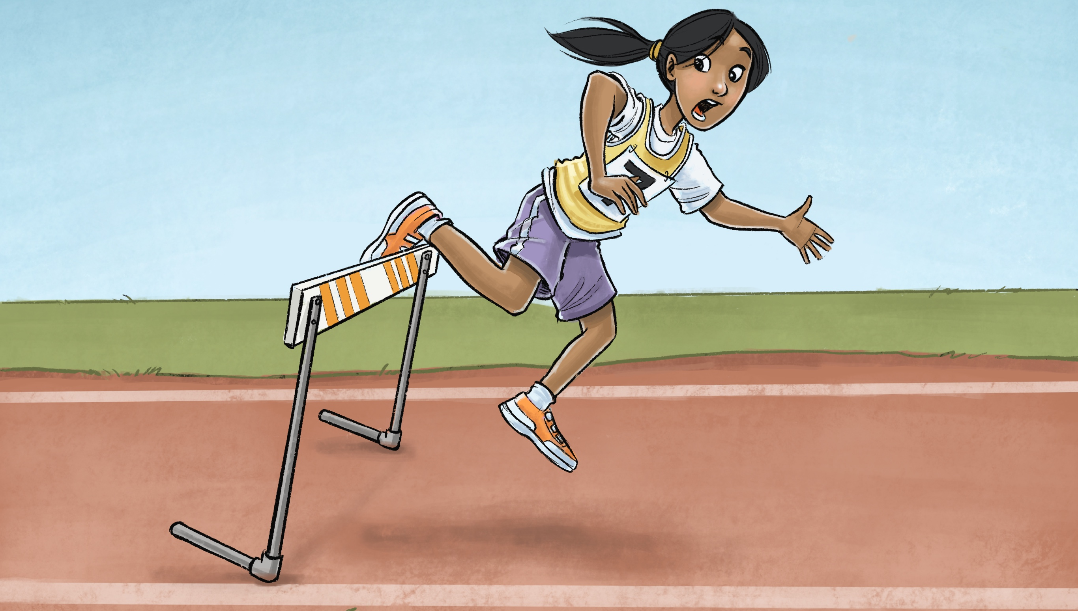

Slide 8
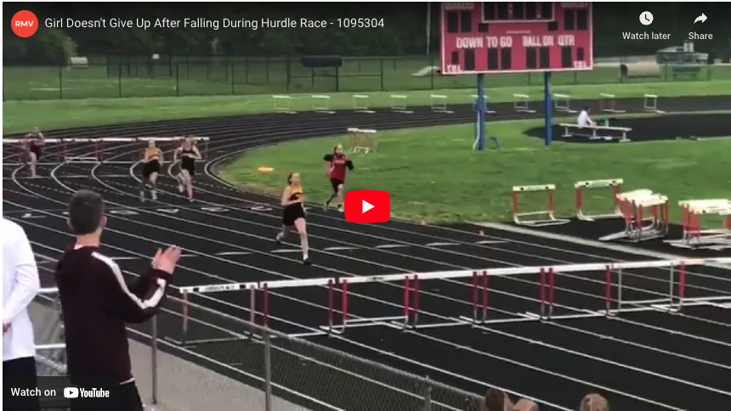
Video Clip
Video Link: https://www.youtube.com/watch?v=0Zosz0CzsHU

Slide 9
Questions:
What happened in that video?
How did the girl respond after she fell down?
What things do you think helped her get back up after she fell?
Do we ever fall or make mistakes in life?
What can we do to get back up and keep trying?
Why is it important to get back up if we fall down or make a mistake?

Slide 10
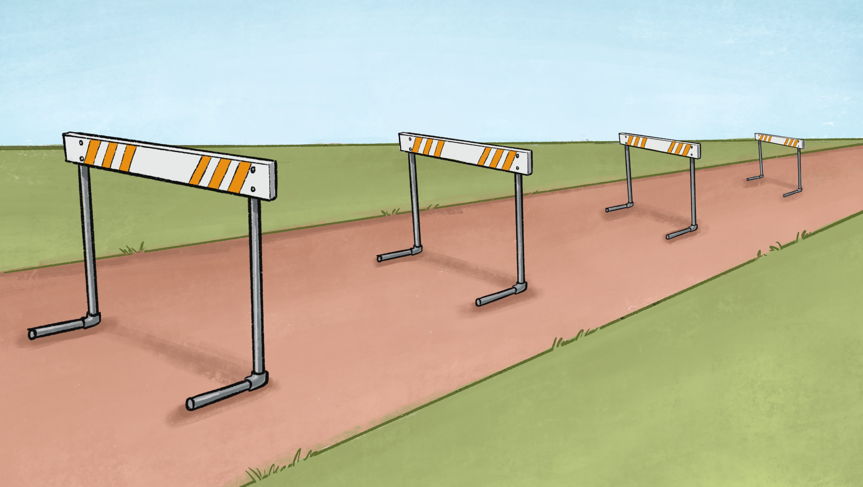

Slide 11
Thanks for Coming!

