Slide 1


Welcome to Class!
Daily Check-in:
On a scale from 1-10 how is your day going? 1 = poor 10 = awesome

Slide 2
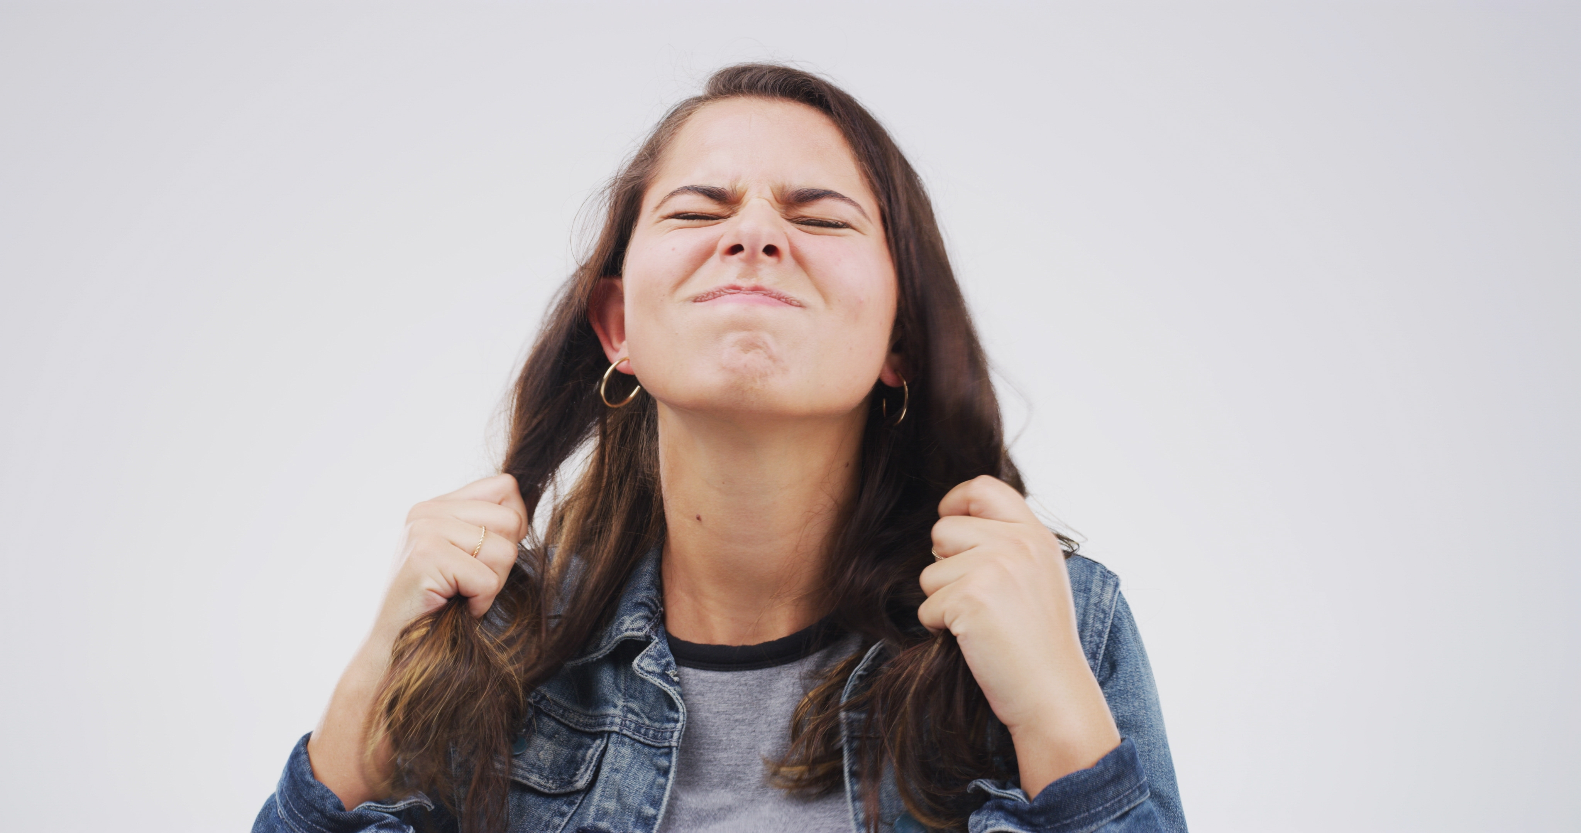
Welcome to Class!
Question of the Day:
“What’s something that shouldn’t make you mad, but somehow does?”

Slide 3
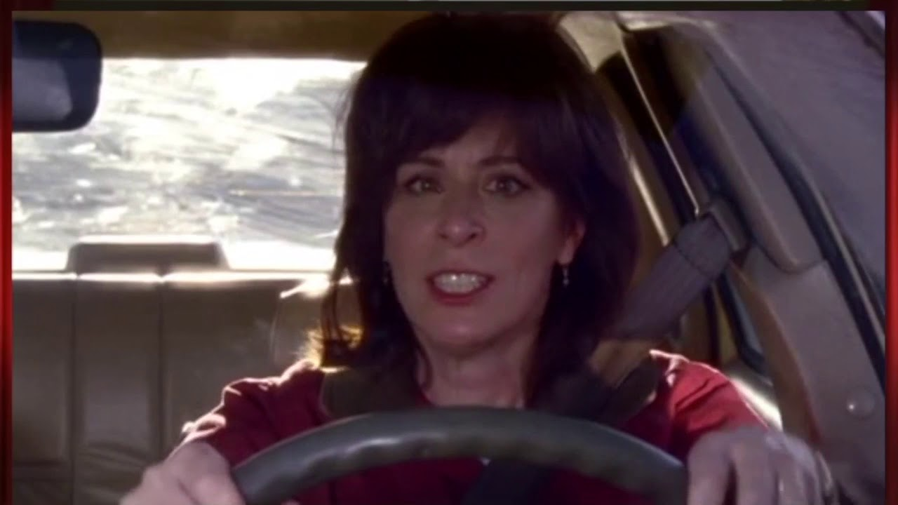
Video: Parking Lot Rage

Slide 4
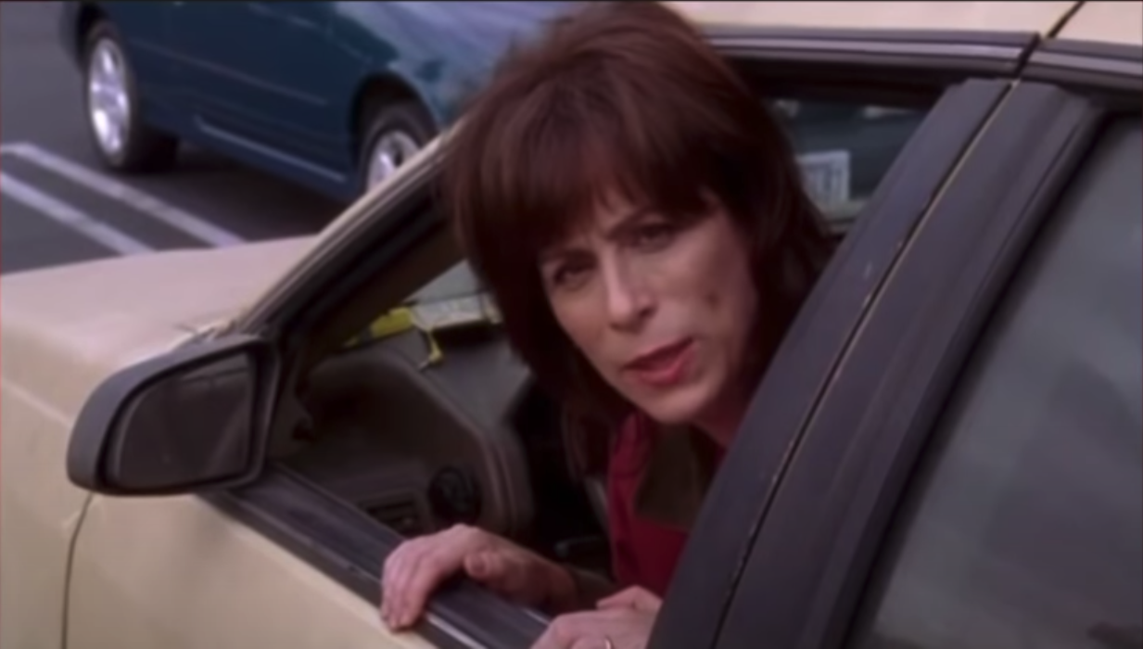
Video: Parking Lot Rage
Questions:
What would you say was the problem between these two people?
Who was the winner?
Why did it keep going on and on?
What do you think she meant when she said “I don’t know what happened” at the end of the clip?
How do you think they could have handled the situation better?

Slide 5
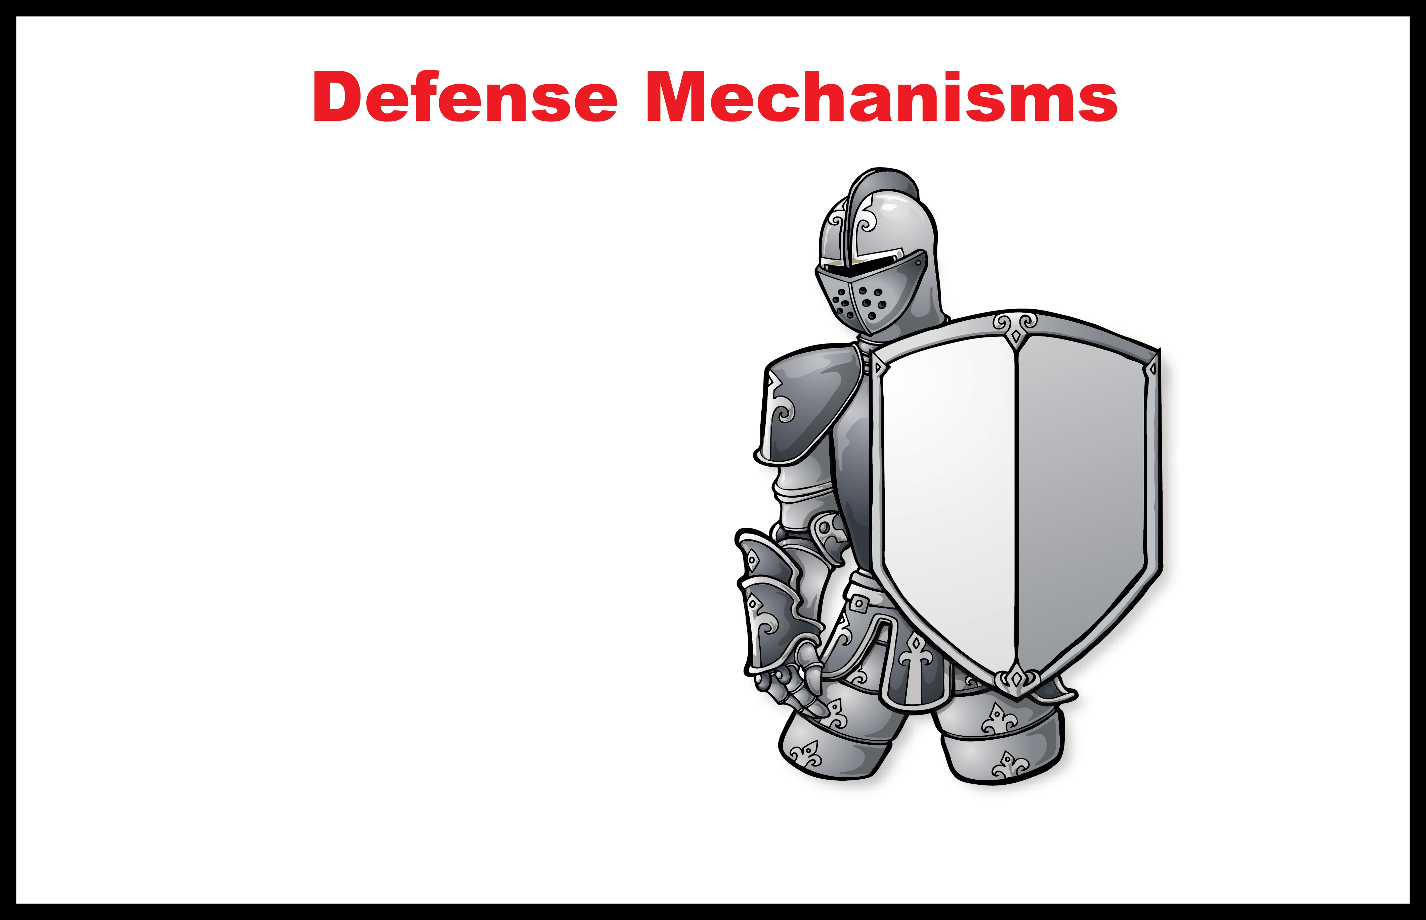
1
What is a defense mechanism?
2
Situation:
How do you respond (act) when . . .
Disrespected
Yelled at
Put down
Laughed at
Mad at parent
Embarrassed
Make a mistake
Feel pressure
You’re hit
You lose
Confronted
Frustrated
Blamed
Get caught
Hurt
Angry
3
Feeling
Negative
Positive
“Easy”
“Hard”

Slide 6
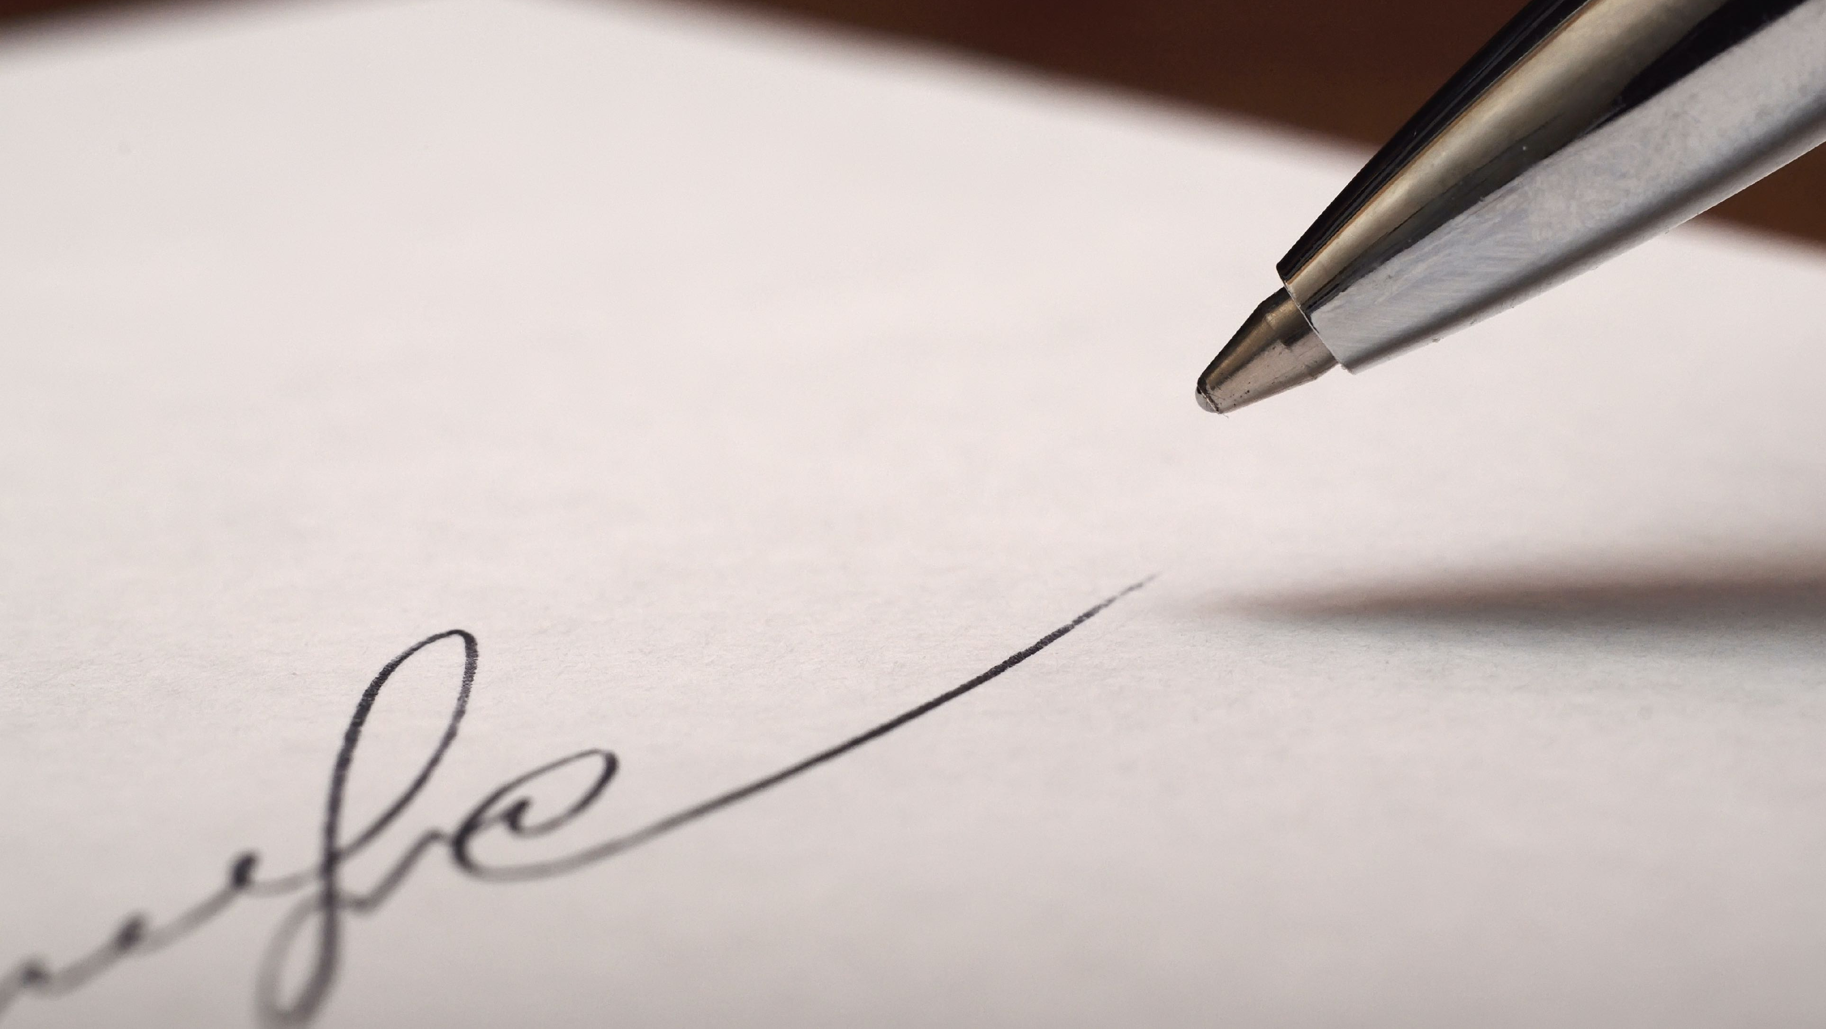
Activity: Name Writing
Instructions:
Get a pen or pencil to write with and a piece of scratch paper
When I say “Go!,” I am going to give you 30 seconds to write your full name as many times as you can
Everybody ready?
GO!

Slide 7
Activity: Name Writing
Questions:
Do you agree that it was harder when you changed hands? Why?
Why was it easier to do this activity with the hand that you normally write with?
Why is change hard?
What do we usually do in pressure situations when someone yells, hits, or blames us?
Why is it hard to do something different?

Slide 8
1
What is a defense mechanism?
4
Choice
2
Situation:
How do you respond (act) when . . .
Who chooses the defense?
Disrespected
Yelled at
Put down
Laughed at
Mad at parent
Embarrassed
Make a mistake
Feel pressure
You’re hit
You lose
Confronted
Frustrated
Blamed
Get caught
Hurt
Angry
How do you protect your feelings?
Four steps to control your defense mechanisms
3
Feeling
Negative
Positive
1. Recognize the situation.
When you are in a pressure situation, these are the signs: You feel angry, frustrated, nervous.
What outward behaviors can you use to help control the pressure?
2. Identify the situations where you can practice step 1.
What are the situations you need to practice this?
“Easy”
“Hard”
3. Don’t let other people choose (or control) how you will respond. The signs are: someone is yelling at you, you are physically attacked, or you are put down.
This gives you “self-respect.” Why?
What could happen when you stay in control?
5
Defense
4. Select a positive solution
What would motivate me to do the “tougher” harder thing?
How do you know when you’ve selected a positive defense mechanism?. . .
“When you are helping (not hurting) yourself and others.”

Slide 9
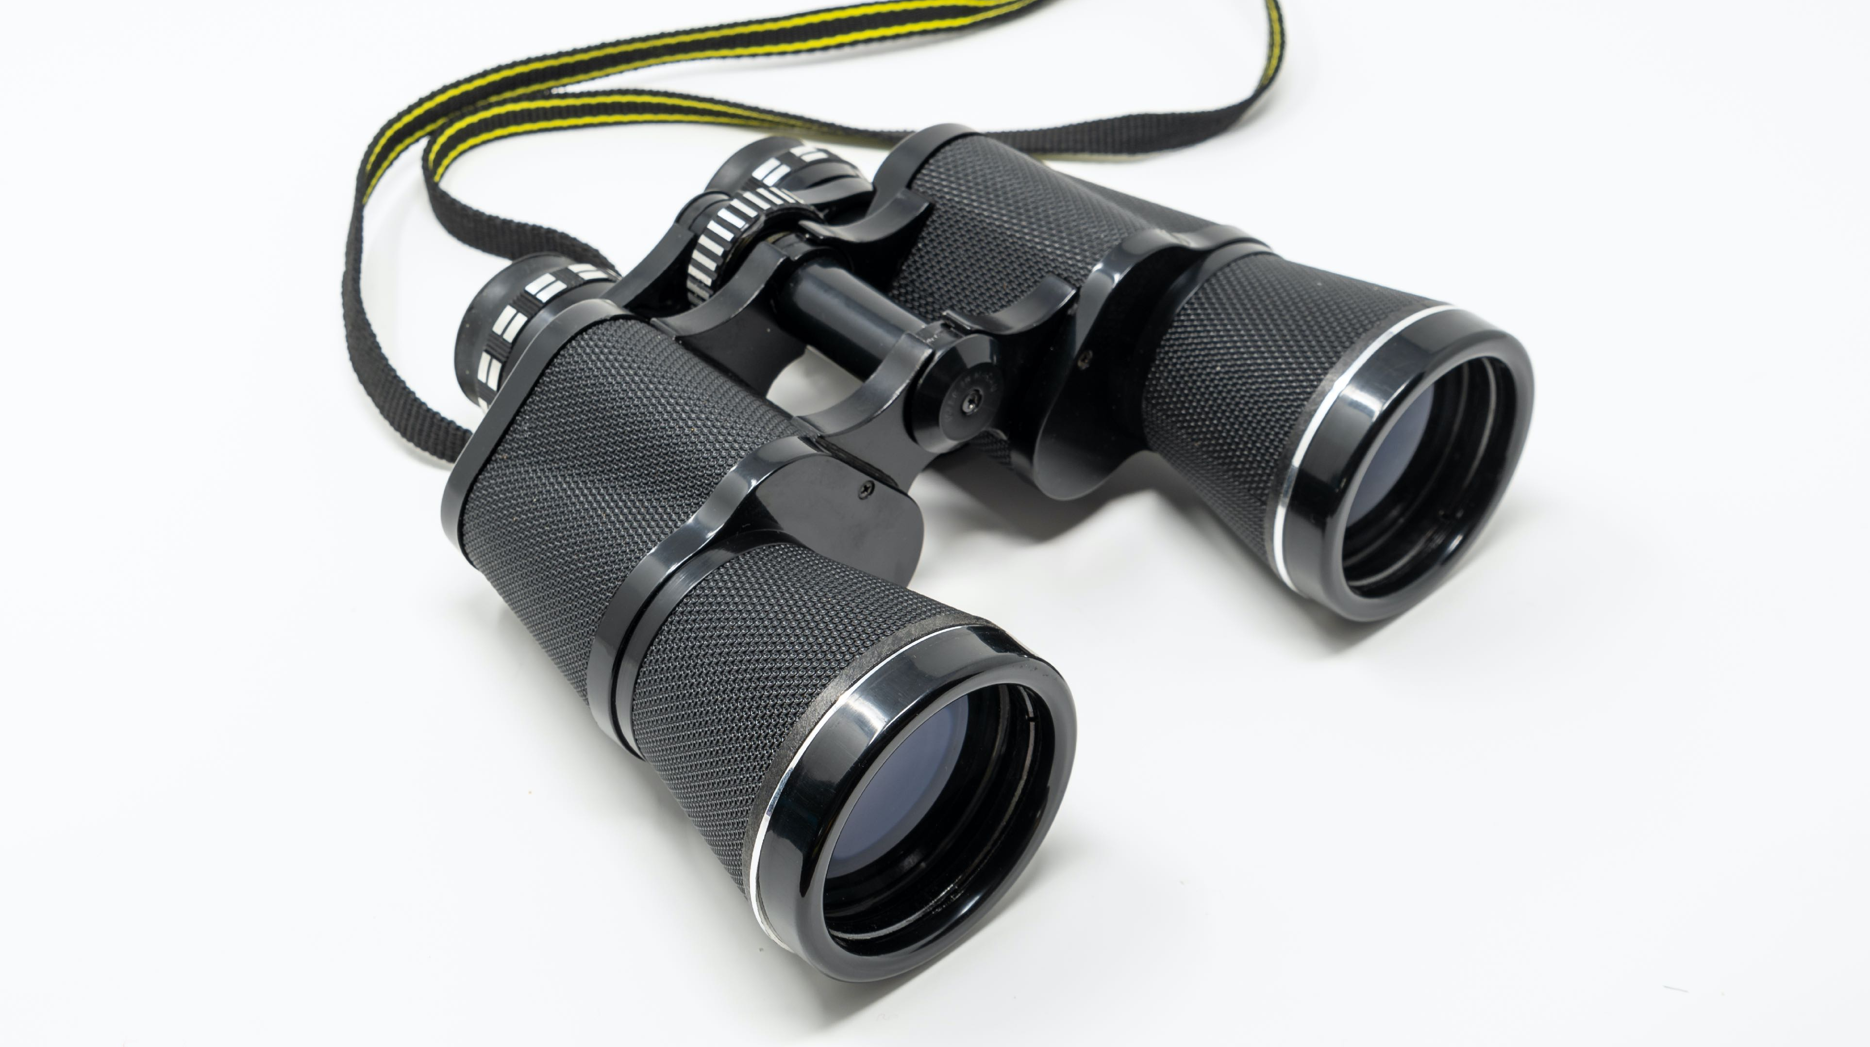
Student Booster Observation Booster
Spend time observing your friends or those around you to see if you can identify when they use defense mechanisms.
List three defense mechanisms that you observed other people using today:
Were they positive or negative?
What defense mechanisms did you observe in others as a result of something that you said or did to them?

Slide 10
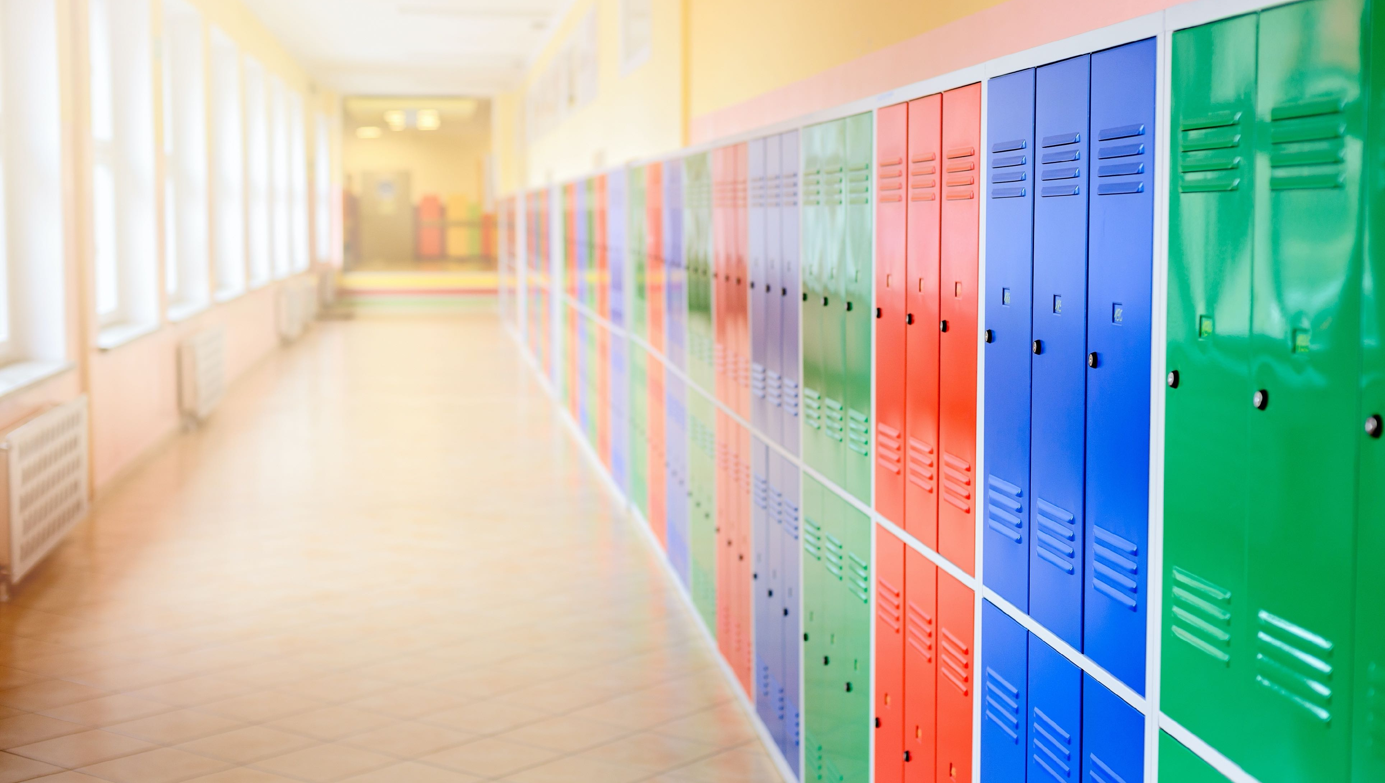
Thanks for Coming!

