Slide 1
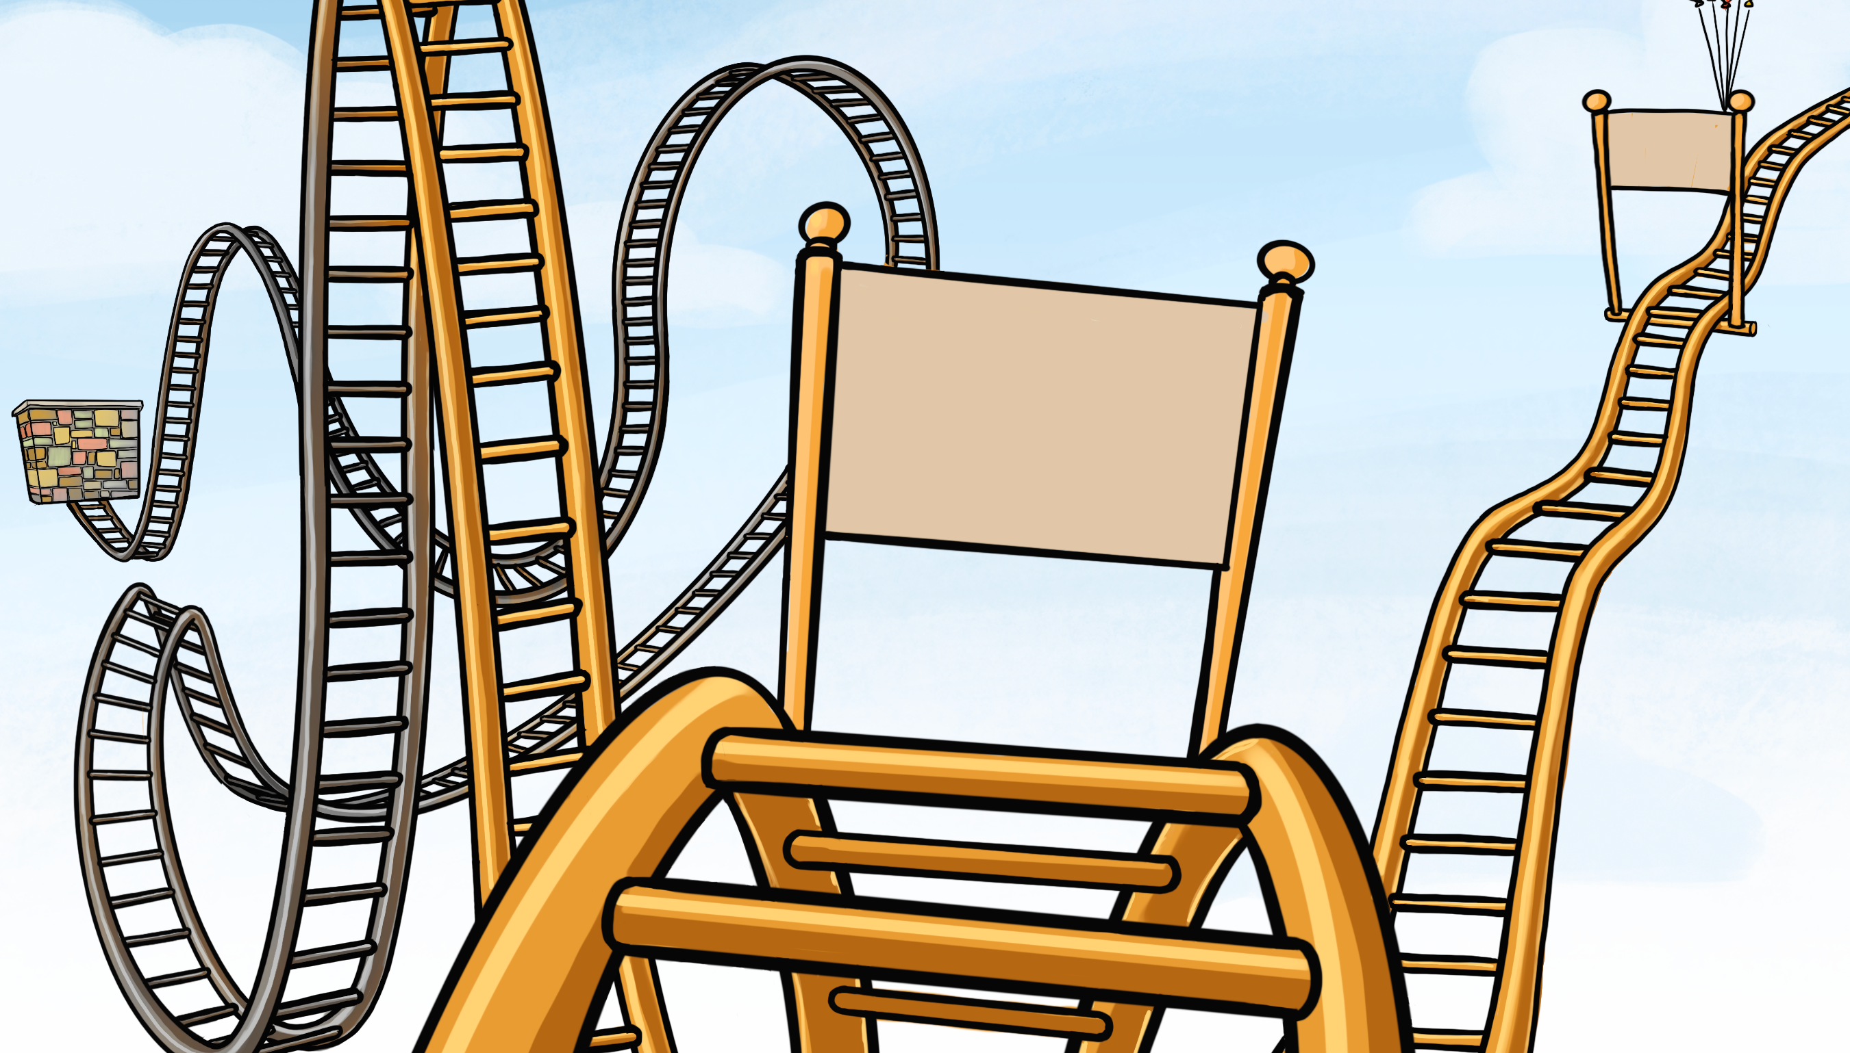
The Reality Ride
(The Helpful Track)
Part 1

Slide 2
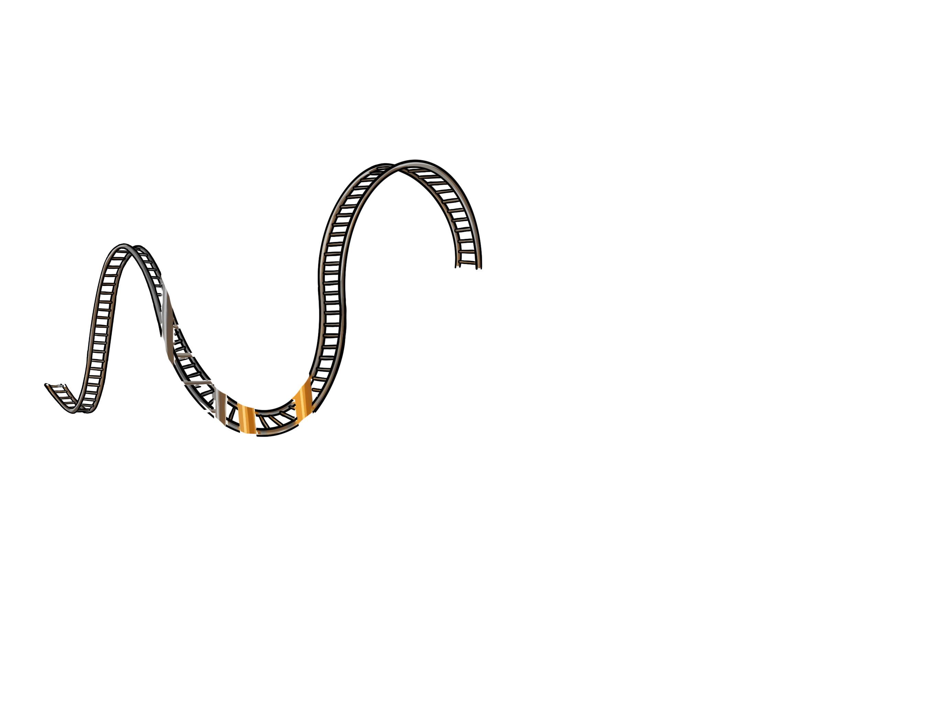
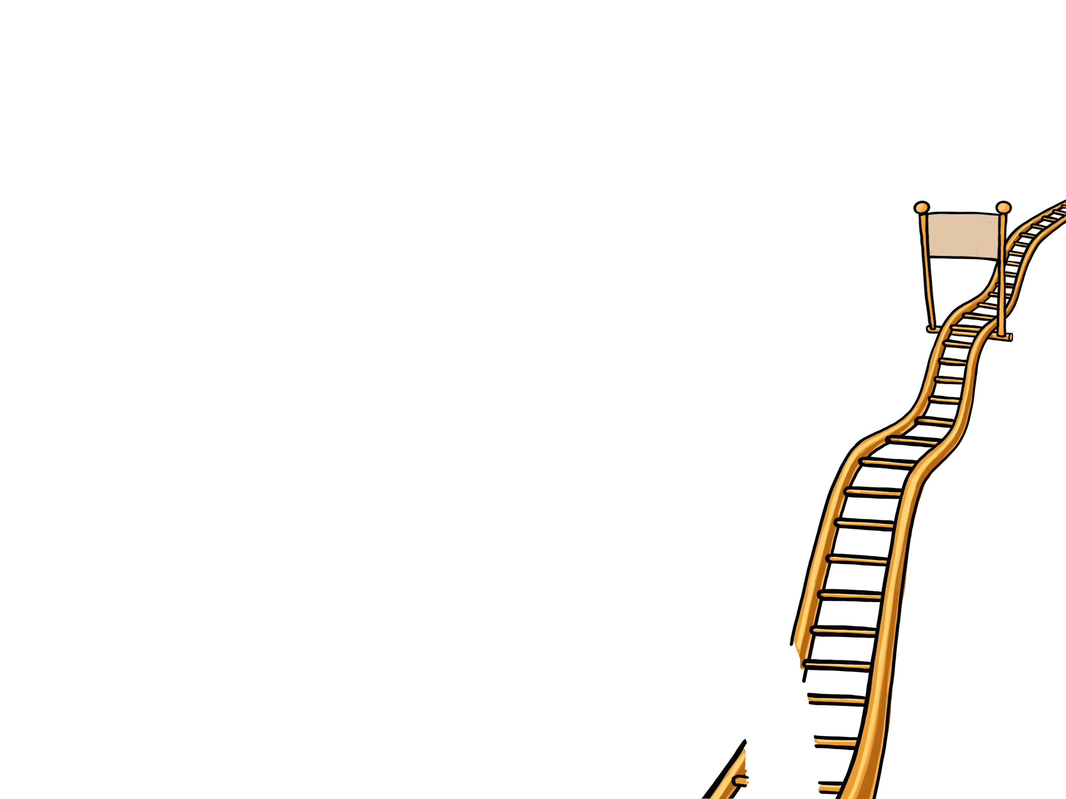
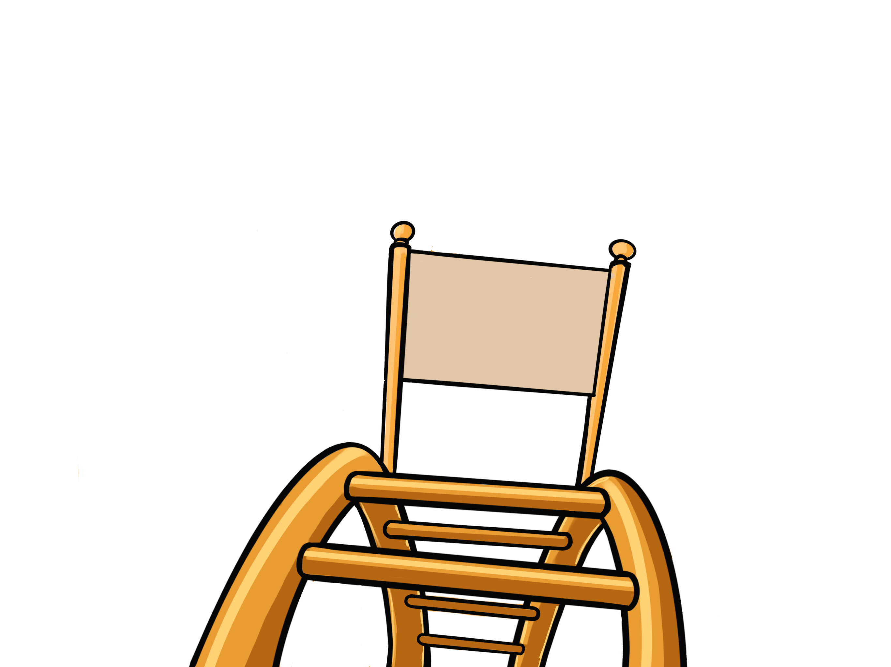
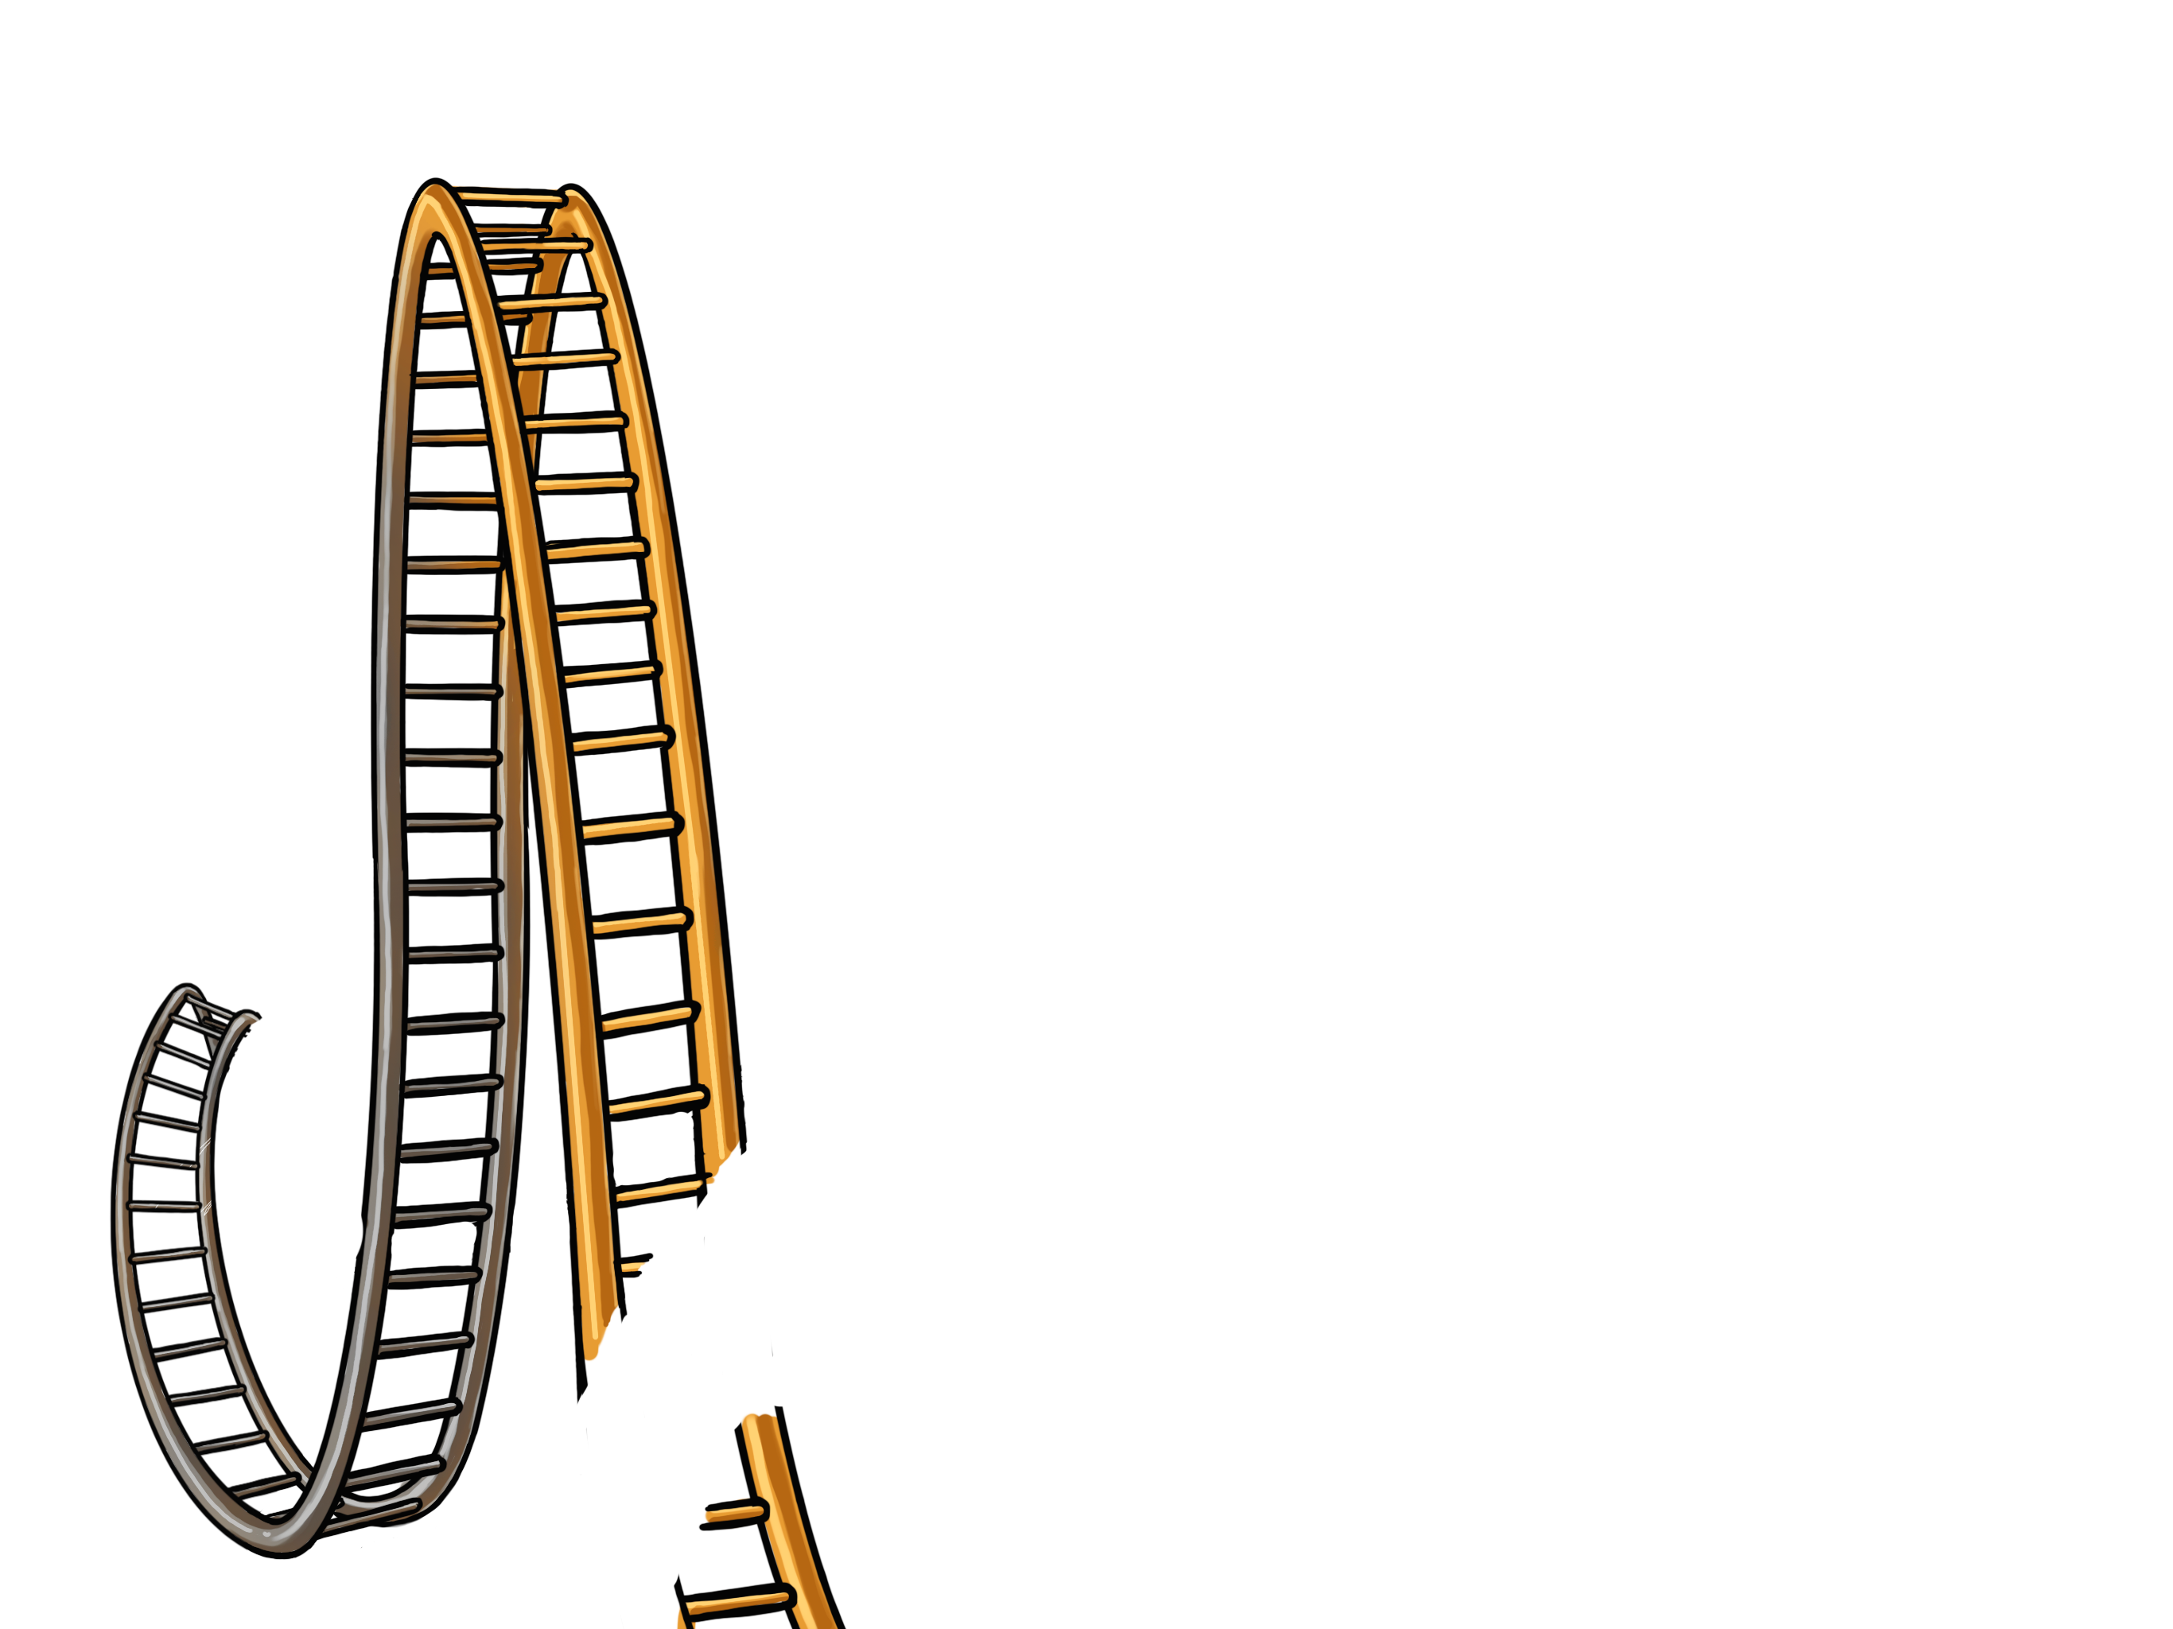
The Helpful Track
3
Finish
4
Stop
Feel
Think
Choose
2
1

Slide 3
ACTIVITY:
“Follow The Track”
Make a decision and pick a track to go on, then go stand by the green sign at the start of the track!

Slide 4
ACTIVITY:
“Follow The Track”
When I say “go” start your track!
GO!

Slide 5
Questions:
What did you think of that?
Did any of you have a favorite track or a favorite part?

Slide 6
“getting on a track can be like making a choice that will take us someplace”

Slide 7
“Some choices we make can be more helpful and lead us to places we want to go”

Slide 8
Questions:
What was hard about staying on track?
What were some things that you did that were helpful to make it to the finish?

Slide 9
Story Example:
“My Magical Choices”

Slide 11
Story Example:
“My Magical Choices”

Slide 12
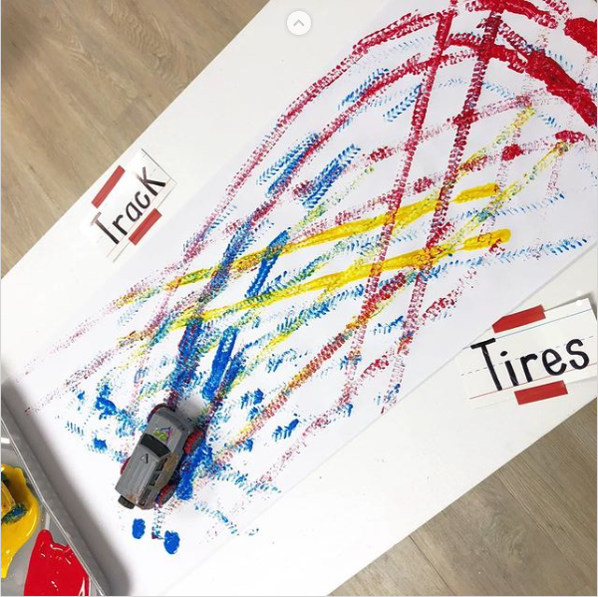
Booster: Art Activity
“My Own Helpful Track”

