Slide 1
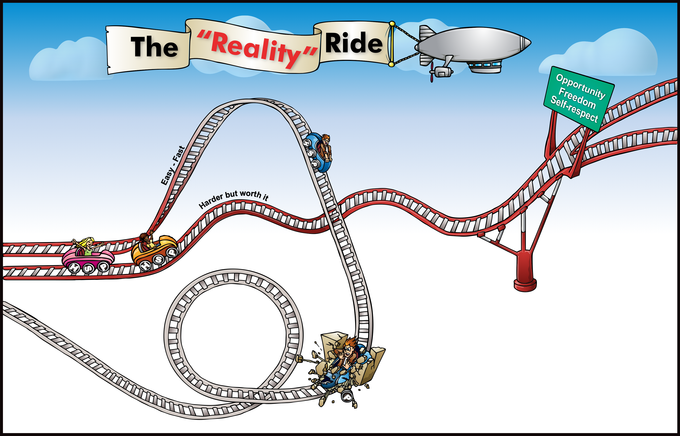

1
9
My Goal:
My positive outcomes
3
Things that get me in trouble
7
Staying on track
2
More Options
Challenges . . .
Home:
School:
Peers:
8
Peers
My support team
School
Home
6
The two tracks
5
Crash!
4
Feeling:
“stuck in the loop”
Let’s be real: “Possible Consequences”
(Reality)
“Hit the wall”

Slide 2
1
9
My Goal:
My positive outcomes
3
Things that get me in trouble
Decision-Making & Consequences
7
Staying on track
2
More Options
Challenges . . .
I can be resilient by:
Home:
School:
Peers:
Recognizing that my decisions have consequences.
Making positive choices that lead to opportunity, freedom, and self-respect.
Learning from past choices to make better decisions in the future.
8
Peers
My support team
School
Home
6
The two tracks
5
Crash!
4
Feeling:
“stuck in the loop”
Let’s be real: “Possible Consequences”
(Reality)
“Hit the wall”

