Slide 1

Welcome To Class!
Question of the day:
“What is something in your life that feels restrictive or frustrating—but you know helps you improve or get better?”

Slide 2
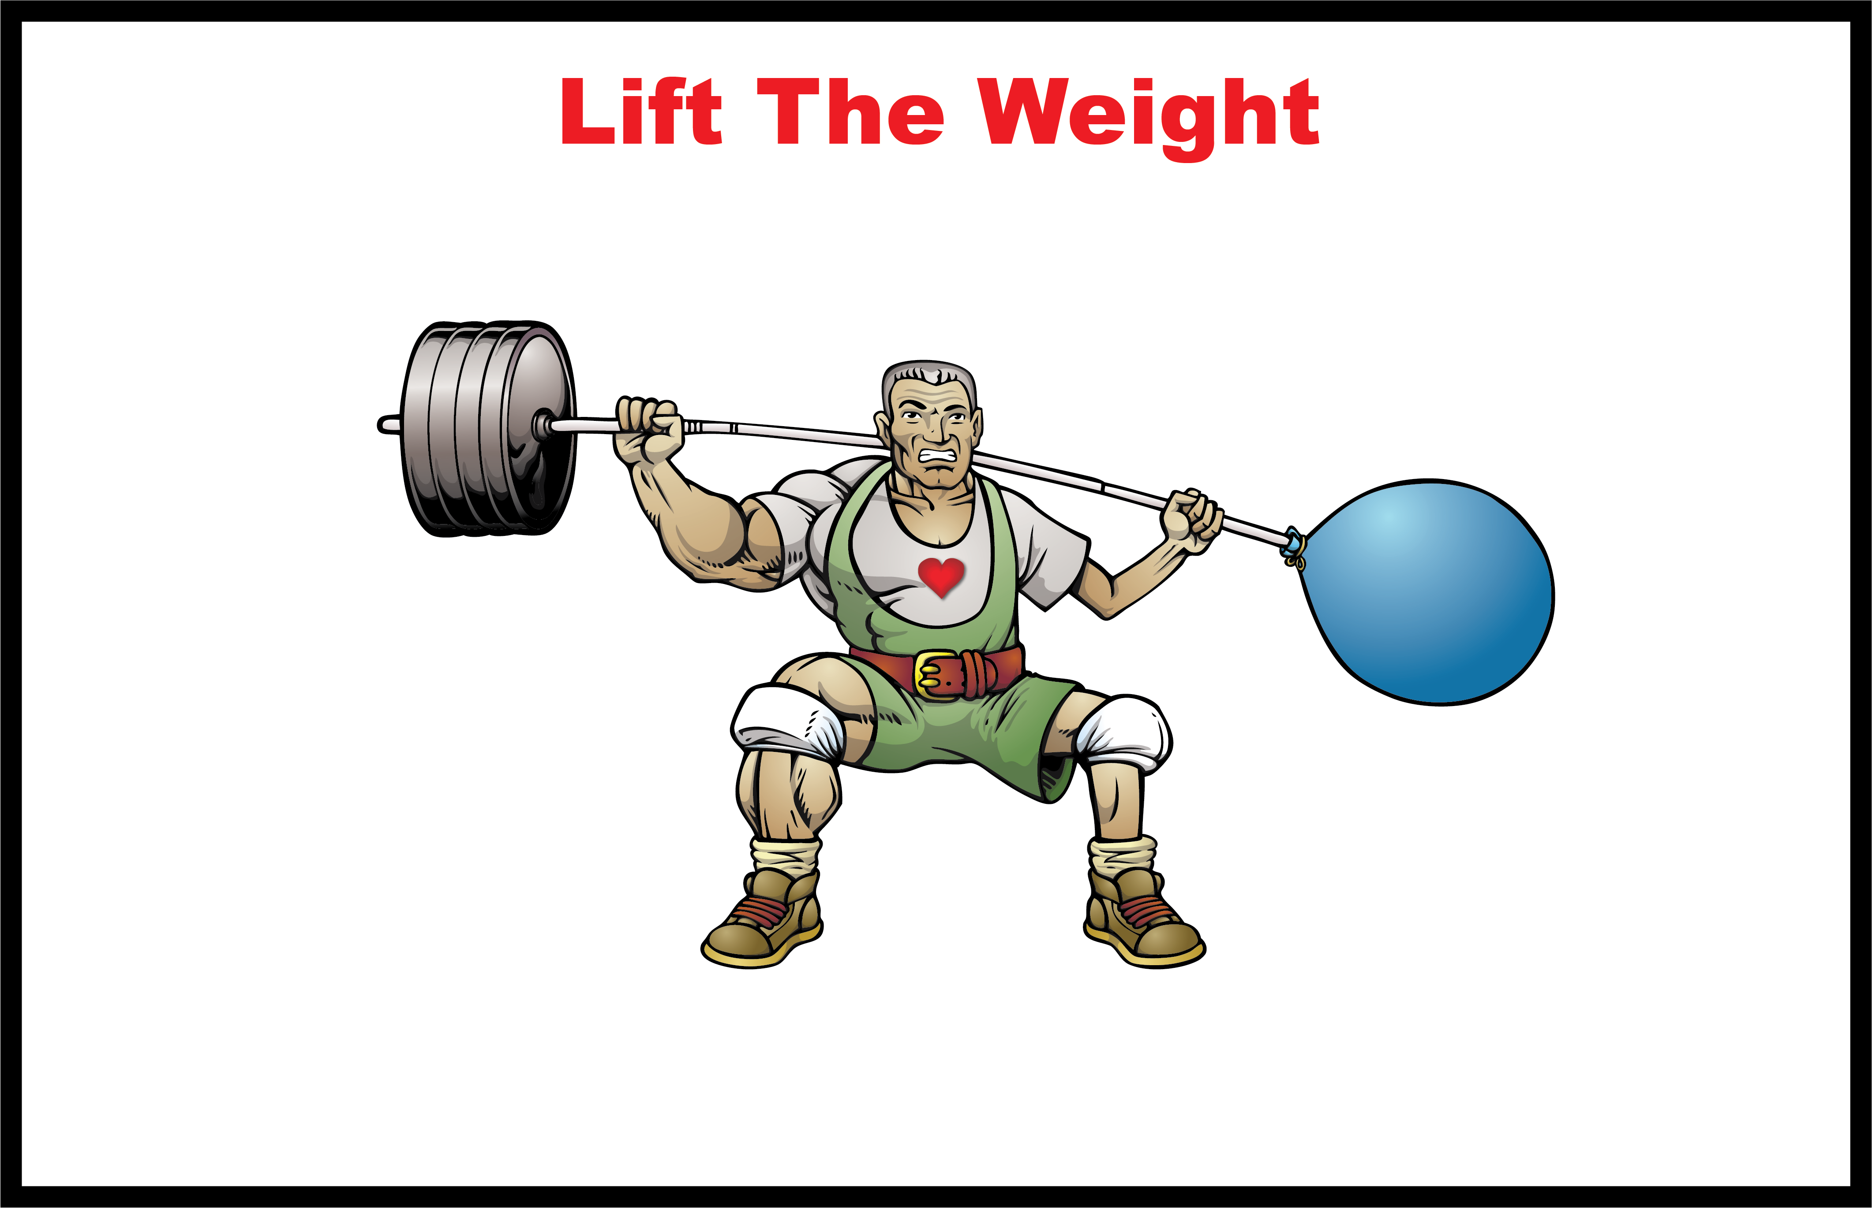

Slide 3
Activity: Number Grid
This might seem like a simple challenge—but it’s really about how you handle structure, expectations, and effort in real life. Sometimes rules, systems, or guidelines can feel limiting, but they’re often the exact thing that helps you succeed faster and more effectively.
In this activity, you’ll experience the difference between working without structure and working with it. Pay attention—this connects directly to how you approach school, goals, and challenges in your everyday life.

Slide 4
Instructions:
I’m going to show you a slide with some numbers on it. You will have 60 seconds to count as many numbers as you can in order starting with (1, 2, 3, 4…) You must go in order—you cannot skip ahead.
Ready?

Slide 5
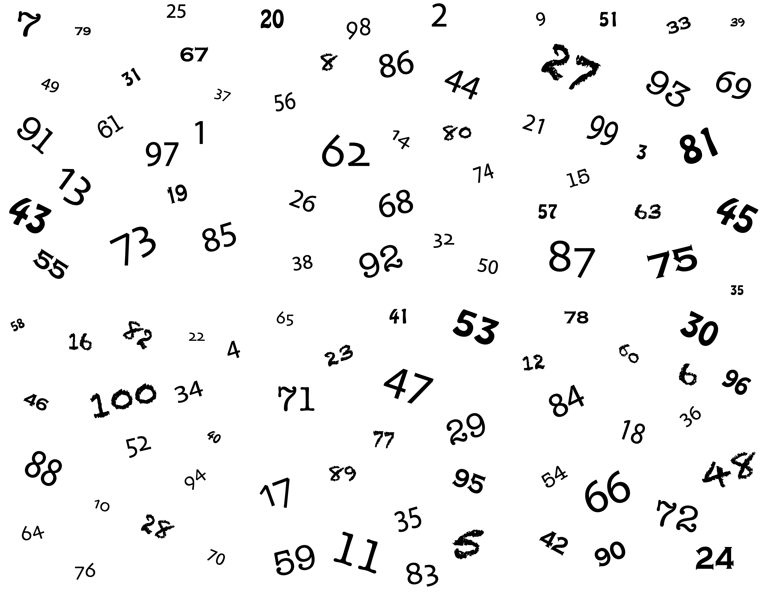

Slide 6
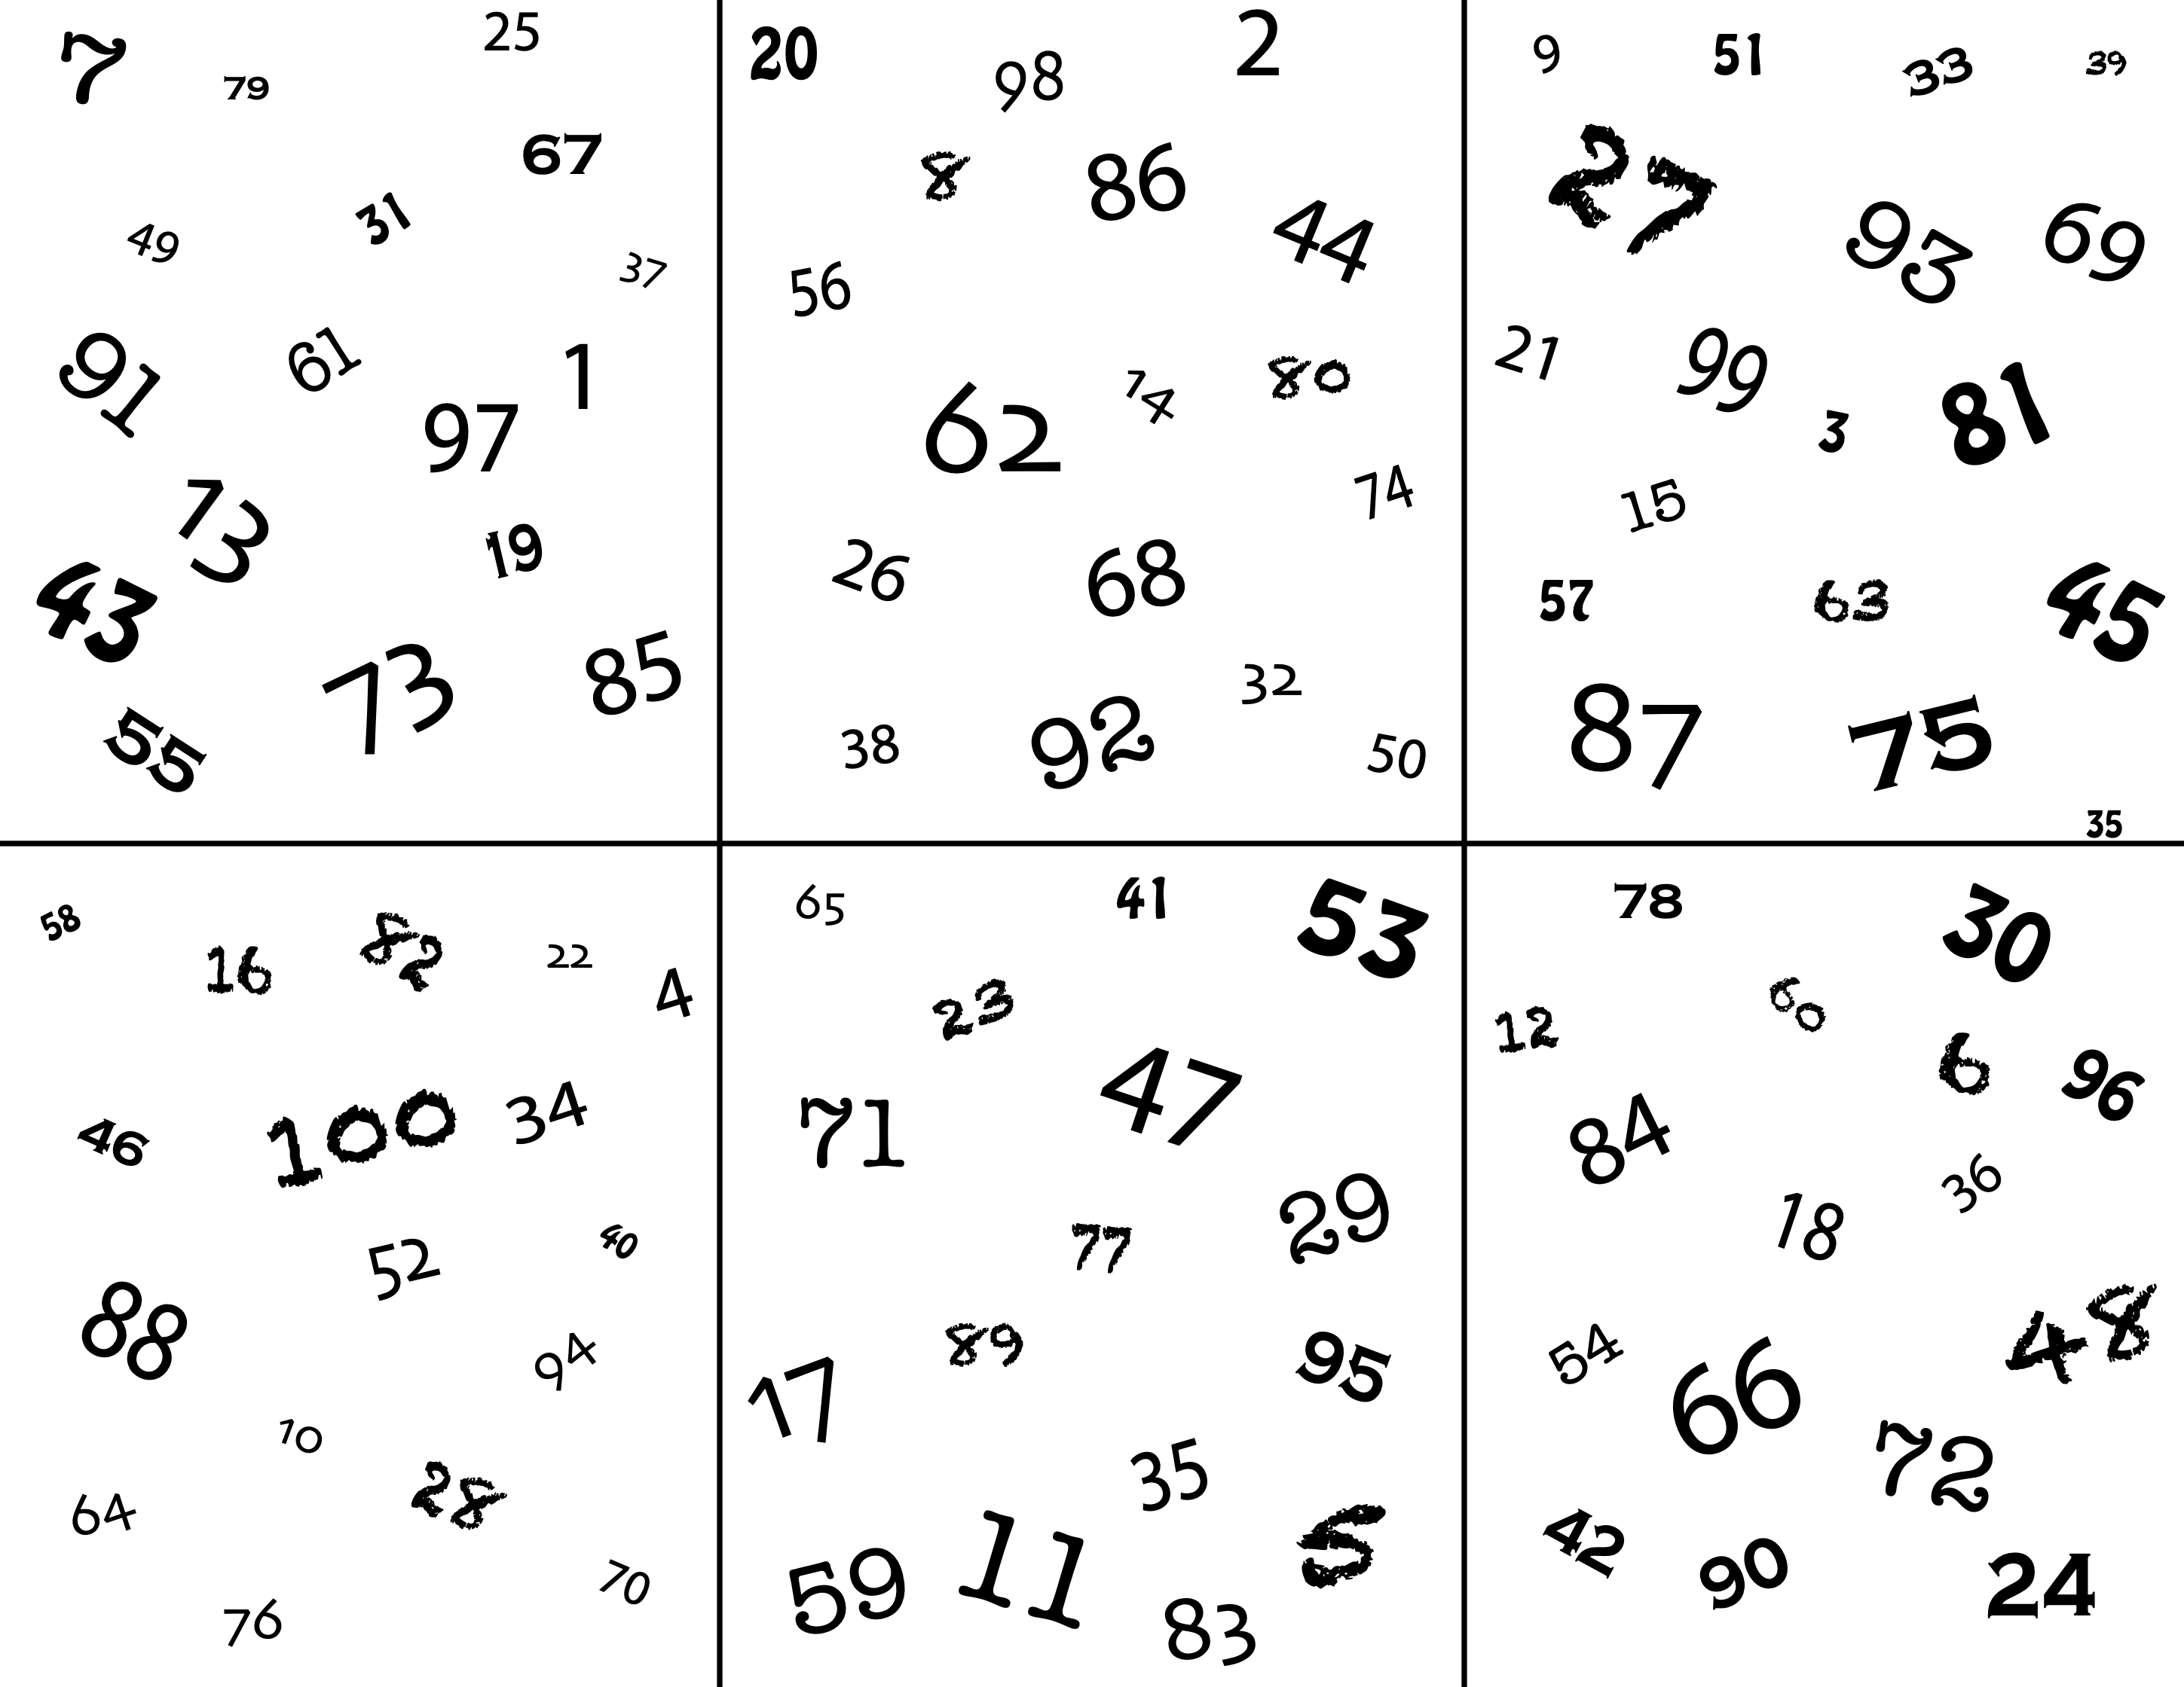

Slide 7
Questions:
What made the first round frustrating or difficult?
What changed in the second round that made it easier?
How did the lines (structure) actually help you succeed faster?
How is this similar to rules, routines, or expectations in real life?
What is one ‘rule’ or structure in your life that actually helps you succeed—even if it feels restrictive?

Slide 8
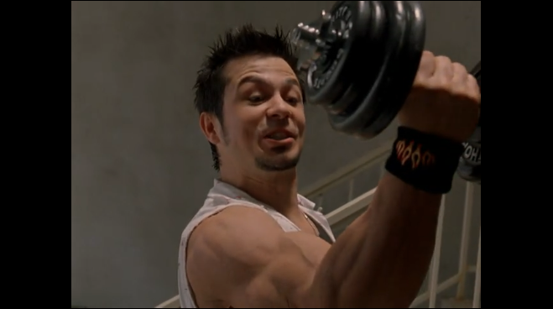
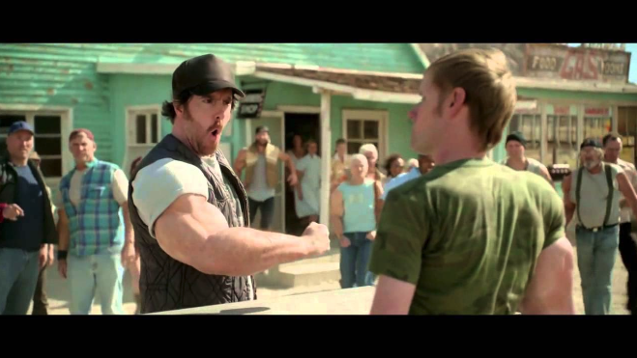
Video Clips
You’re about to watch two short clips. They’re funny—but they actually show something really important about how we grow (or don’t grow) in life.
As you watch, I want you to pay attention to this question:
What happens when you only train one side—and ignore the other?
Think about how this might connect to your life—your habits, your choices, and what you put effort into.

Slide 9
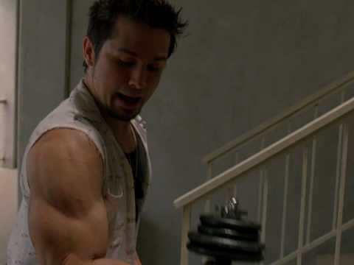
Link: https://youtu.be/BkIgXlE8bSo

Slide 10
Alright… that’s a little weird, right? But let’s see another version of the same idea.

Slide 11
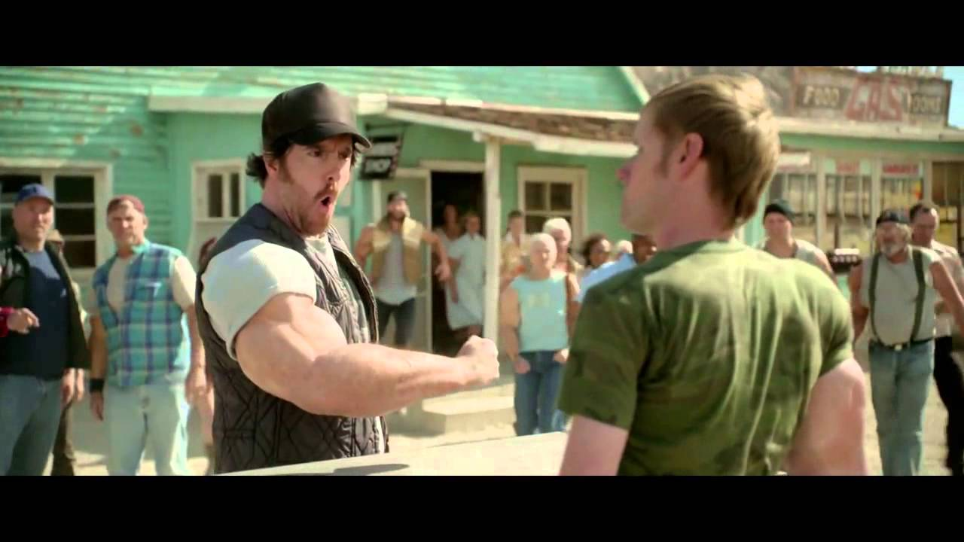
Video Clip:
Link: https://www.youtube.com/watch?v=n7BVxLyIgqM

Slide 12
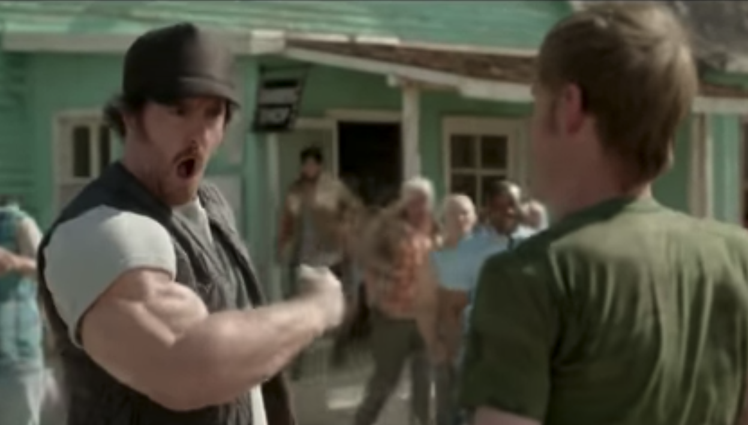
Questions:
What did you notice about the people in both videos?
Why did they end up strong on only one side?
What problems or limitations might that create for them?
What are things people might focus on too much in life that get them out of balance?
What are some things people avoid because they’re challenging—but might actually matter?
What is one “weight” (rule, responsibility, or expectation) that would make you stronger if you committed to it?

Slide 13
1
What is expected of me?
From Parents: (rules)
From Society: (laws)
For Myself: (Self Discipline)

Slide 14
2
Discuss Picture . . .
Why do I need resistance to become stronger?
1
What is expected of me?
From Parents: (rules)
From Society: (laws)
For Myself: (Self Discipline)

Slide 15
2
Discuss Picture . . .
Why do I need resistance to become stronger?
1
What is expected of me?
From Parents: (rules)
From Society: (laws)
For Myself: (Self Discipline)
What things get me into the most trouble?
3
What have I given up on?
Why does giving up make me weak?

Slide 16
2
Discuss Picture . . .
Why do I need resistance to become stronger?
1
What is expected of me?
From Parents: (rules)
From Society: (laws)
For Myself: (Self Discipline)
What things get me into the most trouble?
3
What have I given up on?
“Hard”
A Lot of
Resistance
“Easy”
No Resistance
Why does giving up make me weak?

Slide 17
2
Discuss Picture . . .
Why do I need resistance to become stronger?
1
What is expected of me?
From Parents: (rules)
From Society: (laws)
For Myself: (Self Discipline)
What things get me into the most trouble?
3
What have I given up on?
“Hard”
A Lot of
Resistance
“Easy”
No Resistance
4
What are three things that I put most of my Time and Effort into?
Why does giving up make me weak?
1.
2.
3.

Slide 18
2
Discuss Picture . . .
Why do I need resistance to become stronger?
1
What is expected of me?
From Parents: (rules)
From Society: (laws)
For Myself: (Self Discipline)
What things get me into the most trouble?
3
What have I given up on?
“Hard”
A Lot of
Resistance
“Easy”
No Resistance
4
What are three things that I put most of my Time and Effort into?
Why does giving up make me weak?
1.
2.
3.
Do any of these things
give you Opportunity,
Freedom, and Self-Respect?
If YES keep lifting . . . If NO, create a new workout

Slide 19
2
Discuss Picture . . .
Why do I need resistance to become stronger?
1
What is expected of me?
From Parents: (rules)
From Society: (laws)
For Myself: (Self Discipline)
What things get me into the most trouble?
3
What have I given up on?
“Hard”
A Lot of
Resistance
“Easy”
No Resistance
4
What are three things that I put most of my Time and Effort into?
Why does giving up make me weak?
1.
2.
3.
5
What are three new options you could do with your time that will make you stronger?
1.
2.
3.
Do any of these things
give you Opportunity,
Freedom, and Self-Respect?
If YES keep lifting . . . If NO, create a new workout

Slide 20
2
Discuss Picture . . .
Why do I need resistance to become stronger?
1
What is expected of me?
From Parents: (rules)
From Society: (laws)
For Myself: (Self Discipline)
6
Why does this need to be your strongest muscle?
What things get me into the most trouble?
3
What have I given up on?
“Hard”
A Lot of
Resistance
“Easy”
No Resistance
4
What are three things that I put most of my Time and Effort into?
Why does giving up make me weak?
1.
2.
3.
5
What are three new options you could do with your time that will make you stronger?
1.
2.
3.
Do any of these things
give you Opportunity,
Freedom, and Self-Respect?
If YES keep lifting . . . If NO, create a new workout

Slide 21
Activity: Follow Directions
This might look like a simple activity—but it’s actually about how you handle real-life situations every day. In life, rules, directions, and expectations can feel annoying or easy to ignore—but those moments are exactly where your choices matter most. The way you approach this activity will say a lot about how you deal with challenges, responsibility, and pressure in real life. Pay attention—you might learn something about yourself.

Slide 22
Activity: Follow Directions
Instructions:
“I’m going to give you a short assignment. Your job is to follow the directions exactly as they are written.”
Important:
Work independently (no helping each other)
Do not talk or ask questions during the assignment
Follow the directions as closely as possible

Slide 23

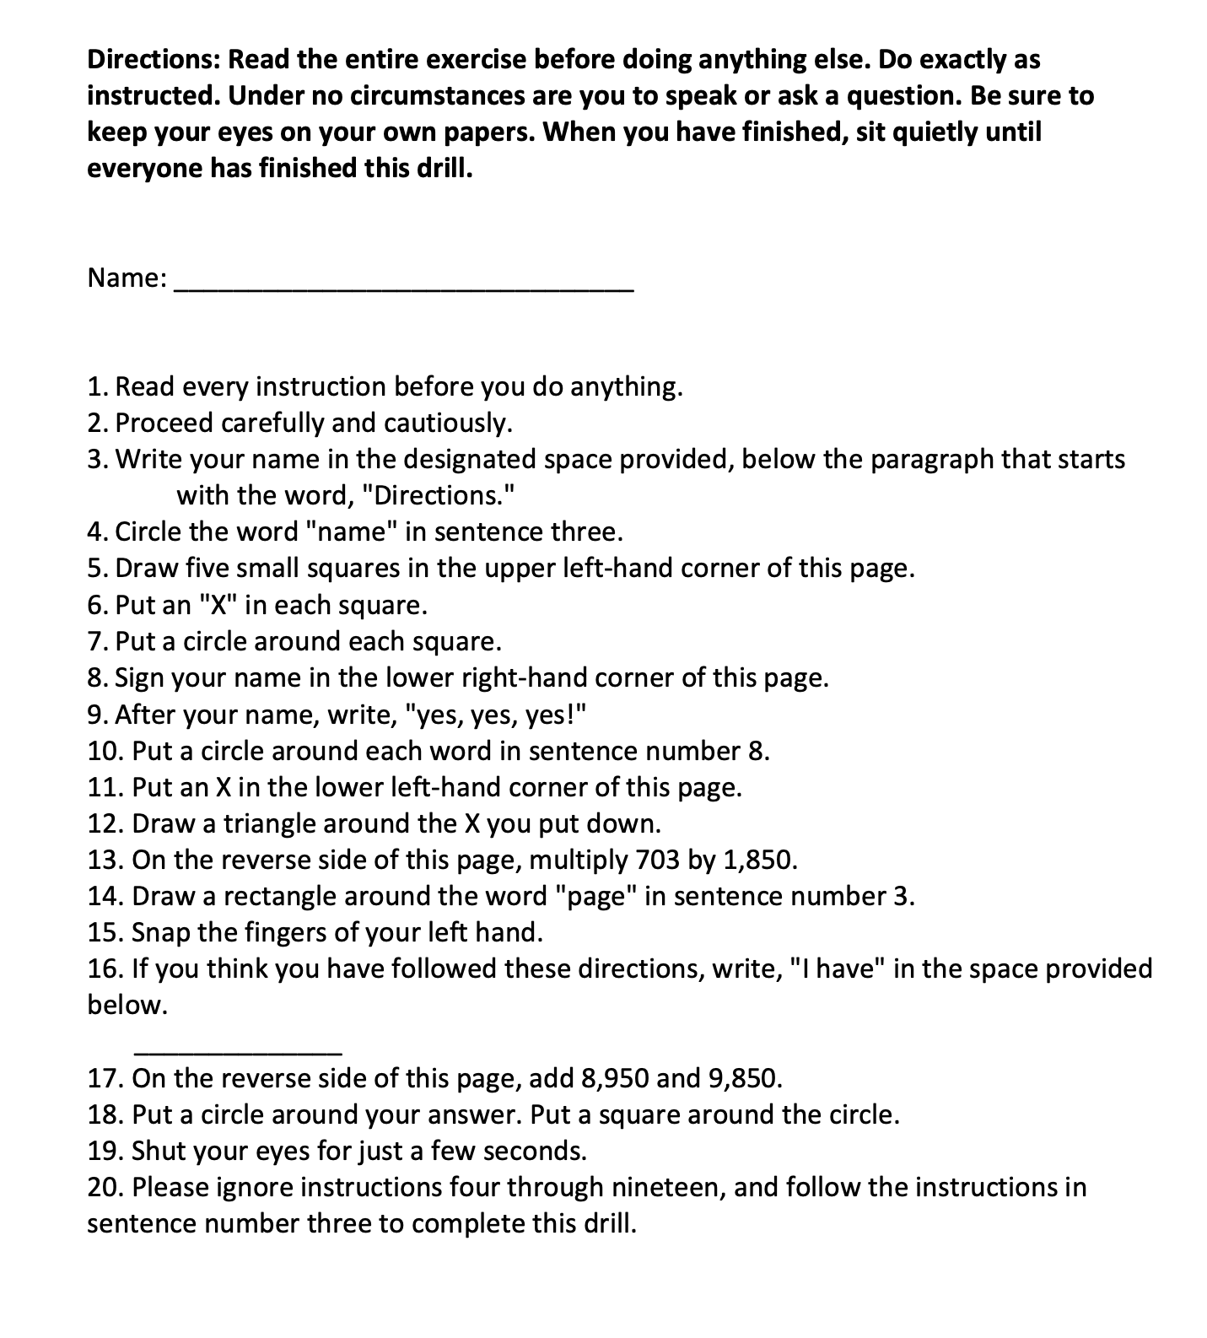
Activity: Follow Directions

Slide 24
Questions:
What was the most important direction—and how many people actually followed it?
Why did so many people start without reading all the directions?
In this activity, what was the “weight” (the hard thing), and what was the “balloon” (the easy choice)?
How is this similar to rules and expectations in real life—at school, home, or with behavior?
What is one “weight” in your life right now that you know would make you stronger if you followed through?

Slide 25

Game Plan Activity
Resilience Booster
Your new workout!
Identify three things you can spend your energy and time on to help you become a stronger person.
Schedule a routine for the next week to start making it happen!

Slide 26
Art Activity
Bumper Sticker:
Bumper stickers often contain sayings that are meant to influence or motivate people in some way.
Design a bumper sticker that will motivate you and others to “lift the weight.”

