Slide 1
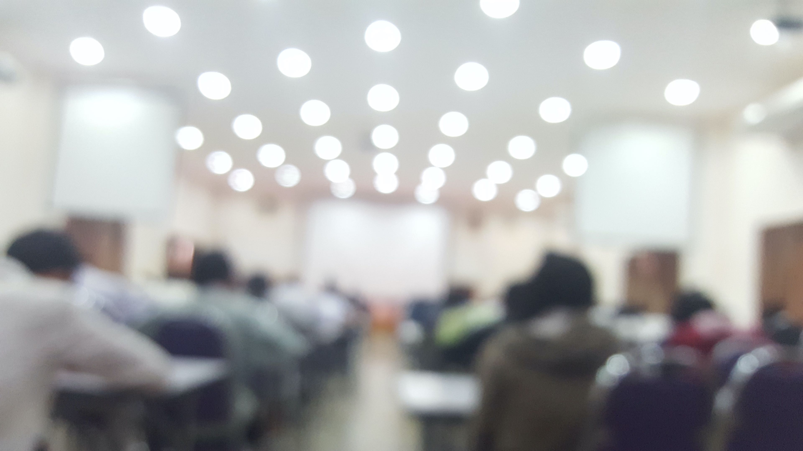

Welcome to Class!
Question of the Day:
“If you knew you could not fail… what is something you would be willing to work really hard to accomplish?”

Slide 2
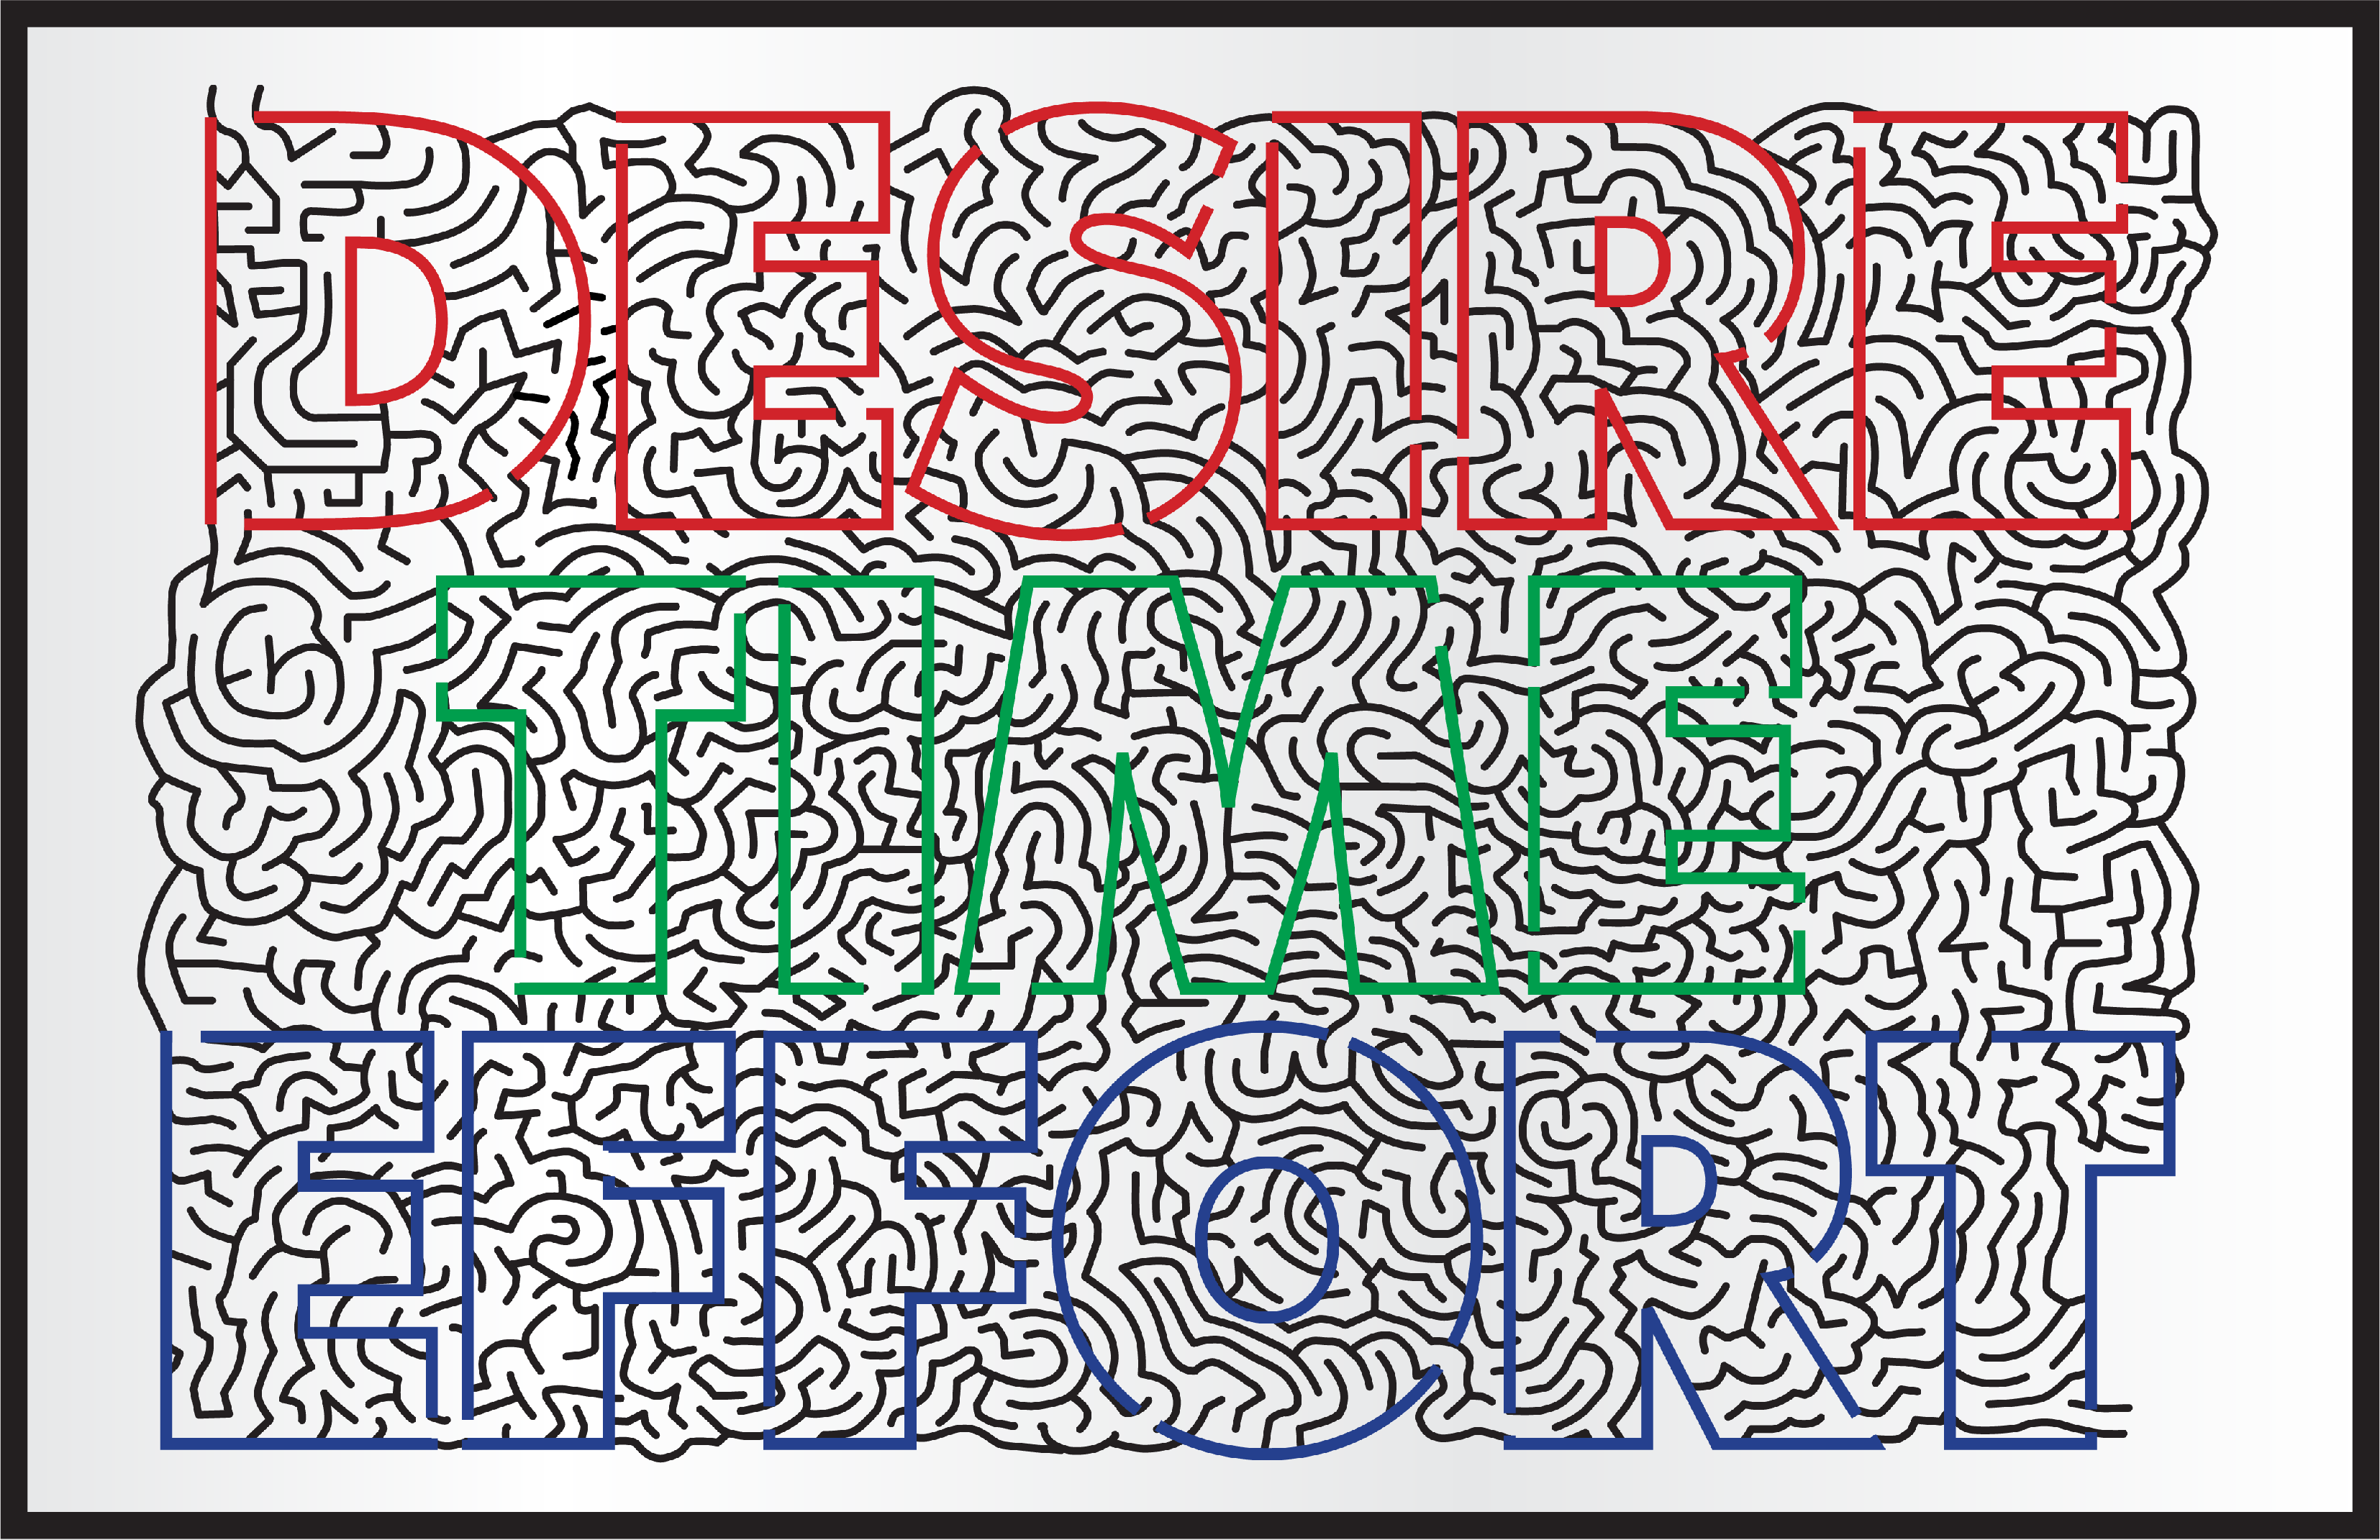
Start:
Finish

Slide 3
  Questions:
  Did any of you feel like giving up when you hit a dead end? How is that like life?
  For those of you who had their maze taken away, how did that make you feel?

Slide 4
  “You see that feeling you had in that moment?… That is what we call the “Accomplishment Zone”... It’s the feeling we get when we’ve worked hard at something, and we’re about to finish—or we accomplish it... It feels really good!”

Slide 5
  Questions:
  For those of you that were able to complete the maze, how did it feel when you crossed the finish?
  Why is hard work important in life?
  Can you think of a time when you experienced the “accomplishment zone?”

Slide 6
  Desire Time & Effort

Slide 7
  Desire
  When you first started the maze, where was your desire?
  How did your desire change as you got closer to finishing?

Slide 8
  Time
  There are three ways that we can look at time. We can look to the past, the present, and the future.
  How can it be helpful to look at the past?
  Why is it important to think about the future?
Even though it's helpful to look to the past, and to the future, remember, we live in the “now,” or the present. It's most important that we focus the majority of our effort each day on the present.

Slide 9
  Effort
  The Present:
  What you do today—and then repeat tomorrow, and the next day—is what builds your future!
  When you stack days, one after another, that are full of effort, time becomes a very powerful tool.

Slide 10
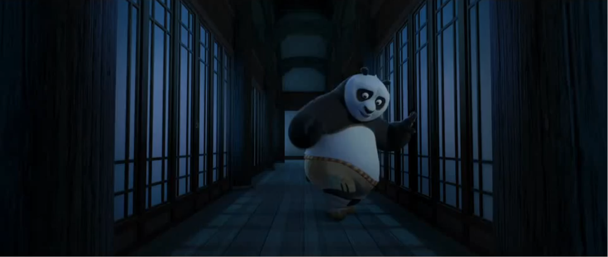
Video: Kung Fu Panda
As you watch this clip, see if you can make the connection with what we just discussed.

Slide 11
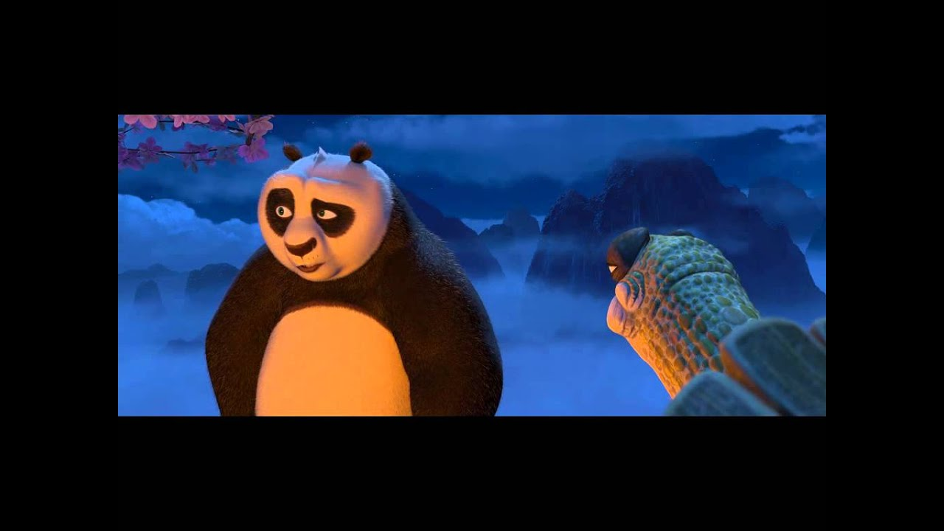
Video: Kung Fu Panda
https://youtu.be/Csga4tg5Pq0

Slide 12
Questions:
What did Master Ugway say that was so important?
Have you ever looked at today as a gift? What do you think he meant by that?
In what ways can today be a gift?

Slide 13

Activity: Focus
Instructions:
This is a short experiment to observe how your brain works when trying to focus.
  Sit still and choose one thing to focus on
  (It could be anything like breathing, a number, a word, etc.)
  Your job is to stay focused on that one thing for 30 seconds. Try not to think about anything else.
  Are you ready?
  Begin!

Slide 14
Activity: Focus
Questions:
  What did you choose to focus on?
  How did it go?…be honest – did your mind wander at all?
  If so… about how long did it take before your mind drifted?

Slide 15
Activity: Focus
What you just experienced is normal. At any moment, your brain is taking in a lot—what you’re seeing, hearing, and feeling. All of that information is being processed at the same time, which makes it easy for your mind to get pulled in different directions

Slide 16
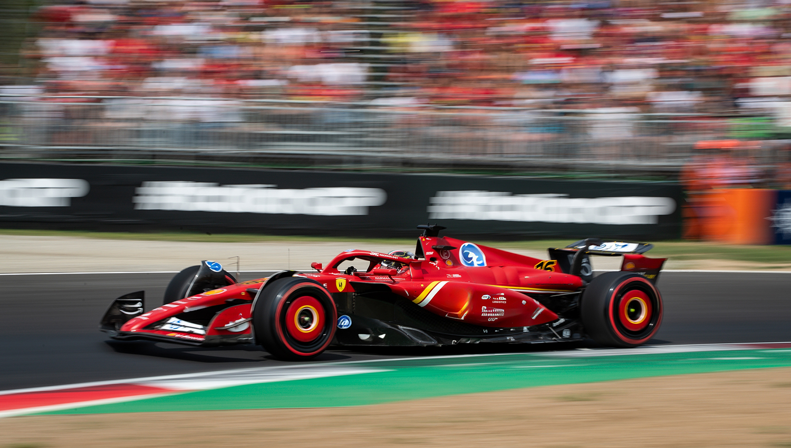
Your ability to focus is a skill. And just like any skill, it takes time, effort, and practice to improve

Slide 17
For example, a Formula 1 race car driver travels at over 200 miles per hour and must stay completely focused on the track. Their ability to focus is one of the most important skills that helps them succeed.”

Slide 18
Focus Training Strategies
Pick one clear focus (your “anchor”)
Slow your breathing or counting
If your mind wanders, calmly bring it back
Don’t get frustrated—the effort is in returning your focus
Sit up and stay physically still to help your concentration

Slide 19
Activity: Focus
Instructions: (round 2– 45 seconds)
Now we’re going to try it again, using those strategies
You can choose the same thing to focus on or something different
Your goal is to stay with it the entire time

Slide 20
Activity: Focus
Questions:
  What felt different the second time compared to the first?
  What helped you stay focused longer?
  When your mind wandered, what did you do?
  Which round took more effort? Why?
  What does this teach you about focus and effort?
  How does this connect to things in your life—like schoolwork, challenges, or the Maze?

Slide 21
Activity: Focus
Questions:
  What felt different the second time compared to the first?
  What helped you stay focused longer?
  When your mind wandered, what did you do?
  Which round took more effort? Why?
  What does this teach you about focus and effort?
  How does this connect to things in your life—like schoolwork, challenges, or the Maze?

Slide 22
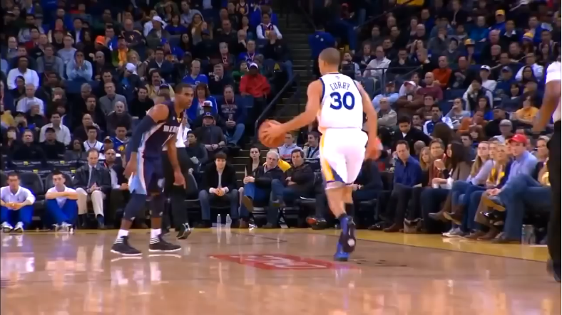
Story Example: Steph Curry
What do you know about Steph Curry?
What is he famous for?
What are some of his accomplishments?

Slide 23
Significant accomplishments:
4× NBA Champion (2015, 2017, 2018, 2022)
2× NBA MVP (2015, 2016) - First unanimous MVP in NBA history (2016) - NBA Finals MVP (2022)
10×+ NBA All-Star (and counting)
Olympic Gold Medalist

Slide 24
Significant accomplishments:
Impact on the Game:
Revolutionized basketball by: Making deep 3-point shooting a primary weapon, forcing defenses to extend far beyond the arc.
Widely credited with changing how the entire sport is played—from the NBA down to youth basketball

Slide 25
Significant accomplishments:
Lesser-Known Facts:
He was lightly recruited out of high school and played at a small school Davidson
Led Davidson to the Elite Eight in the NCAA Tourney (2008)
Son of former NBA player Dell Curry
Known for elite conditioning—runs miles every game due to constant movement
He has far exceeded expectations at every level, proving all his doubters wrong

Slide 26
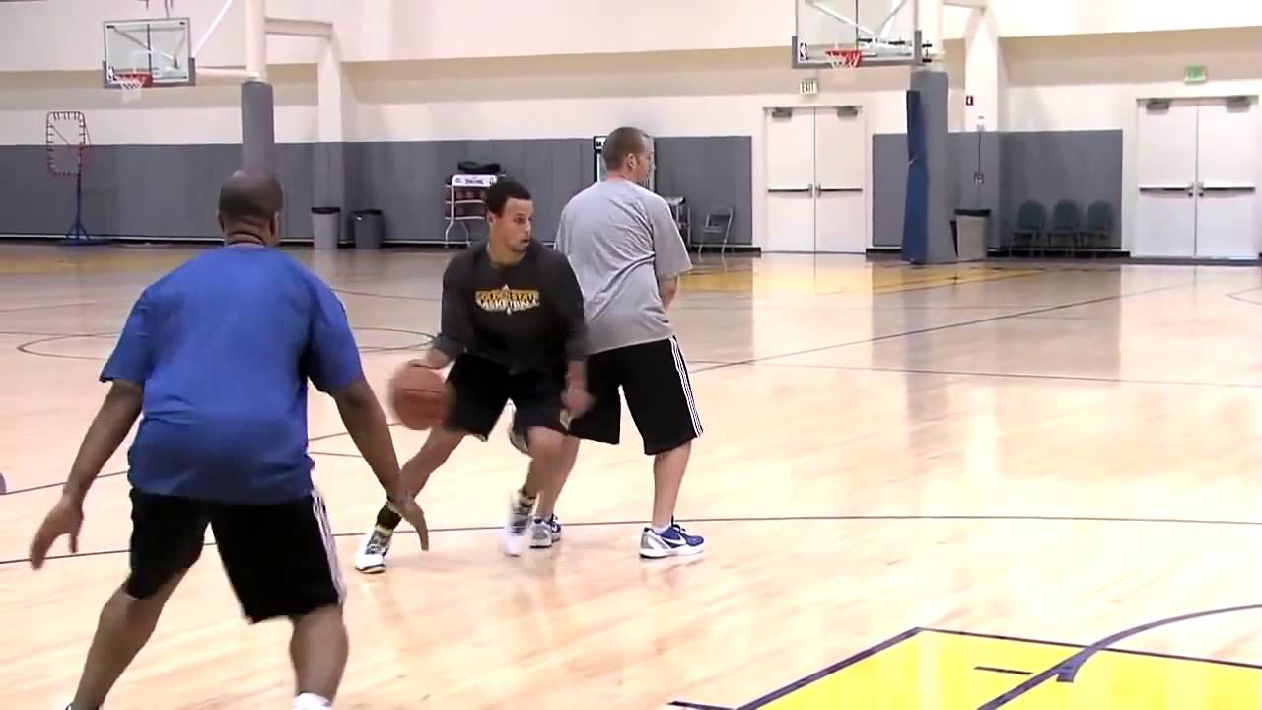
Video: Steph Curry
https://www.youtube.com/watch?v=3N3MjUmSeJw

Slide 27
Questions:
What stood out to you about how he trains?
How much of his success comes from talent vs effort?
What kinds of effort does he put in? (physical + mental)
Why is it important that he practices the same things over and over?
How does his preparation affect what happens during the game?

Slide 28
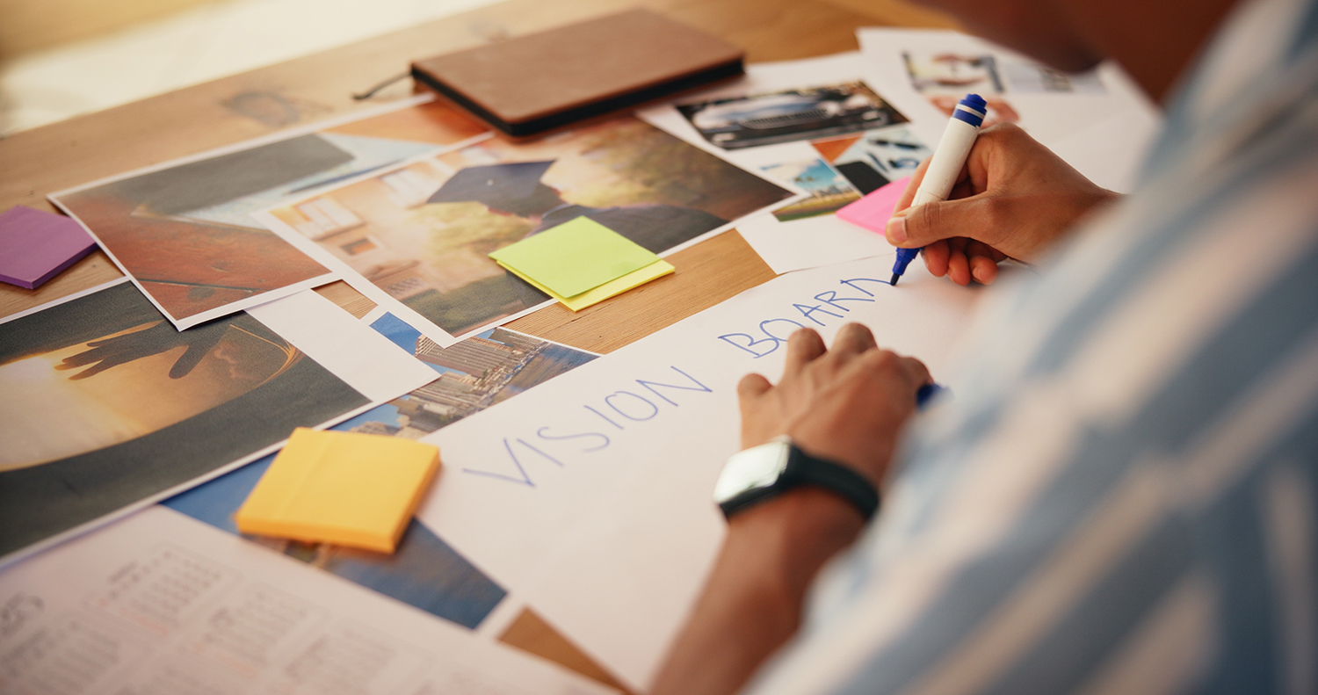
Activity: Vision Board
Instructions:
Create a board that represents a vision of your future. You can draw images, use pictures, stickers and words to make a collage that represents things you vision for your future. Ideas for your board could include:
Something I want to accomplish in school
Something I want to do when I'm older
Something I want to get better at outside of school (a hobby or interest)
Something I can do to be a better friend

Slide 29
Activity: Vision Board
Questions:
How do you think it will feel when you accomplish the goals you set for yourself?
How can you avoid getting distracted from accomplishing your goals?
What can we do to make sure we stay focused on our goals (the finish line)?

Slide 30

Thanks for Coming!

