Slide 1
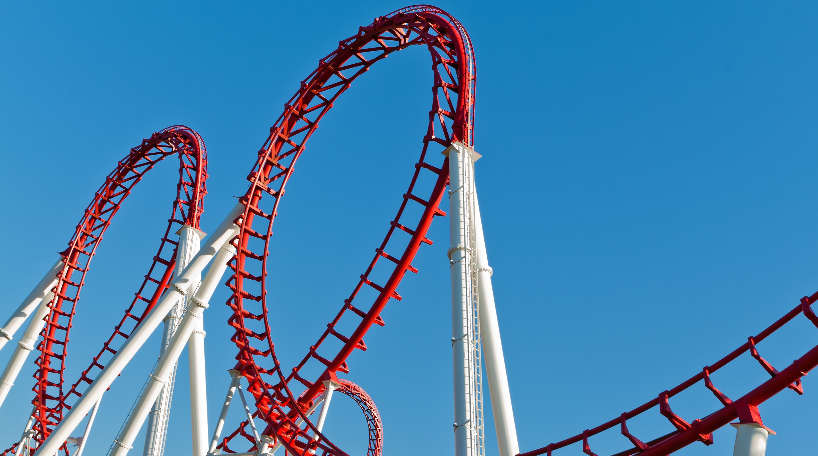

Welcome To Class!
Question of the day:
“If your life this week were a roller coaster, what would it be called?”

Slide 2
Rollercoasters:
Who likes rollercoasters?
Who dislikes rollercoasters?
Do you have a favorite?
Roller Coaster Video

Slide 3
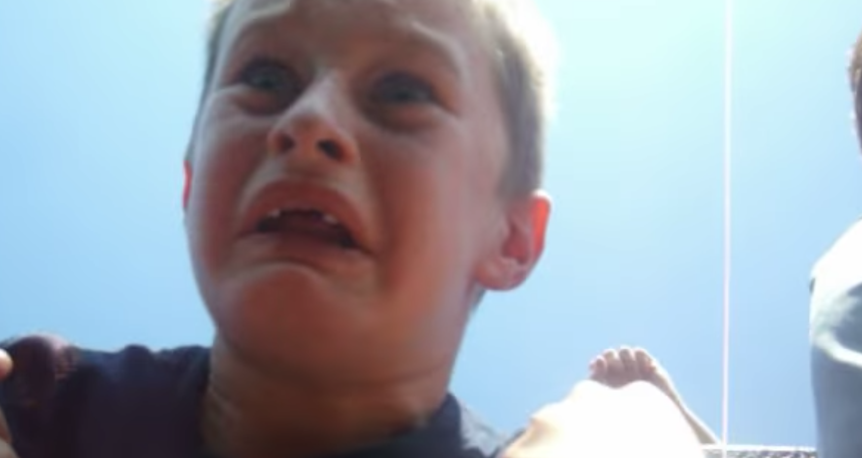
Video: Emotional Rollercoaster
As you watch this video, try and imagine what this kid is thinking and what he is feeling

Slide 4
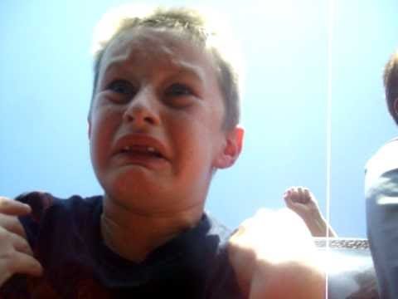
Video: Emotional Rollercoaster
https://www.youtube.com/watch?v=8XQzQYFYfy8&t=1s

Slide 5
Video: Emotional Rollercoaster
Questions:
What do you think he was feeling / thinking at the beginning of the ride?
What do you think was going through his mind during the first two big drops?
What did he say at the end of the ride?
Why do people ride rollercoasters?

Slide 6
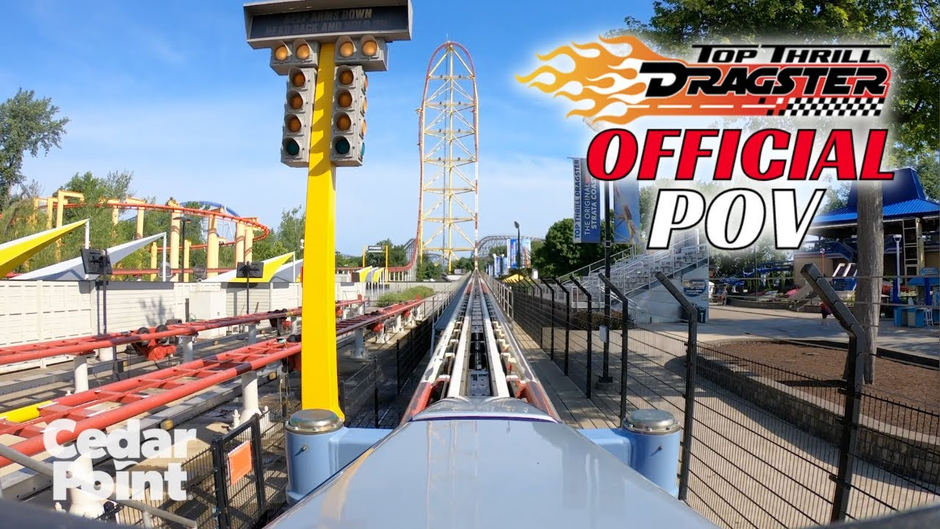
https://www.youtube.com/watch?v=zfzfoPuBgfc&t=1s
Notes:
Top Thrill Coaster

Slide 7
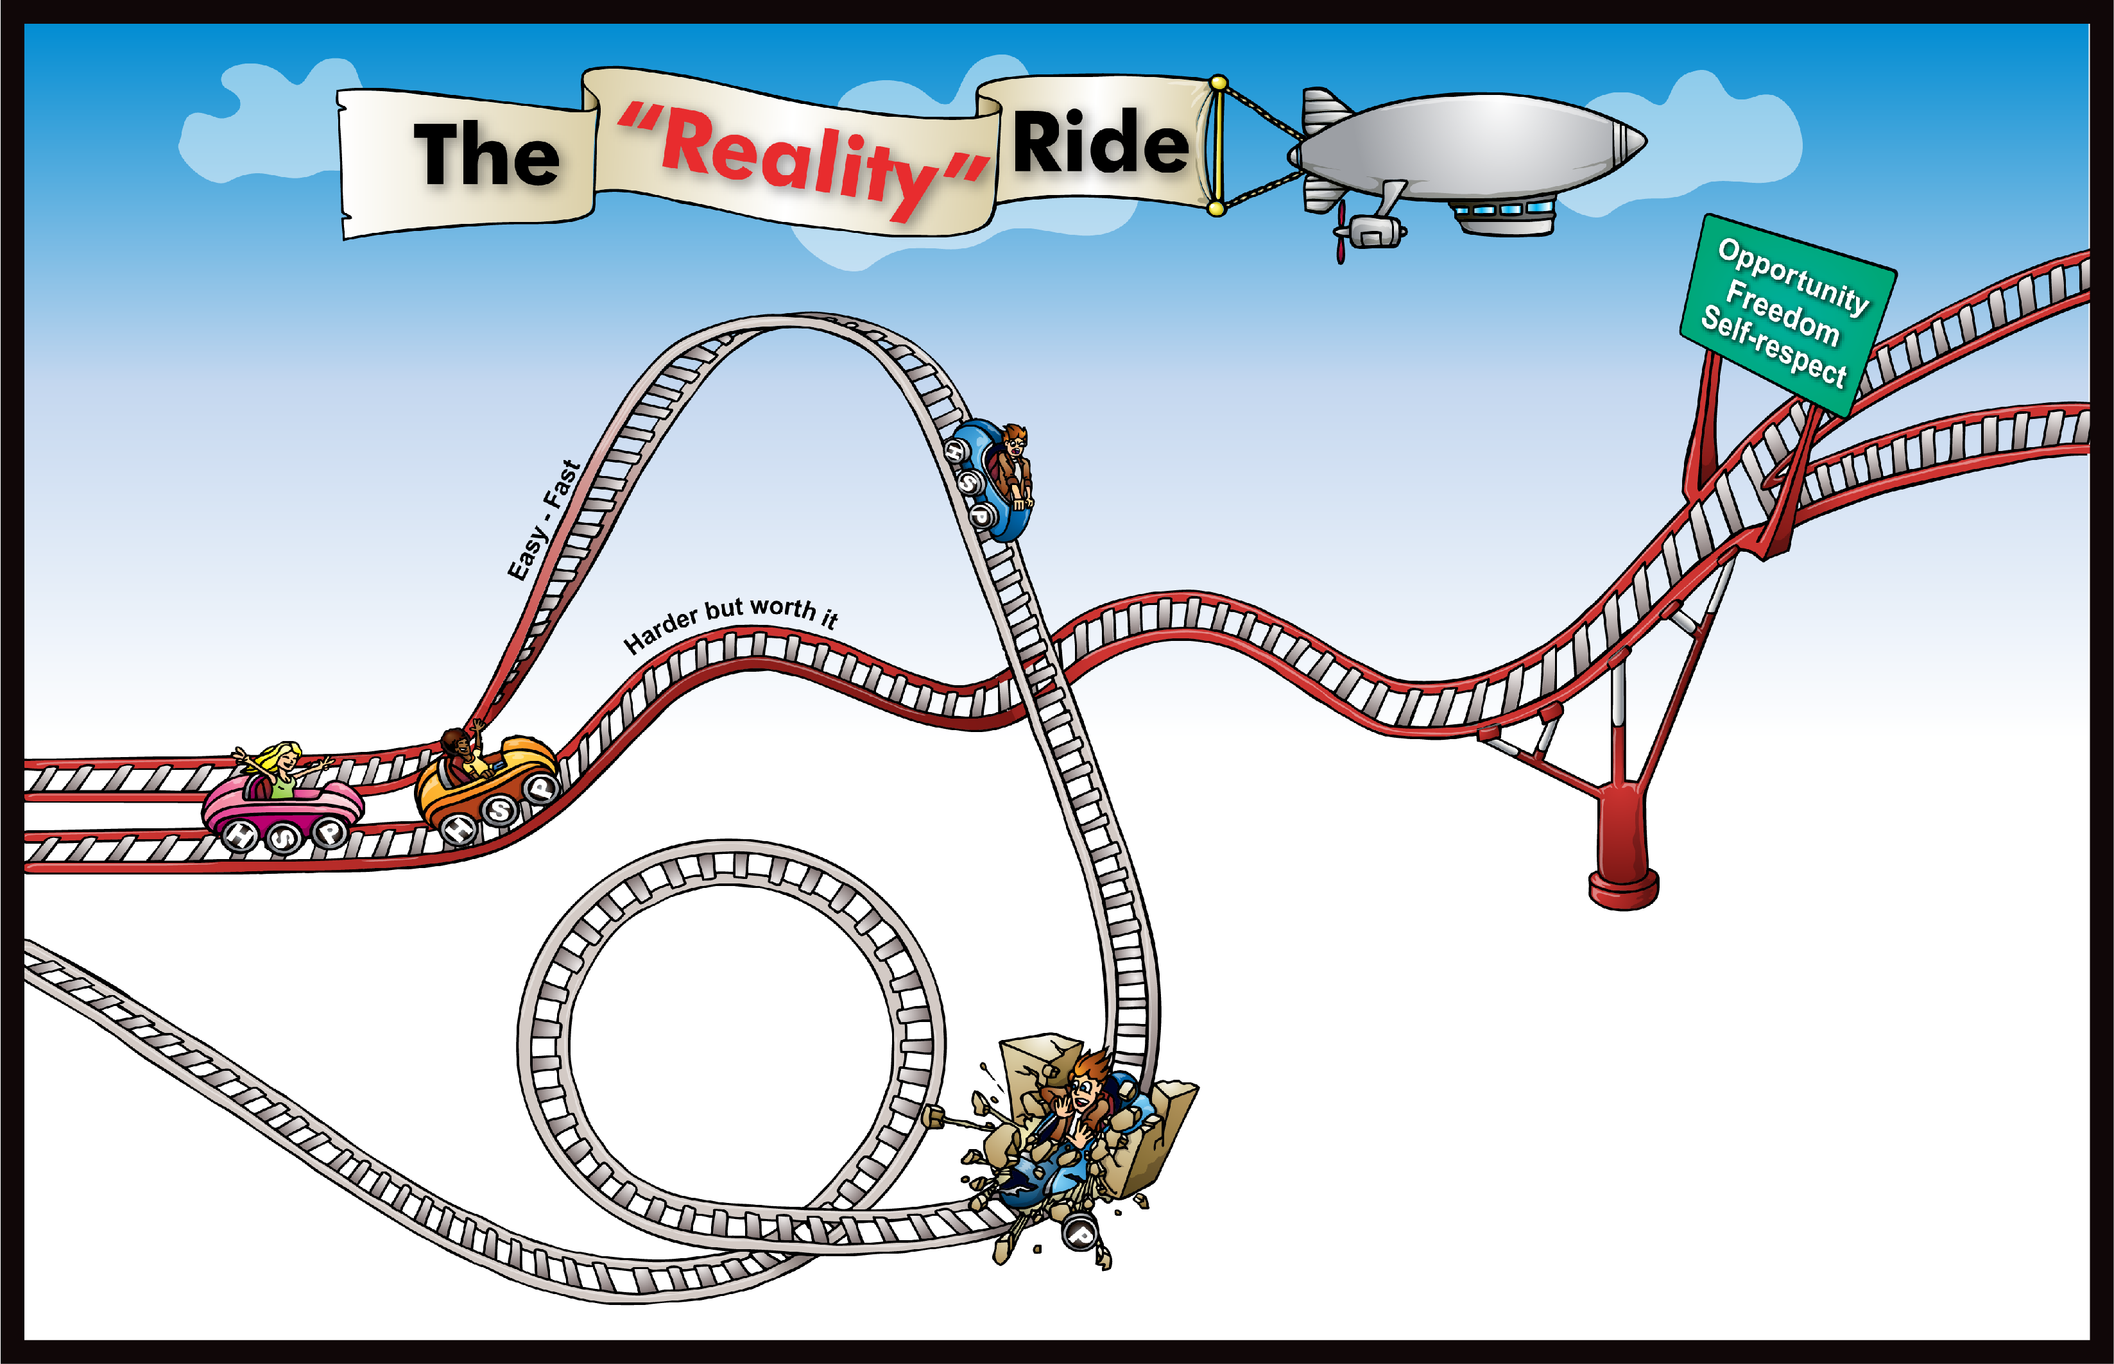
1
2
Goal:
5
Things that get you in trouble . . .
4
Your Challenges . . .
Home:
School:
Peers:
Peers
School
Home
3
6
Crash!
“Reality”
Consequences of the crash . . .
Will these things give you lasting
Opportunity?
Freedom?
Self Respect?
“Hit the wall”

Slide 8
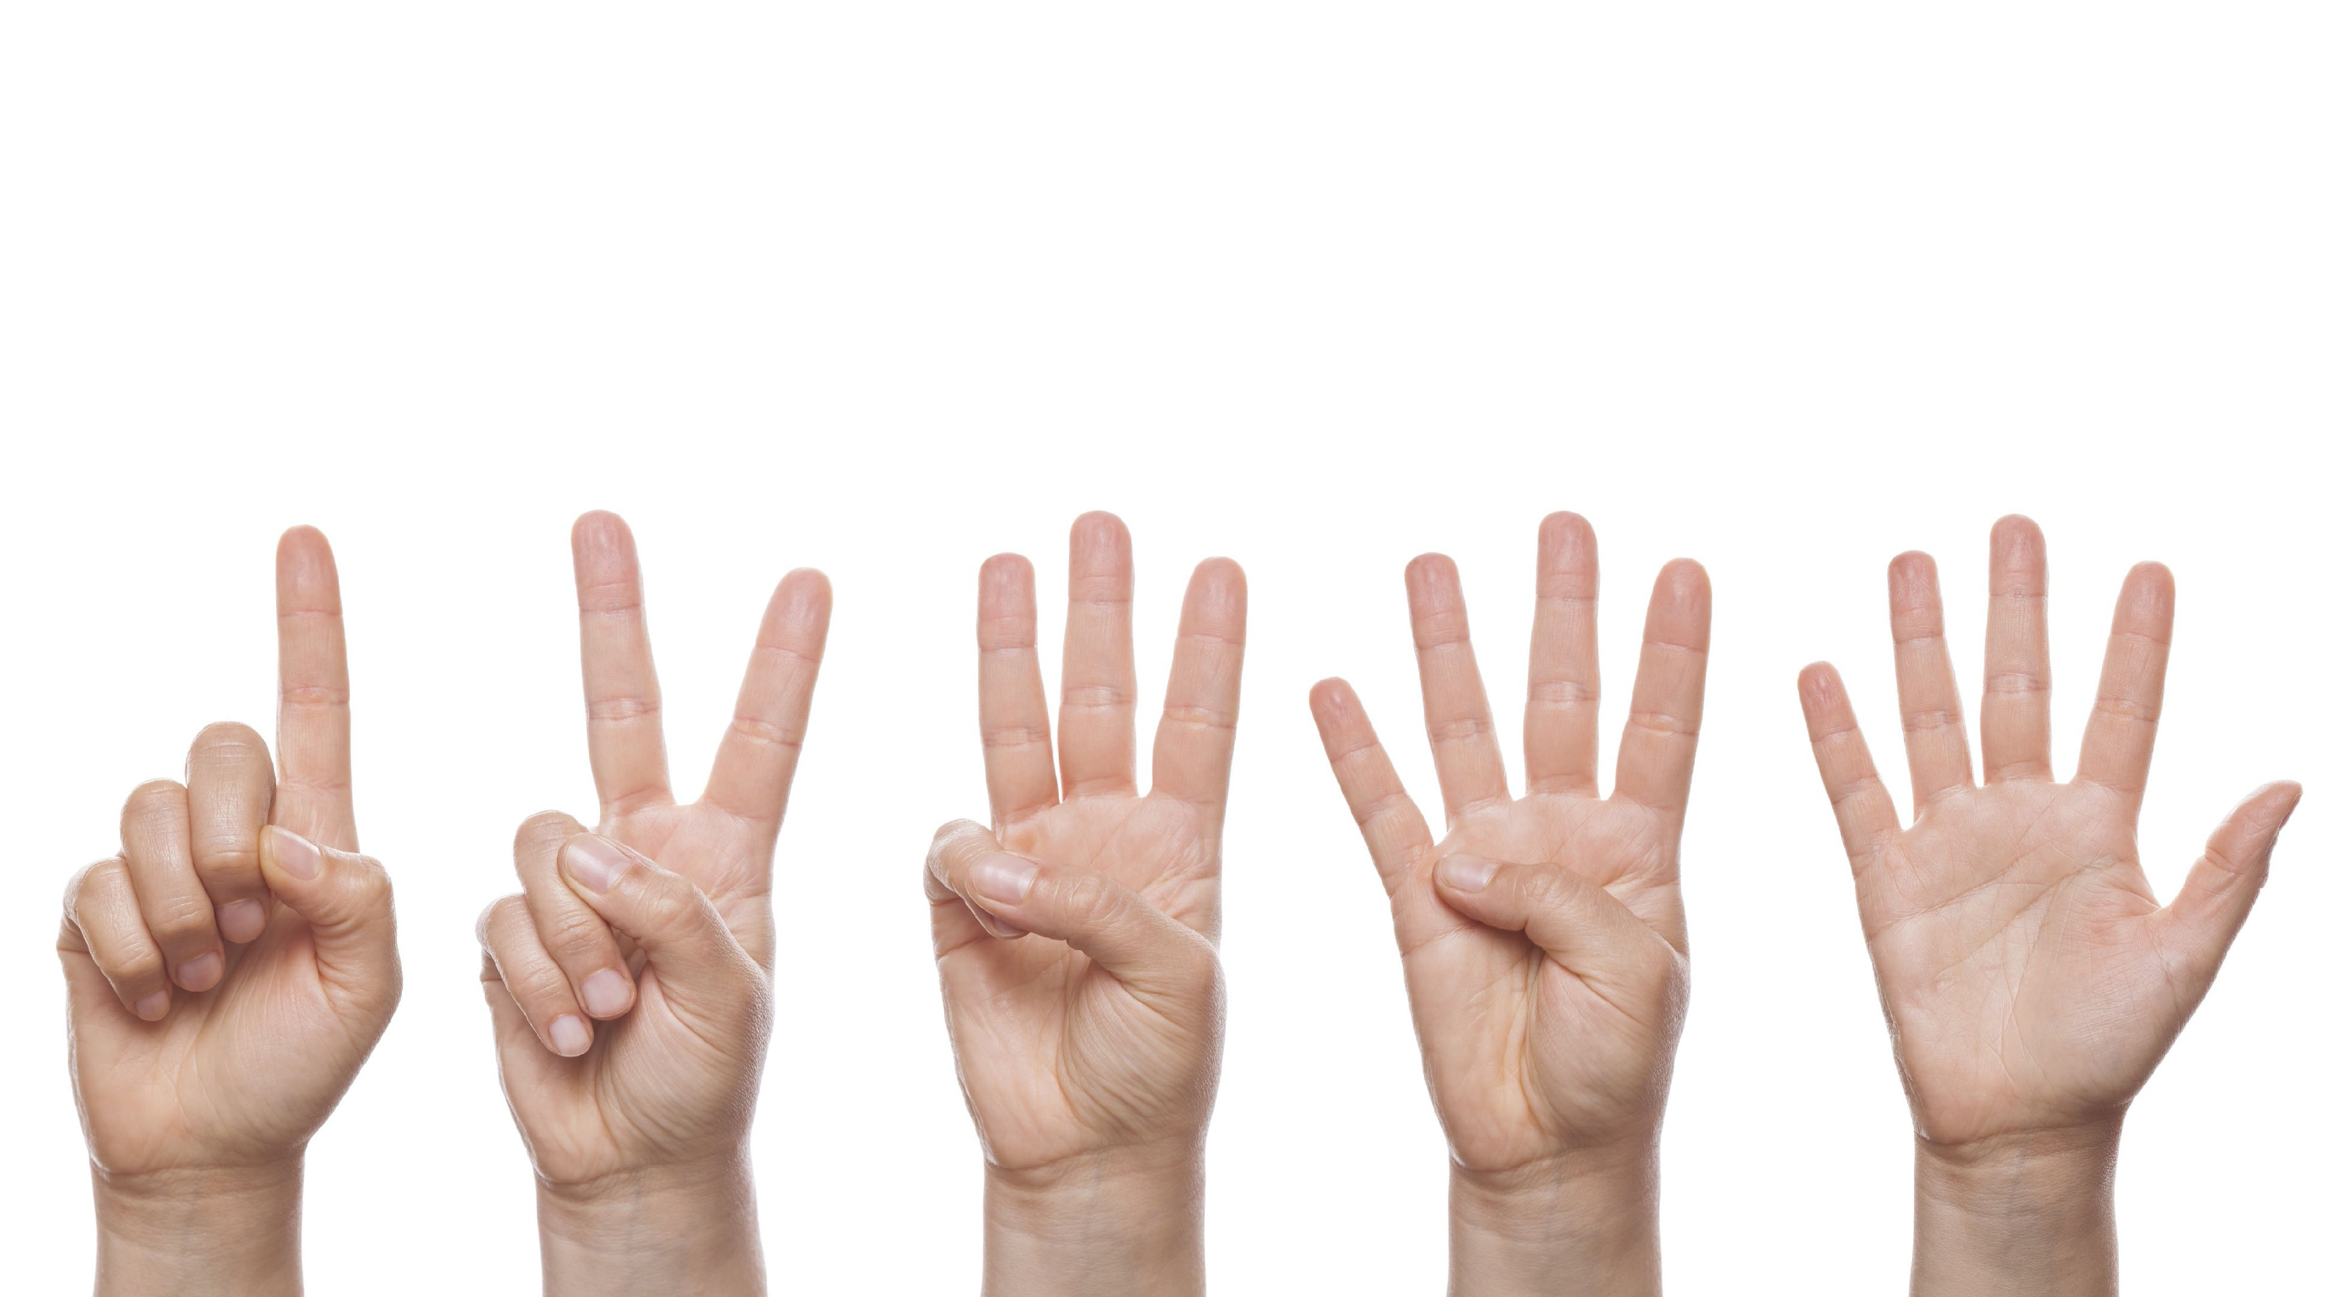
Activity: Count Your Fingers
Instructions:
  Stand up
  Get a partner
  Face your partner
  Put your hands behind your backs

Slide 9
Activity: Count Your Fingers
Questions:
What was the key to success in this activity?
Do you feel that you are making decisions today that will impact your future?
Why can it be helpful to make up your mind before you are faced with a choice that could get you into trouble?

Slide 10
1
2
Goal:
5
Things that get you in trouble . . .
9
What will your reality be when you ride here?
At Home:
At School:
With Peers:
In Future:
What choices will
give you. . .
4
Your Challenges . . .
More Options
Home:
School:
Peers:
7
What problems do you keep having over and over?
Who Can Support You?
Peers
School
Home
8
3
6
Frustrate
Confused
Angry
Scared
Keep getting same results
Crash!
“Reality”
Consequences of the crash . . .
Start ride over
Will these things give you lasting
Opportunity?
Freedom?
Self Respect?
“Hit the wall”

Slide 11
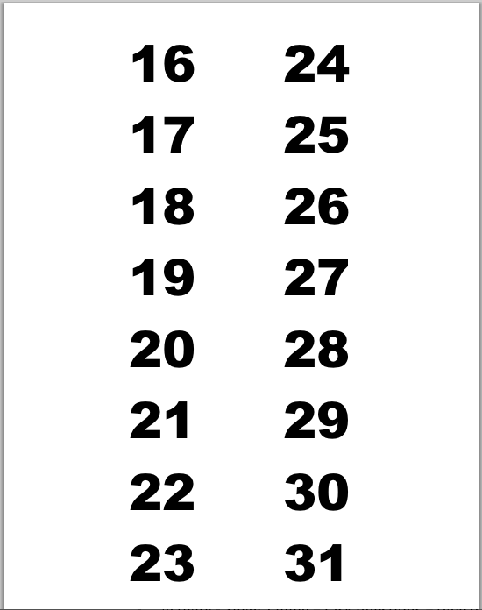
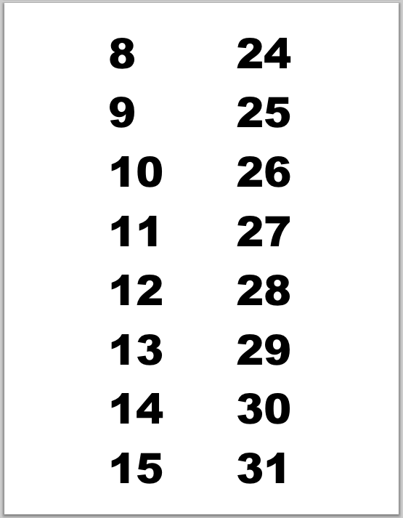
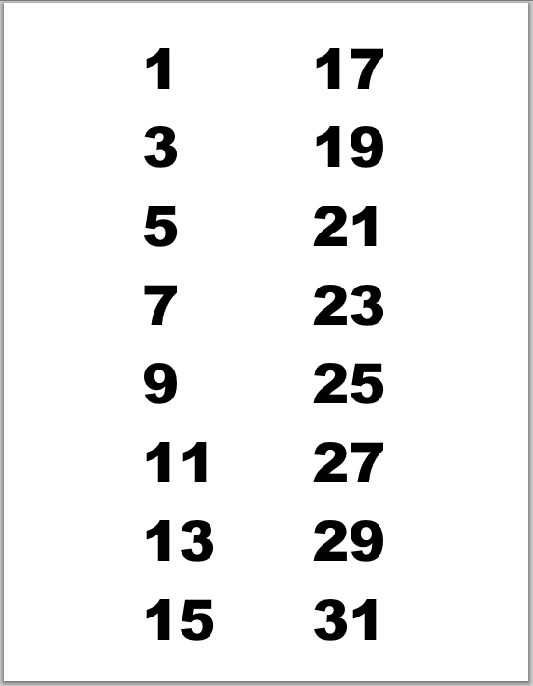
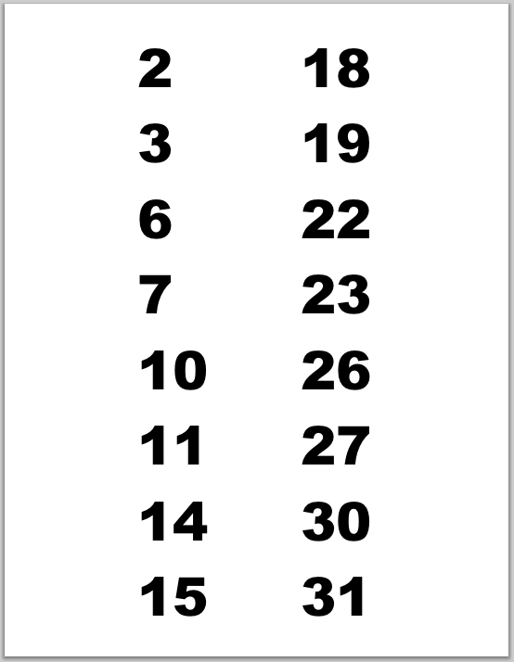
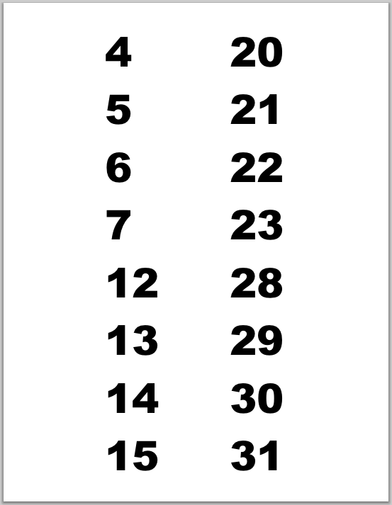
Birthday Cards

Slide 12
Birthday Cards
Questions:
Could I really read your mind?
What does the word “Deceiving” mean?
How might the “Easy Fast Track” be deceiving?
What things in life might appear fun but in reality could have consequences that are not what you would want?

Slide 13

Student Booster
Journal Booster
Tell about a time when you did something that was harder but worth it. What did you do to stick with it? How did you feel when you were done?

Slide 14

Thanks for Coming!
Remember:
Pay attention to the decisions you (and those around you) make over the next week and notice what consequences happen as a result.

