Slide 1


Welcome to Class!
Question of the day:
If life were a video game, what kind of obstacle would you rather jump over—
lava pits, spiky traps, or hungry alligators?

Slide 2

Video: High School Hurdler
This is a video clip from the Oregon High School State Championships girls
100-meter hurdles final. As you watch this clip, think about what would you do if you were in this situation?

Slide 3

Video: High School Hurdler

Slide 4
Questions:
What impressed you as you watched that race?
What first went through your mind as you saw her trip on the last hurdle?
If you had to think of a lesson that we can take away from this video, what might that be?

Slide 5
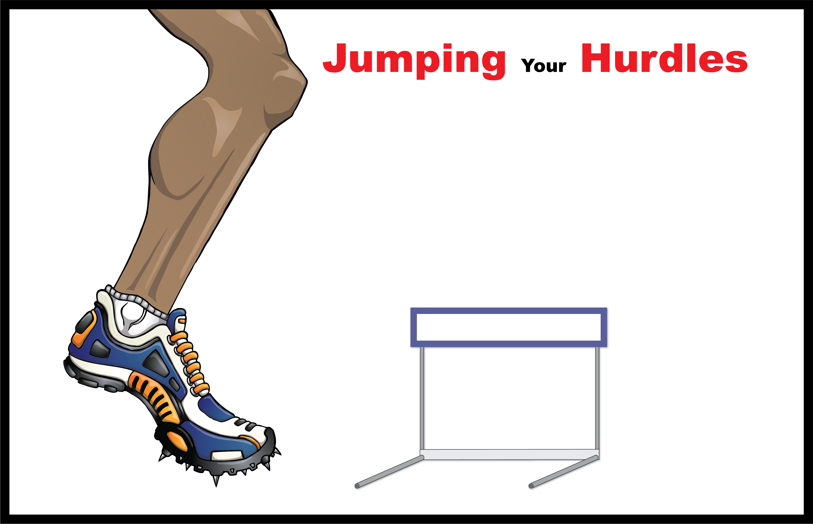
2
What Have I
Jumped Over?
6
1. Identify Problem:
4. Take Action
3
What Can I Jump Over?
What specific behaviors (actions) do I need to stop or add to jump my hurdle?
What problem do I really want to overcome?
Stopped Behaviors Added Behaviors
2. Create Options
5. Believe in Change:
What are some options I can create?
On a scale from one to ten, circle where you are in believing change will happen.
4
Why Should I Try To Jump My Hurdle?
“I can’t
change”
“I know I have
the strength”
“Maybe”
3. Get Help
1. 2. 3. 4. 5. 6. 7. 8. 9. 10.
Who can help me get over my hurdle?
Who can I help?
1
My Problem:
5
Strengths:

Slide 6

Activity: Math Problem
Instructions:
Pick a number between 1 and 10 Do not share the number with anyone
Double the number
Add 10
Divide by 2
Subtract the number you started with
Add 11

Slide 7
Activity: Math Problem
Questions:
What happened when you followed the steps exactly as they were given?
What happened if you skipped a step or got off track?
When you do math in your head, do you have your own ‘method’—like using your fingers, picturing the numbers, or remembering how you were taught? How is that similar to how people solve real-life problems in different ways?
What does this teach us about problem-solving?
Why is it helpful to know that there’s usually more than one way to solve a problem?

Slide 8
2
What Have I
Jumped Over?
6
1. Identify Problem:
4. Take Action
3
What Can I Jump Over?
What specific behaviors (actions) do I need to stop or add to jump my hurdle?
What problem do I really want to overcome?
Stopped Behaviors Added Behaviors
2. Create Options
5. Believe in Change:
What are some options I can create?
On a scale from one to ten, circle where you are in believing change will happen.
4
Why Should I Try To Jump My Hurdle?
“I can’t
change”
“I know I have
the strength”
“Maybe”
3. Get Help
1. 2. 3. 4. 5. 6. 7. 8. 9. 10.
Who can help me get over my hurdle?
Who can I help?
6. Jump Back Up:
If I trip how will jumping back up make me stronger?
1
My Problem:
You Only Lose
If You
Give
Up!
What Should My
“Self Talk” Be
Telling Me As I Try
To Jump My Hurdle?
5
Strengths:

Slide 9

Student Booster
Game Plan Booster
Try to think of a problem where you can apply the Problem Solving Formula. Practice using the Problem Solving Formula by trying it out on a challenge you are facing.
Identify the Problem
Create Options (what are 3 possible things to do?)
Get Help (Who can I get to help me?)
Take Action (when will you do it?)
Believe in change (what is your belief level on a scale from 1-10?)
Jump Back Up (what will you do if your first plan doesn’t work?)

Slide 10

Activity: 15 Pencils
1
0
1
1
1
2
1
3
1
4
1
5
1
2
3
4
5
6
7
8
9

Slide 11
Activity: 15 Pencils
Questions:
What made this game difficult?
Were you able to figure out the pattern? If so, how?
How did you feel when class members continued to lose?
How does the pattern in this game apply to the formula for jumping hurdles?
Which will help us solve our problems or jump our hurdles more: waiting to see what happens or following a formula? Why?
What does this statement mean: “You only lose (fail) if you give up.”
What behaviors can you change to help you be successful? What behaviors can you keep in your life to help you achieve success?
1
0
1
1
1
2
1
3
1
4
1
5
1
2
3
4
5
6
7
8
9

Slide 12

Thanks for Coming!

