Slide 1


Welcome To Class!
Question of the day:
When something gets really hard, which feels tougher to deal with?
    1. A problem you didn’t see coming
    2. A problem you saw coming but couldn’t avoid

Slide 2

Balloon Pop
What is something that annoys you?
What is something that makes you mad?
What is something that frustrates you?

Slide 3
Balloon Pop
Questions:
Why did the balloon pop?
In real life, what does it look like when someone ‘pops’?
What usually happens to relationships, opportunities, or trust when someone reacts instead of responds?
Why do some people react to the items on the board in a negative way, and others do in a positive way?
Is it OK to be angry? Why or why not?
When does anger become not OK?

Slide 4
Balloon Pop
What are some things that we can do to channel the anger (energy) from the things we listed into positive motivation?

Slide 5
Balloon Pop
Questions:
What happens when we channel our anger in positive ways?
How do you get motivated to channel anger in a positive way?
Why is it important to channel our anger?
How would your life be different if your anger was controlled?
What kind of opportunities could you have if you channel your challenges in a positive direction?

Slide 6
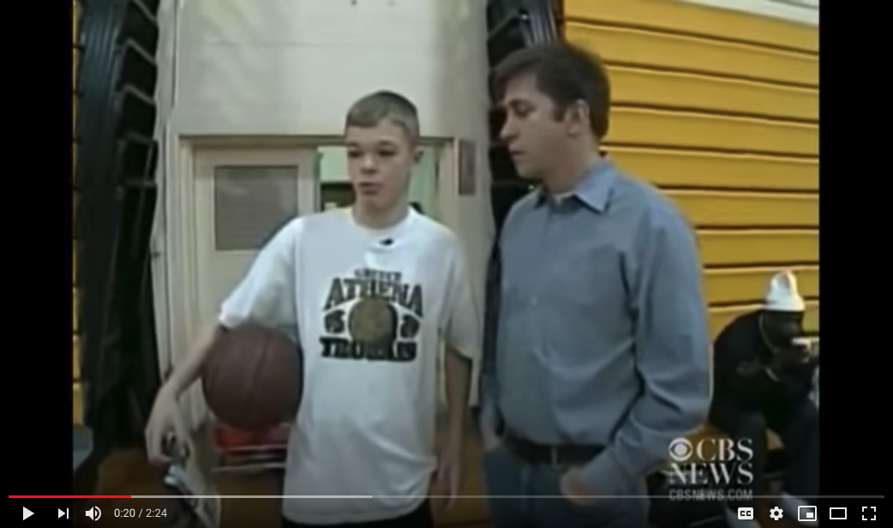
Video: Autistic Hoop Dreams
https://www.youtube.com/watch?v=t7ayocfGDzU

Slide 7
Video: Autistic Hoop Dreams
Questions:
How did the students react when Jason entered the game?
How do you think they felt about Jason?
What were some of Jason’s challenges?
How did he seem to handle his challenges? How would you describe his attitude?
How did his team support him?
Why do you think the students stormed the court and put him on their shoulders at the end?

Slide 8
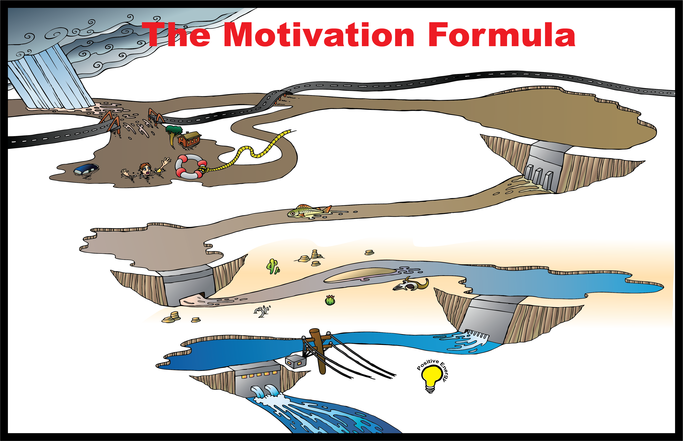
What are some positive ways we use water?

Slide 9


Slide 10
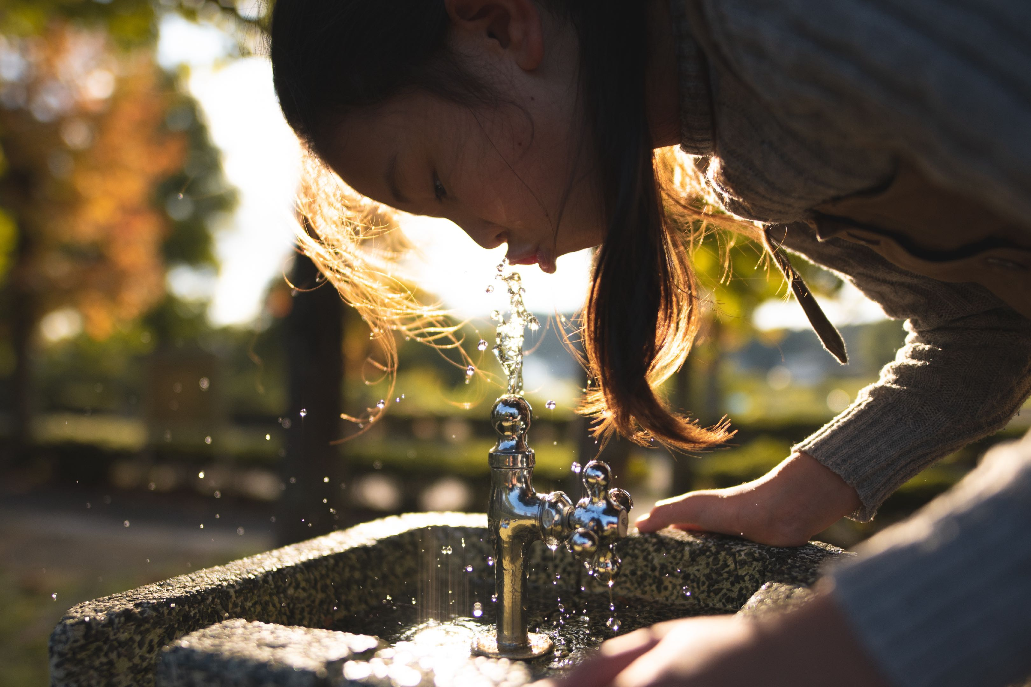

Slide 11


Slide 12


Slide 13
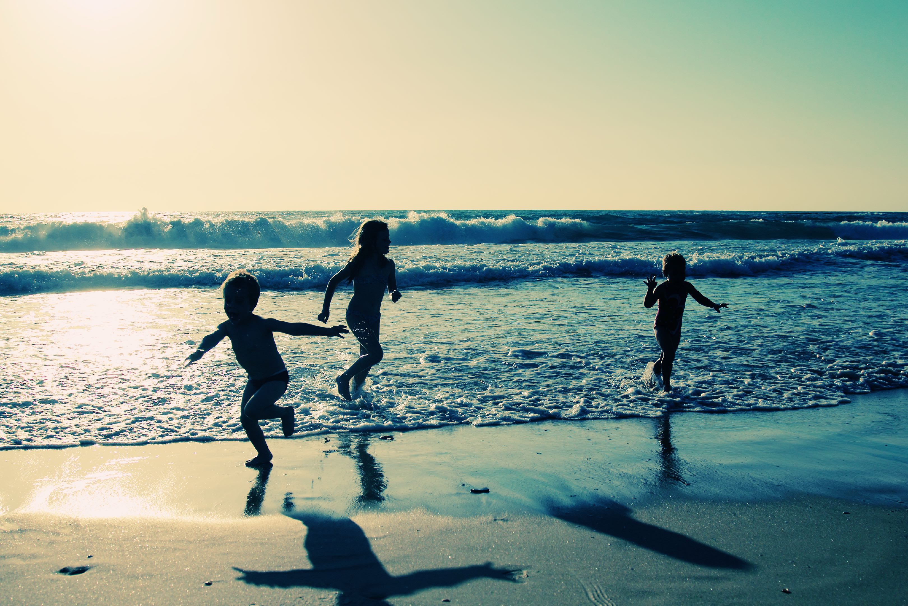

Slide 14


Slide 15


Slide 16


Slide 17
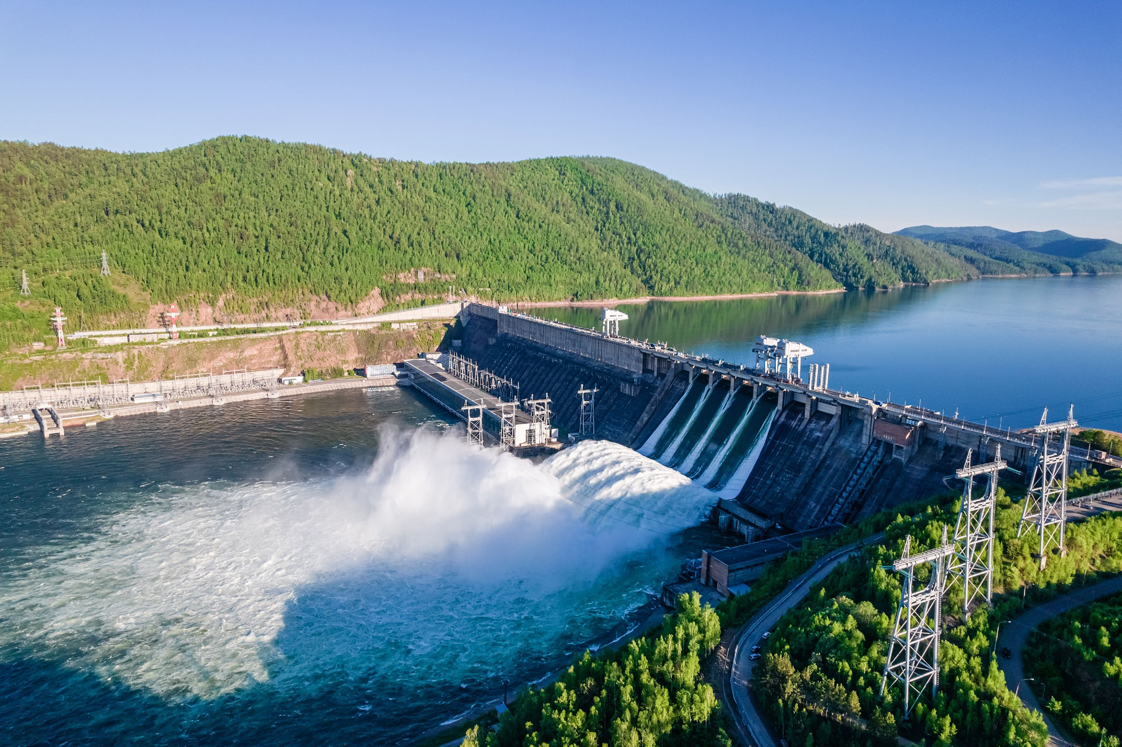

Slide 18
How can water cause a
negative impact on people?

Slide 19
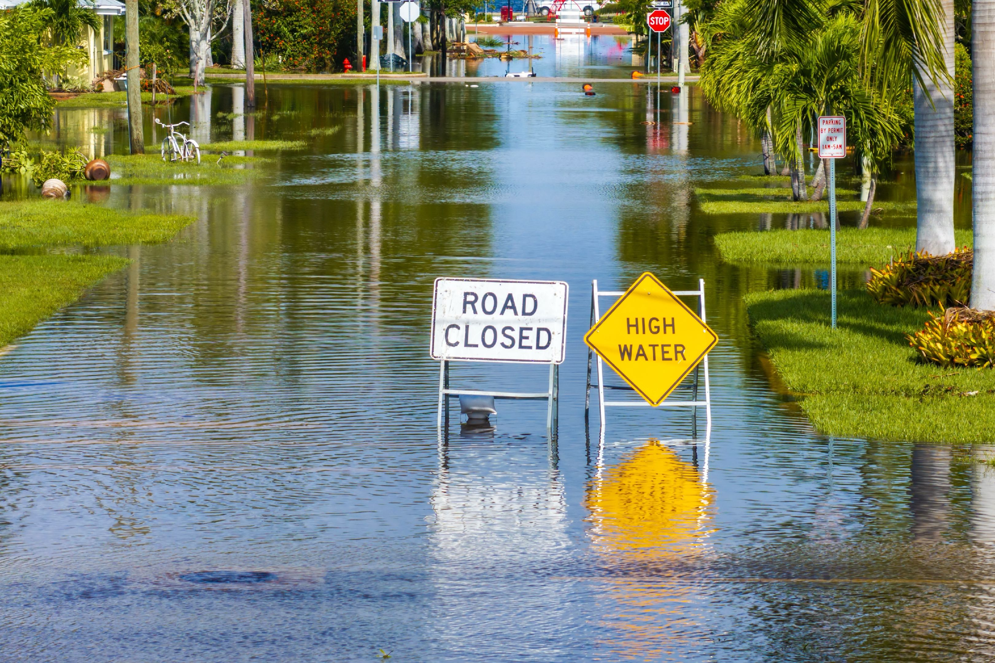

Slide 20
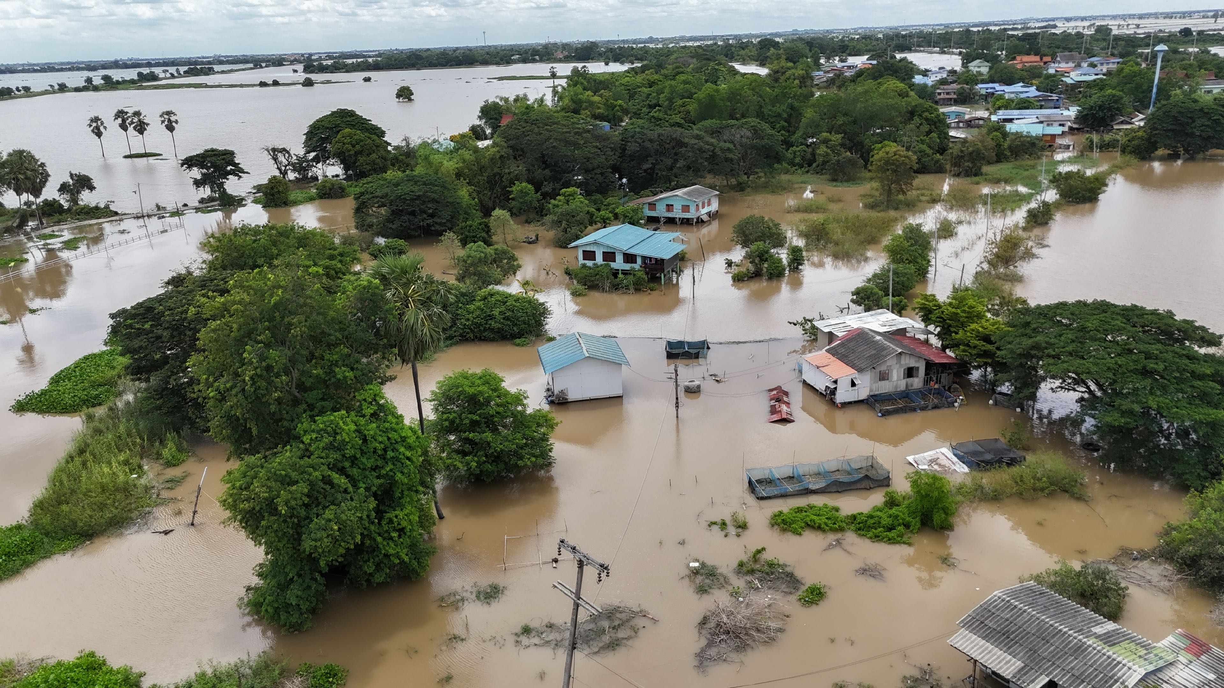

Slide 21
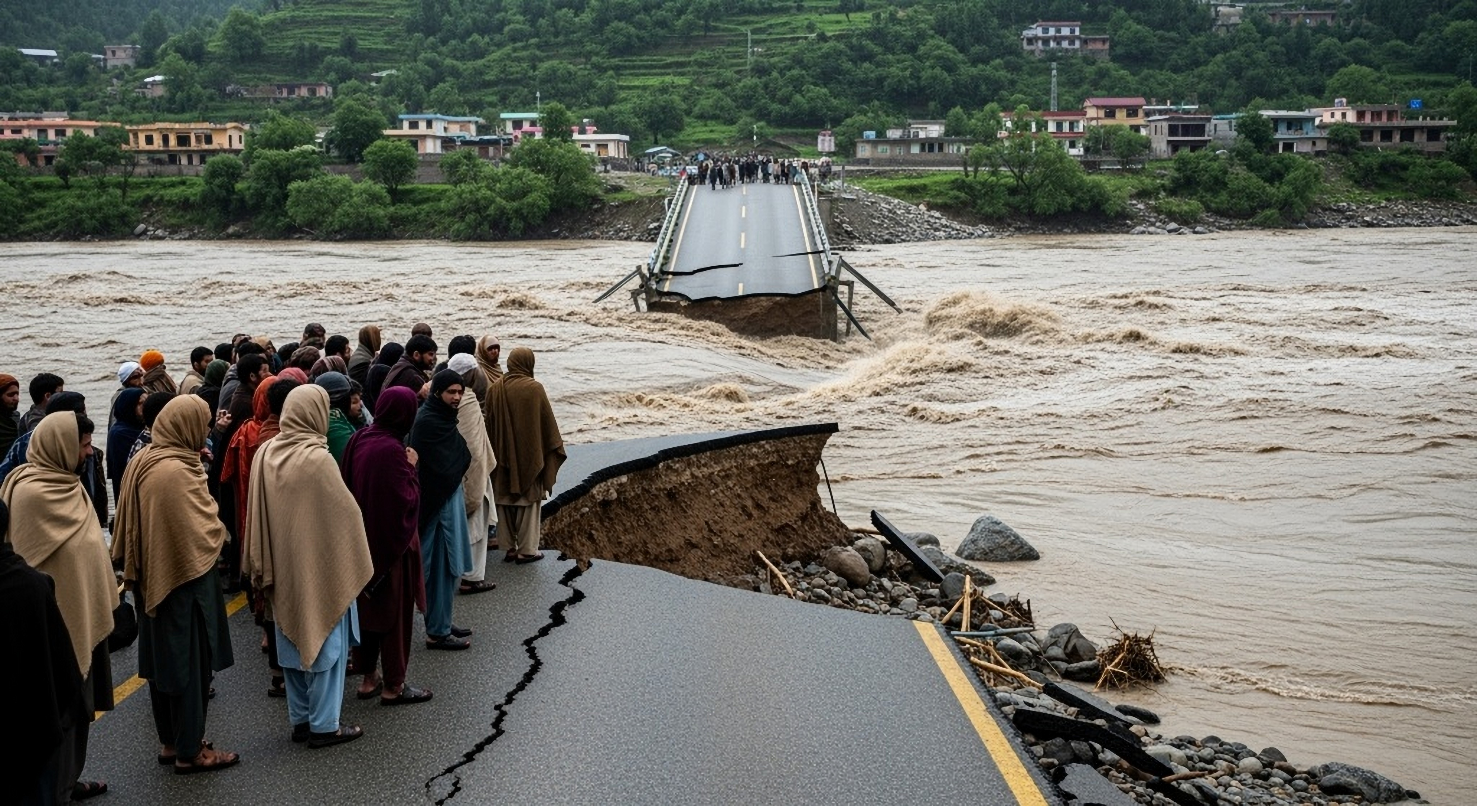

Slide 22
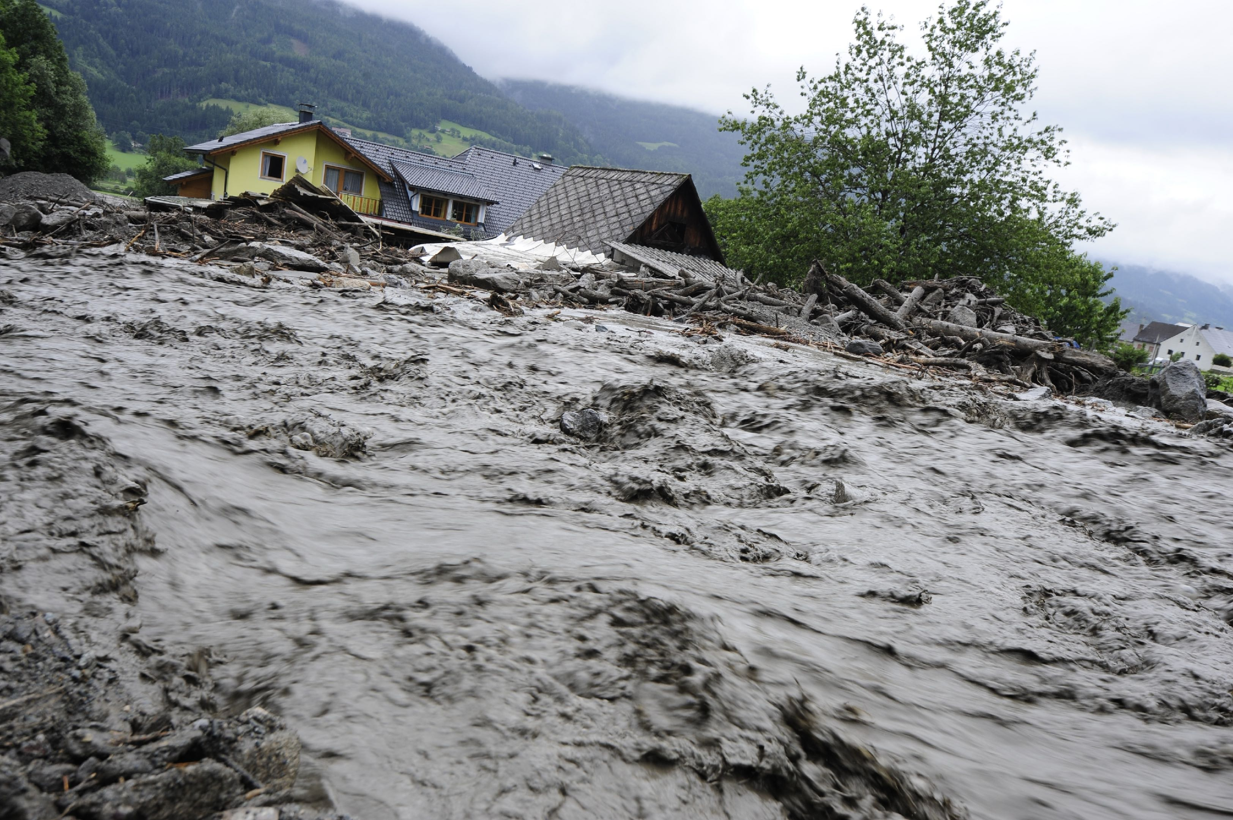

Slide 23
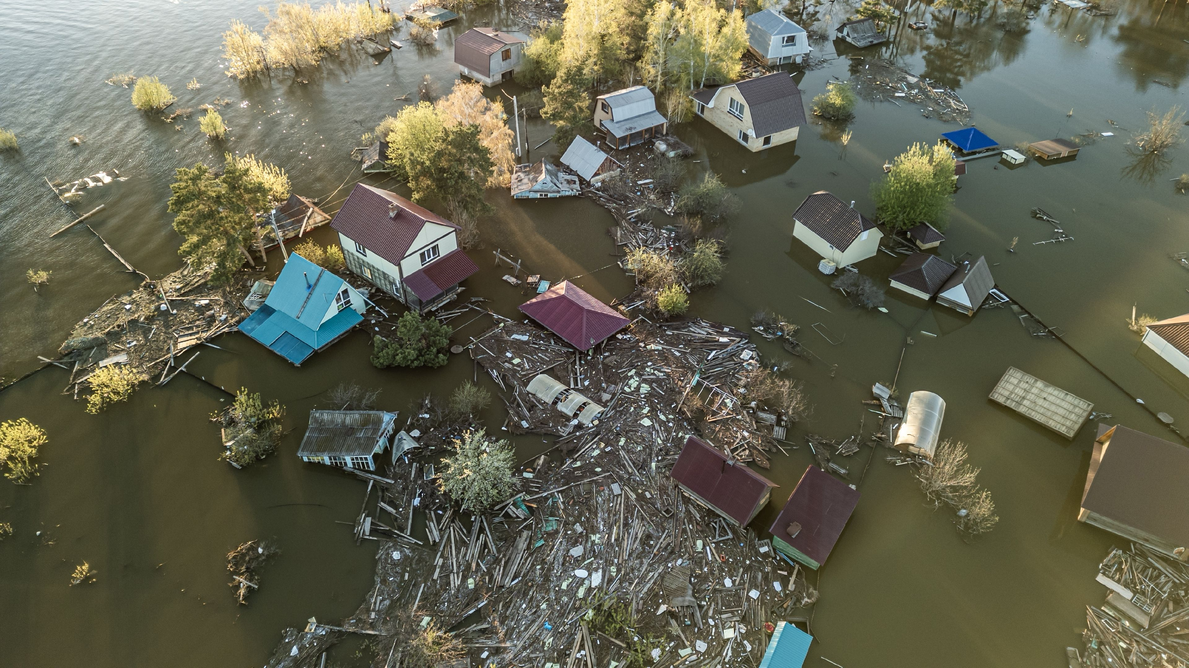

Slide 24
Challenges
Choice
Anger
Frustration
Fear
Energy
Negative
Positive
What are your lifelines?
Who can help you out of the flood zone at home?
at school?
with your peers (friends)?
Less Opportunity
and Freedom
“The Flood Zone”
Easy – path of least resistance
- No self-respect
- Energy dies
- Hurt self and hurt others

Slide 25


Slide 26
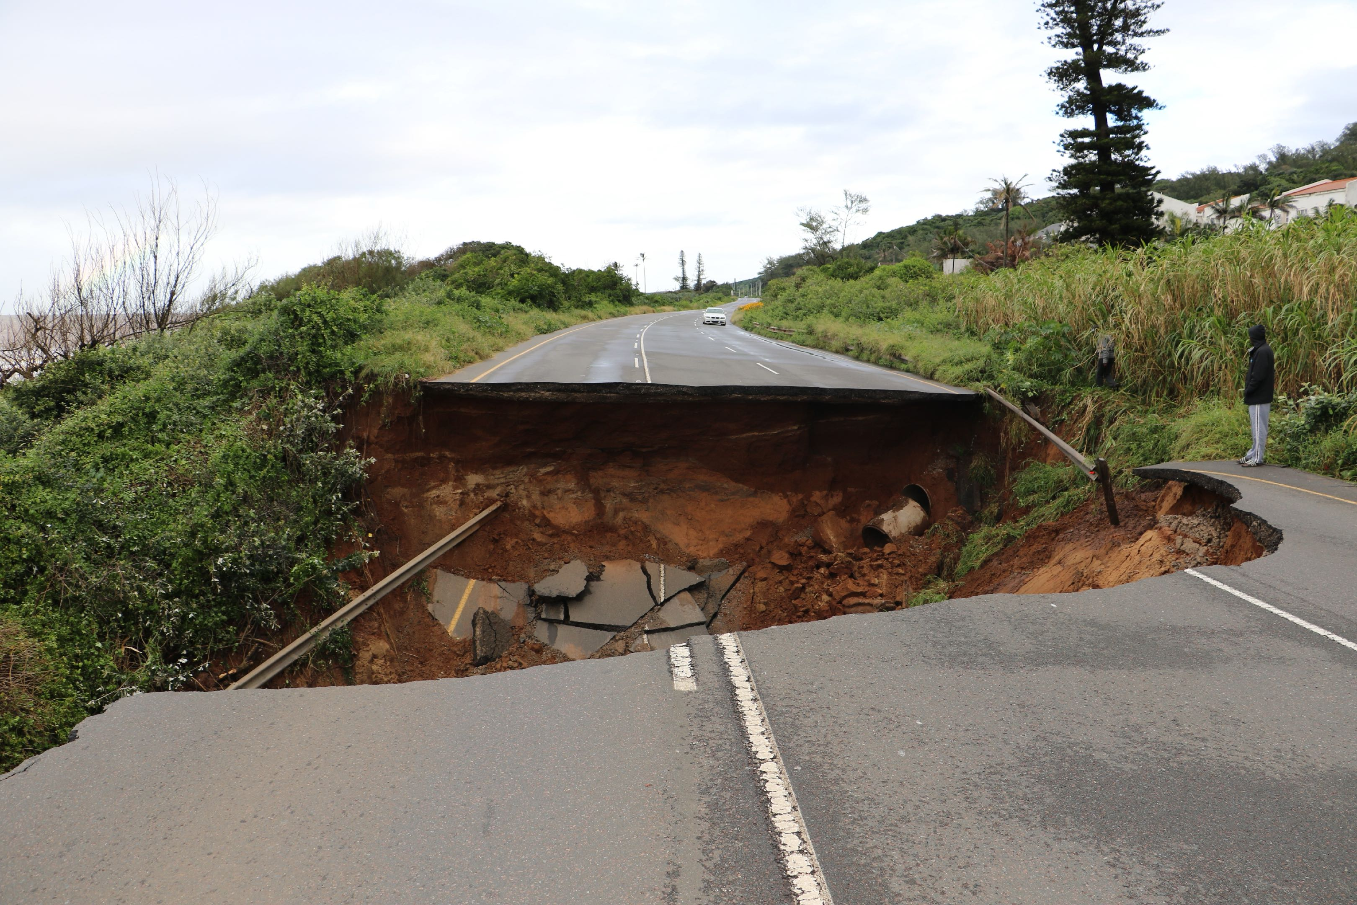

Slide 27
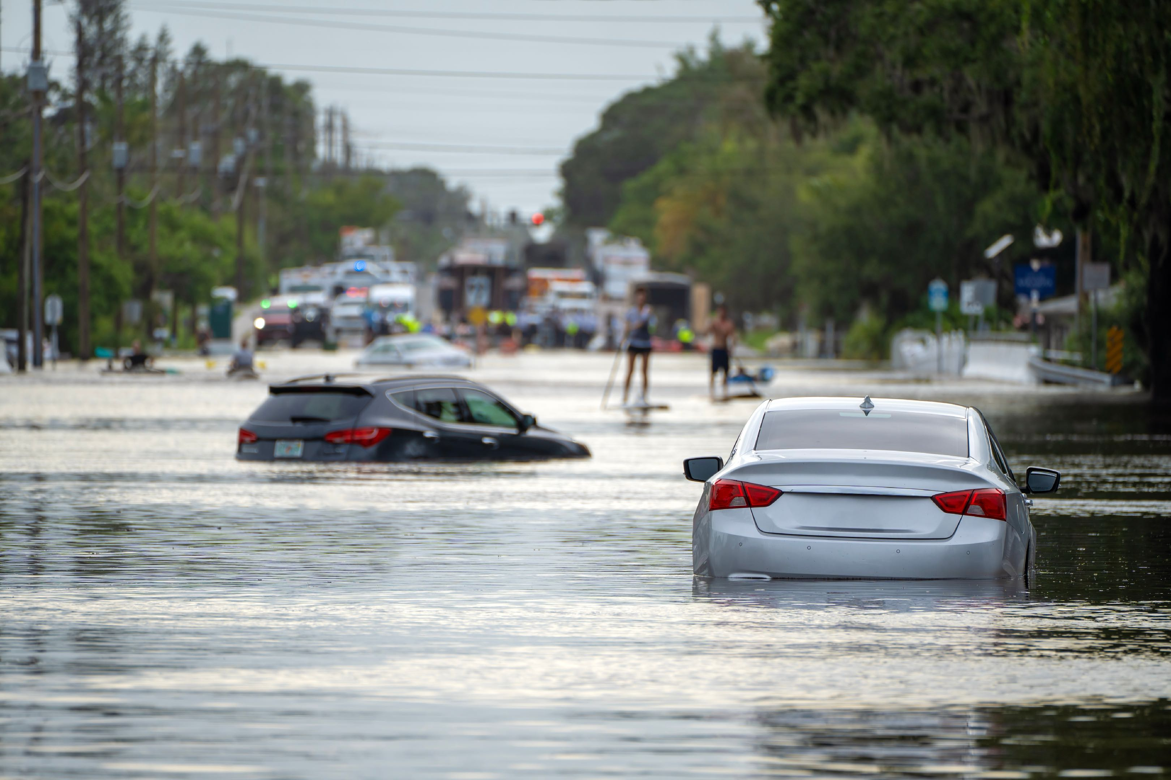

Slide 28
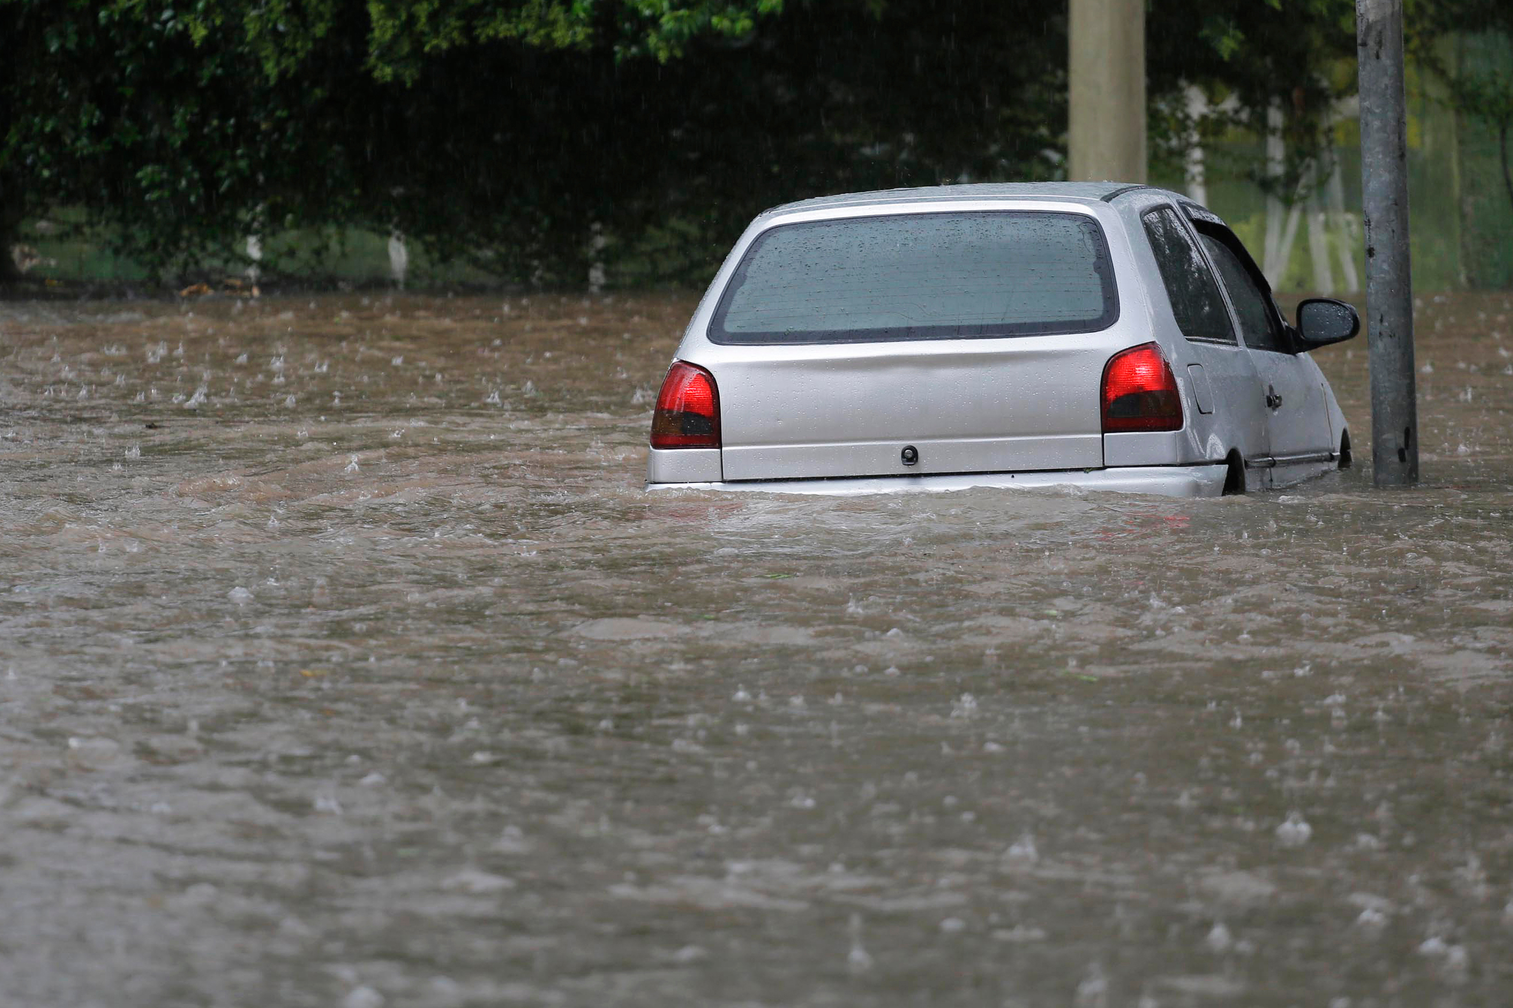

Slide 29
Challenges
Choice
Anger
Energy
Negative
Positive
What are your lifelines?
Who can help you out of the flood zone at home?
at school?
with your peers (friends)?
Less Opportunity
and Freedom
“The Flood Zone”
Easy – path of least resistance
- No self-respect
- Energy dies
- Hurt self and hurt others

Slide 30

I hate it when…
One thing that makes school stressful is…
It feels unfair when…

Slide 31
Silver Lining
“Every cloud has a silver lining”
What does that mean?

Slide 32
“Silver Lining”
I hate it when…
One thing that makes school stressful is…
It feels unfair when…
What positive outcomes could come from these experiences?

Slide 33
Silver Lining
Questions:
How difficult was it to finish the phrase, “I hate it when…” or “one thing that makes school stressful is” or “it feels unfair when”?
How difficult was it to think of positive scenarios?
When facing a challenge, how can looking for the silver lining be beneficial?

Slide 34

Observation Activity
Observe those around you (friends, classmates, family members) to see if you can identify someone that is in the “flood zone.”
Do you know someone that is in the flood zone?
What can you learn from them?
How does observing their situation motivate you?
Do you know anyone that used to be in the flood zone?
What can you learn from them?

Slide 35

Thanks for Coming
and
Have a Great Day!

